Slide 1
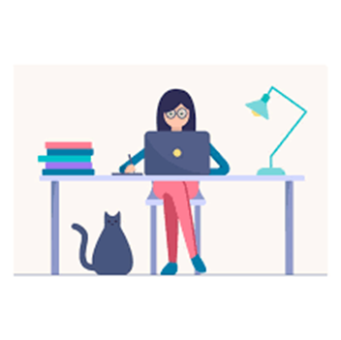

Securely Working From Home
Best Practices and Tips
Shirley F. Brown CIA, CISA, MBA, MMM
IT Audit Manager, Office of University Audit
Lori Havens, PCI ISA, PCIP
Senior IT Auditor, Office of University Audit
May 2020
Notes:
Hello from the Office of University Audit. First and foremost, we hope that you, your teams, and your families are safe and healthy. We are thankful for everyone’s effort to maintain business operations and internal control processes under these historic and unique circumstances. We are especially thankful for the frontline workers who have put themselves at risk and in the middle of the pandemic response.

Slide 2
Introduction / Purpose
During this session, we will be covering:
  Staying Productive
  Working Securely
** University Audit has gathered these Tips from external sources. Although we are not the author of any portions of this information, we thought you may find it useful.
Notes:
As many employees at the University of Rochester are now working remotely, we wanted to provide some helpful tips to help with not only staying productive while working remotely, but also working securely. We have gathered these tips from a few reputable, external sources.

Slide 3

Working From Home?
4 Tips for Staying Productive
Source
  Kim Mok, Gabriel Manga/March 2020/Organizational Culture
  from Google’s Primer team to help you make the most out of the situation.
Notes:
One of our sources comes from the Google Primer’s team. They provide 4 tips for staying productive while working from home.

Slide 4
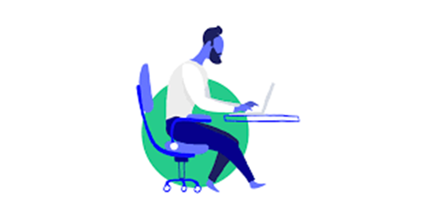
Staying Productive – Google’s Primer Team
Tip 1: Create “work” triggers for your brain
Establishing a designated workspace can help tell your brain you’re in the place where you do work productively.
You can create “start the day” triggers that get your head ready for work in a similar way, like exercising, reading the news, or making coffee.
About distractions: They’re one of the biggest challenges of working remotely.
Notes:
The first tip is to Create work triggers for your brain.
If you can sit down and be productive anywhere, that’s great. If you need more structure, establishing a designated workspace — whether it’s a separate room, a fully stocked desk, or just a clean part of your kitchen table — can help tell your brain you’re in the place where you do work productively and without distraction.
You can get in the habit of following a familiar routine to start your work day. There are several ways that can be done such as exercising, catching up on the news, or grabbing your first cup of coffee. When you have finished that familiar activity, and you then start your work day, this should help to get your head ready for your workday.
Distractions can be a considerable challenge when working from home. To keep your brain in the right mode, avoid doing non-work tasks during your work time. For example, schedule a separate time to do laundry instead of tackling it while you’re finishing a work presentation.

Slide 5
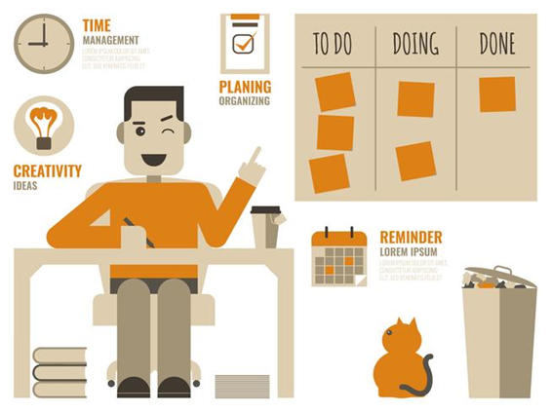
Staying Productive – Google’s Primer Team
Tip 2: Stay motivated with a list
A simple to-do list can do wonders for keeping you both organized, motivated, and productive as you work from home.
Write or type out your list instead of just having it in your head.
Notes:
Our second tip recommends staying motivated by using a list.
As you create your list, think about big, long-term goals, like finishing a project, as well as small goals, like completing tasks that lead to that big goal. Checking off those smaller goals lets you know you’re making progress, which gives you positive reinforcement throughout your day. And work feels much more doable when it’s not all one giant task.
By writing or typing out your list, you won’t have to devote headspace to constantly remembering what you have to do, and the pleasure of crossing tasks off your list can help you stay motivated.

Slide 6

Staying Productive – Google’s Primer Team
Tip 3: Make a schedule for everything
Remote work requires a schedule much like a typical office job, except you’re the only one holding yourself accountable.
When creating your schedule, take into account the other commitments in your life and find a routine that lets you take care of those as well.
Once you’ve set your schedule, make it visible to your coworkers with a shared calendar. This way, they’ll know when you’re free to meet and when you’ve blocked out work and personal times.
Notes:
The 3rd tip has us making a schedule for everything.
That doesn’t mean your entire day has to be work only (it’s actually important to take regular breaks to refresh yourself mentally, physically, and emotionally), just that any non-work activities also need to be scheduled.
If you have a child, build their care into your schedule. If you enjoy working out or volunteering, schedule time to get work done before or after these activities.
It’s also a good idea to make sure friends and family understand your schedule and respect it. Set boundaries and expectations by letting them know that working remotely doesn’t mean you’re free all the time

Slide 7
Staying Productive – Google’s Primer Team
Tip 4: Create a process for collaboration
Working from home might seem like a solo experience, but it usually still involves interacting with others, whether it’s meeting with your team, getting assignments, making decisions, or giving and receiving feedback. So it’s important to set up methods for collaboration while you work remotely.
Brainstorming or detailed discussions usually require an official meeting.
While email can be effective for making an official decision or passing on information, people’s inboxes can get clogged up quickly.
University Audit comment - Try using Skype - Wikipedia: a telecommunications application that specializes in providing video chat, and voice calls between computers, tablets, mobile devices, console, and smartwatches over the Internet; provides instant messaging services; users may transmit text, video, audio and images; allows video conference calls.
Notes:
Tip 4 involves creating a process for collaboration.
We have become much more dependent upon our technology – whether that be by phone or using our computer – to stay in touch with those that we need to communicate with. We often do not have the luxury if simplying going to someone’s office to meet with them or to ask a question or provide information.
You can decide whether communicating through email or a video conference would work best depending upon the situation.
Talking face to face can often help collaboration, so using video conferencing can be convenient. consider videoconferencing for moments. Videoconferencing can also help everyone keep up a rapport that might otherwise go neglected from not sharing a workplace.

Slide 8
Top 32 Working from Home Tips
Source: Nextiva
Notes:
The displayed table represents several quick and helpful tips to help keep you work from home remain focused and productive.

Slide 9

TOP 5 STEPS to Securely Working From Home
Source - SANS SECURITY AWARENESS - FACTSHEET
The SANS Institute was established in 1989 as a cooperative research and education organization. Its programs now reach more than 165,000 security professionals around the world. A range of individuals from auditors and network administrators, to chief information security officers are sharing the lessons they learn and are jointly finding solutions to the challenges they face. At the heart of SANS are the many security practitioners in varied global organizations from corporations to universities working together to help the entire information security community.
Notes:
We are now going to shift from staying productive while working at home to completing your work in a secure manner. The following tips are provided by the SANS organization, which is a cooperative research and education organization comprised of security professions from around the world.

Slide 10

Securely Working From Home – SANS Security Awareness
First and foremost, technology alone cannot fully protect you – you are the best defense.
The most common indicators of a social engineering attack include:
  Urgency: Someone creating a tremendous sense of urgency, often through fear, intimidation, a crisis or an important deadline.
  Policies: Pressure to bypass or ignore security policies or procedures, or an offer too good to be true (no, you did not win the lottery!)
  Contacts: A message from a friend or co-worker in which the signature, tone of voice or wording does not sound like them.
Ultimately the best defense against these attacks is you.
Notes:
Attackers have learned that the easiest way to get what they want is to target you, rather than your computer or other devices. If they want your password, work data, or control of your computer, they’ll attempt to trick you into giving it to them, often by creating a sense of urgency.
For example, they can call you pretending to be Microsoft technical support and claim that your computer is infected.
Or perhaps they send you an email warning that a package could not be delivered, fooling you into clicking on a malicious link.
Urgency - Cyber attackers are good at creating convincing messages that appear to come from trusted organizations, such as banks, government or international organizations.

Slide 11
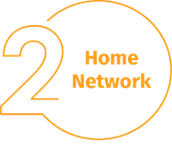
Securely Working From Home – SANS Security Awareness
Home Network: Almost every home network starts with a wireless (often called Wi-Fi) network. This means securing your wireless network is a key part of protecting your home.
We recommend the following steps to secure it:
    Change the default administrator password
    Allow only people that you trust
    Make passwords strong
  Not sure how to do these steps? Ask your Internet Service Provider, check their website, check the documentation that came with your wireless access point, or refer to the vendor’s website.
Notes:
This is what enables all of your devices to connect to the Internet. Most home wireless networks are controlled by your Internet router or a separate, dedicated wireless access point. Both work in the same way: by broadcasting wireless signals to which home devices connect.
Change the default administrator password: The administrator account is what allows you to configure the settings for your wireless network. An attacker can easily discover the default password that the manufacturer has provided.
Allow only people that you trust: Do this by enabling strong security so that only people you trust can connect to your wireless network. Strong security will require a password for anyone to connect to your wireless network. It will encrypt their activity once they are connected.
Make passwords strong: The passwords people use to connect to your wireless network must be strong and different from the administrator password. Remember, you only need to enter the password once for each of your devices, as they store and remember the password.

Slide 12
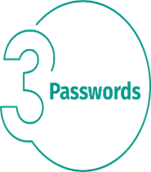
Securely Working From Home – SANS Security Awareness
When a site asks you to create a password: create a strong password, the more characters it has, the stronger it is.
  Using a passphrase is one of the simplest ways to ensure that you have a strong password. A passphrase is nothing more than a password made up of multiple words, such as “bee honey bourbon.”
  Using a unique passphrase means using a different one for each device or online account. This way if one passphrase is compromised, all of your other accounts and devices are still safe. Can’t remember all those passphrases?
Use a password manager, which is a specialized program that securely stores all your passphrases in an encrypted format (and has lots of other great features, too!).
https://tech.rochester.edu/services/lastpass-enterprise-faculty-staff/
  Finally, enable two-step verification (also called two-factor or multi-factor authentication) whenever possible.
  https://tech.rochester.edu/services/two-factor-authentication/
  https://www.urmc.rochester.edu/remote-access/two-factor-authentication.asp
Notes:
Two-step --- It uses your password, but also adds a second step, such as a code sent to your smartphone or an app that generates the code for you. Two-step verification is probably the most important step you can take to protect your online accounts and it’s much easier than you may think.

Slide 13
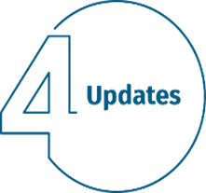
Securely Working From Home – SANS Security Awareness
Make sure each of your computers, mobile devices, programs and apps are running the latest version of its software.
  Cyber attackers are constantly looking for new vulnerabilities in the software your devices use.
  Shutdown or restart your computer periodically to insure that any updates that have been applied to your computer will become active.
Notes:
When they discover vulnerabilities, they use special programs to exploit them and hack into the devices you are using.
Meanwhile, the companies that created the software for these devices are hard at work fixing them by releasing updates.
By ensuring your computers and mobile devices install these updates promptly, you make it much harder for someone to hack you.
To stay current, simply enable automatic updating whenever possible. This rule applies to almost any technology connected to a network, including Internet-connected TV’s, baby monitors, security cameras, home routers, gaming consoles or even your car.
For University managed computer, updates are often applied by your IT support areas. Getting into the habit of periodically restarting your computer will help to insure that any updates that have been applied to your computer will become active.

Slide 14

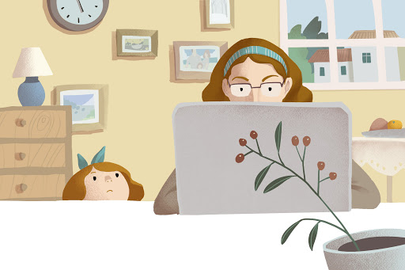
Securely Working From Home – SANS Security Awareness
Kids / Guests: Something you most likely don’t have to worry about at the office is children, guests or other family members using your work laptop or other work devices.
Make sure family and friends understand they cannot use your work devices, as they can accidentally erase or modify information, or, perhaps even worse, accidentally infect the device
Notes:
When they discover vulnerabilities, they use special programs to exploit them and hack into the devices you are using. Meanwhile, the companies that created the software for these devices are hard at work fixing them by releasing updates. By ensuring your computers and mobile devices install these updates promptly, you make it much harder for someone to hack you. To stay current, simply enable automatic updating whenever possible. This rule applies to almost any technology connected to a network, including not only your work devices but Internet-connected TV’s, baby monitors, security cameras, home routers, gaming consoles or even your car.

Slide 15
Reminder
Additional Resource
University Security Awareness Program

Slide 16
https://tech.rochester.edu/security/
Top 10 Security Tips – watch top 10 Tips –
Video, Downloads, Poster
Install antivirus software
Create strong passwords
Secure your mobile devices
Keep your devices updated
Lock or log off unattended devices
Download files legally
Beware of phishing scams
Limit your public presence online
Be careful what you store online
Regularly check your online accounts

Slide 17
Contact Information
University Audit: x52291
https://www.rochester.edu/adminfinance/audit/
Public Safety: x53333
http://www.publicsafety.rochester.edu/
URMC Compliance Office: x51609
https://www.urmc.rochester.edu/compliance-office.aspx
Integrity Hotline: 756-8888
Notes:
In conclusion, we wanted to provide you with some important contact information for areas such as University Audit, Public Safety, the URMC Compliance Office, and the Integrity Hotline.
We hope that you found this information helpful, and that you continue to remain healthy, focused, and productive during these times when working from home are a necessity.

