Slide 1
Buzz Lab
Bob Tobin
University of Rochester
Ain Center for Entrepreneurship
February 9, 2019

Slide 2
Why Start a Business?

Slide 3
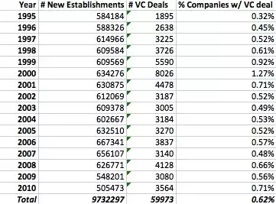
“Raising money has become a disease. Entrepreneurs are wasting lots of brainpower scheming to raise money” Michael Lutz, CEO, Gammalink.
1 in 100 starts-up are funded by venture capital funds.

Slide 4
Entrepreneurship is a management style focused on the pursuit of opportunity without regard to resources currently controlled
Entrepreneurs need to focus on how to legally and ethically use just about any resource on the planet

Slide 5
Guidelines for Success
How to Work Hard in the Right Direction
Seven Components
Find & fill an important unmet customer need
Plan for Profitability
Strive for sustainability
Establish Credibility
Gather necessary resources
Lead & manage effectively
Maintain balance and learn to enjoy the ride

Slide 6
Gather Resources
Resources required
Time
Entrepreneurs invest their time
People
Getting people to work for a better future instead of more traditional compensation
Money
Wise entrepreneurs scrounge for inexpensive resources in order to avoid the need to raise capital = Bootstrapping

Slide 7
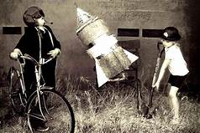
Bootstrapping
Some entrepreneurs start businesses that are self-funded by profits from the business itself. In other words, the business actually generates sufficient cash to fund its own growth
The optimal financing strategy
Manage for cash flow not profitability
Keep expenses smart & low, test ideas first and get that cash.

Slide 8
Bootstrapping
Bootstrapping methods:
Start at home or share an office
Start out part-time
Start as a service business
Hire an affordable team
Barter for services and products using “sweat equity”
Speed up customer payments
Negotiate supplier payments

Slide 9
Bootstrapping
Bootstrapping is easier than any time in history:
Infrastructure is cheap because of cloud based services
Employees can work virtually
Freelancers
Social media
Outsourcing options

Slide 10
“Never buy new what can be bought second-hand. Never buy what you can lease. Never lease what you can rent. Never rent what you can borrow. Never borrow what you can salvage.”
Ian MacMillian

Slide 12
Family & Friends
Other than personal savings or credit this is the second largest source of start-up funding.
Two forms:
Loans (debt)
Ownership (equity)
Make sure the relationship/investment is formalized
Remember you will be sitting around the dinner table with these friends or family for a long time. This form of financing is fraught with risk and the potential grievous relationship consequences.

Slide 14
Crowdfunding
Two Primary approaches to Crowdfunding
Reward-based crowdfunding
Most frequently lists products, services, projects or simply a business idea, allowing the crowd to pledge an amount of money for a reward. Structured to reward the largest backers to receive the highest value or most unique reward.
Equity Crowdfunding
Investments that include an ownership stake and expect a return.
Equity Crowdfunding Platforms:
WeFunder
Start Engine
MicroVentures
Seed Invest

Slide 15
Peer to Peer Lending

Slide 16
Peer to Peer Lending
P2P lending marketplace works through a simple on-line platform. It connects borrowers to lenders eliminating traditional banks.
Projected to be a 150 billion market by 2025
Popular P2P Platforms:
Funding Circle
Prosper
Street Shares (focus on Veterans)
Lending Club

Slide 17
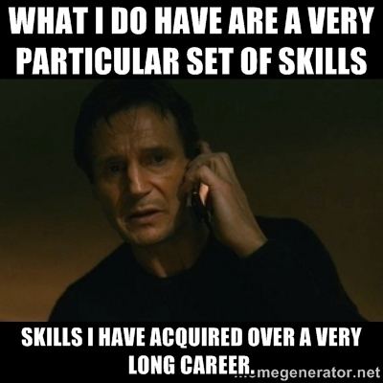

Slide 18
Building a Team
In the beginning the entrepreneur has time:
Manage your time effectively
Achieve and hold your self accountable
Keep a schedule
Use checklists

Slide 19
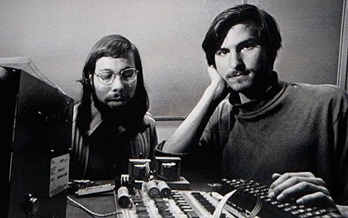

Slide 20
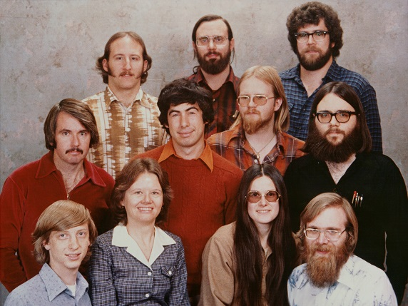

Slide 21
Building a Team
Next the entrepreneur needs people:
It is not impossible to find good people, but it’s very hard to find the right people.
Great teams have to have complementary skills. In almost all successful ventures, they truly know and understand each other, on a personal level.
You want people you can trust
You want co-founders who refuse to fail

Slide 22
Building a Team
Beyond the Founders
Focus on these five functions
Product development
Sales
Production & delivery
Marketing
Internal operations

Slide 23
Building a Team
Evaluating Candidates
There essential questions
Can they do the job?
Background and experience
Will they do the job?
Excited to work with you, work ethic, honesty and attitude
Will they fit the culture of the organization?
Hardest to evaluate

Slide 24
Building a Team
Methods for Generating a Pool of Candidates
Word of mouth & personal relationships
Personal relationships are likely the best way to find great people
Referrals from Other Employees
Leverage your partner’s and employees’ relationships
You want to recruit someone who knows the industry and who is also known in the industry.
Go Where They Are
If you want to recruit a technical person, go where tech people hang out.
Networking in Real Time
Use tools like LinkedIn
Run Advertisements
Monster.com, CareerBuilder, Indeed, ZipRecruiter

Slide 25
Management
Keys
Lead
Vision
Transparency
Share the wealth
Flexibility
We are not a family
Not employees 7/24
Hire slow – fire fast
Treat everyone as a sub-contractor

Slide 26
Getting to Yes
“Everyone lives by selling something”
Robert Louis Stevenson
“Salesmanship is limitless. Our very living is selling. We are all salespeople.”
J.C. Penney
“Nothing happens until somebody sells something”
Thomas Watson, Founder of IBM

Slide 27
Quick Tips
Live the culture
Have a plan but be open to change (LivePlan)
Learn & Use Accounting Software (i.e.. QuickBooks)
Aggressively pursue Accounts Receivable (A/R)
Know your customers (trust but verify)
Cobble together an employee benefit plan
Establish a banking relationship
Network
Luck

Slide 28
Sources
The Art of the Start 2.0, Guy Kawasaki
1
Bootstrap Finance: The Art of Start-Ups, Amar Bhide, HBR
2
Entrepreneur’s Toolkit, HBR
3

Slide 29
Sources
Breakthrough Entrepreneurship, Jon Burgstone & Bill Murphy, Jr.

