Slide 1






Notes:
first speaker, Alexa Rosenbloom
After remarks -
Draw three raffle tickets
Welcome Dr. Blackshear to the stage

Slide 2

Congratulations, Class of 2026!
John H. Blackshear, Ph.D
Vice President for University Student Life
Notes:
John to share congratulatory remarks
Transition to announcing Asbury awards on next slide

Slide 3

Dean Josephine C. Asbury Award for Commitment to Community
Earl Bumagat
Nichole Waligora
Jacob Greenberg
Ilana Weiss
Nyaradzo Mararanje
Notes:
Dean Asbury was a beloved Dean of Students who served the University for many years. These awards were established to honor her commitment to creating an inclusive and open campus community. The award is given each year to those students who, throughout their years at the University, have embodied these principals and values. Through their leadership – regardless of what form it takes – and especially through consistent example, winners of this award have demonstrated not only an understanding of the importance of community but also a deep and abiding understanding of what kind of community we can become. These senior awards are given to exceptional students by the Office of the Dean of Students, and they are awarded in appreciation for the entirety of your time and commitment to the University of Rochester and the values we cherish.
Call them up individually
Let’s celebrate the award winners for the Class of 2026! Could you please come to the stage when your name is called:
Earl Lawrence Bumagat (er-l lo-reh-ns boo-mah-gah-t )
Jacob Greenberg (jay-kuhb green-burg)
Nyaradzo Mararanje (Nh-ya-rha-dzho Vha-le-ri Ma-rha-rha-jay)
Nichole Waligora (nee-kohl vah-lee-goh-rah)
Ilana Weiss (ih-LAH-nuh W-ice)
Fresh off from winning the Liberty League Championship, Ilana is unable to join us today due to playing in the first round of the NCAA Division III Softball Championship tournament tomorrow in Angola, Indiana
John to draw three raffle tickets
Intro Anne-Marie Algier who will lead into medallion recognition

Slide 4





Spring 2026 Level Completions
Level 1
Level 3
Atreyee Ghosh
Christina Emi Falasco
Jannatul Sabah
Nicole Wang
Olaniyi Harty
Paige Lovelace
Rajneet Saini
Ruth Ajiboye
Afroza Zabed
Alin Sung
Ari Lim
Atreyee Ghosh
Christina Emi Falasco
Christopher Ayavaca
Daisy Munoz Castro
Erman Ural
Hanadi Tajir
Hanna Wang
Hannah Wang
Jannatul Sabah
Joseph Jang
Kai Hua Liu
Kathryn Lambright
Kathy Mitchell
Katy Gao
Nicole Wang
Nima Mohamud
Martin Oka
Paige Lovelace
Princess Aniagboso
Rajneet Saini
Ruth Ajiboye
Shailey Guddeti
Sierra Jefferson
Will Murray
Notes:
Anne-Marie Algier
The Medallion program is our multi level leadership program that helps students gain skills and develop their leadership capacity.
There are some members of our senior class that were able to complete a Level or are now members of the Society since our last Level Up event. Please stop at the table in the lobby to pick up your pins or Medallion on the way out.
ask those who are here to stand and be recognized.
Introduce Frank Tallarico, general manager & Bill McCarthy, store manager from the Barnes & Noble bookstore to review regalia
Regalia models: Elijah Bader-Gregory, Jake Adelmann, Savannah Baker

Slide 5


Regalia 101
Bachelors
Master’s
Doctoral
Notes:
Frank Tallarico & Bill McCarthy
Academic regalia dates back to the 12th and 13th centuries where monks wore long gowns during their education in order to help stay warm
Standardized in the US in the late 19th century and and slightly revised three times in the 20th century
Three models to assist - come on up (Elijah Bader-Gregory, Jake Adelmann, Savannah Baker)
Bachelors - basic black gown to be worn closed - mortarboard and tassel - hood colors indicate different disciplines (engineering - orange; arts - white; Eastman - pink) while the yellow and blue represents UR - hood doesn't show much color and how it should be worn
Masters - black gown, but the differences are in the sleeves (yes, that is how they should look) and the hood is longer
Doctoral - blue gown with the yellow stripes and dandelion patch with now a velvet tam
How to get the wrinkles out - Do not iron as made of recycled bottles, but get it out of the bag now and hang it in the bathroom (humidity will help)
Round of applause for models
Draw three raffle tickets
Welcome back Anne-Marie Algier

Slide 6
Commencement Reminders
When and where do graduates line up?
Arrive by 8:00 a.m. on Wilson Quad. There is only ONE security check point to enter the Quad. During the Processional, remain in 4 distinct, single file lines, and walk quickly. Do not pause for photos. There will be a program on your seat and a bottle of water under your chair. Remain standing once you are at your seat.
What do graduates wear?
Full regalia; Think about footwear as you will be walking on grass and standing for awhile.
Where do I go for more information on commencement?
www.rochester.edu/commencement
When do graduates celebrate during the ceremony?
After you are instructed to move your tassel from the right to the left.
Is there a recessional?
No recessional; Pre-determine a meeting place with your family & friends.
Notes:
Anne-Marie Algier
Instructions for graduates
You all received an email with instructions so this should just be some quick reminders
- Arrive by 8am to Wilson Quad
- Walking to location is best - lots of traffic/limited parking and Wilson Blvd will be closed
- One security checkpoint at the end of the quad near the tent
- No storage at lineup so do not bring personal items with you
- What to wear - don't wear anything over your robe like purses or jackets - you may wear graduation stoles and cords
- Once you arrive at your seat, there will be a program on your chair and a bottle of water under your chair
- Once you arrive at your seat, please remain standing until after the Invocation.
- When to celebrate - After the President instructs you to move your tassel . There will be a musical interlude - Stand and cheer, check your seat for a beach ball
- No recessional - designate a meeting place
- Food truck celebration
- Add notes about weather plan – still go , poncho for light rain

Slide 7
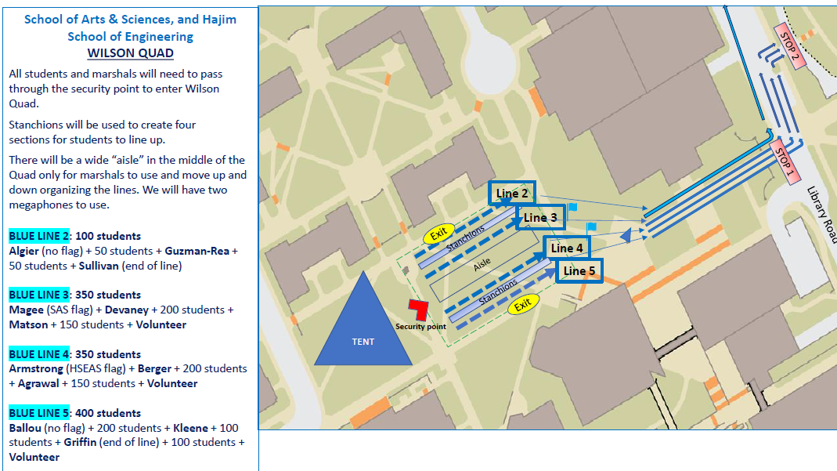
Notes:
You can see the red arrow where the security check point will be - please enter there.
It doesn’t matter what line you get in. You can line up with your friends. This is the line up area for both SAS and Hajim.
Once the processional begins, please stay in 4 distinct lines. Continue to walk quickly.

Slide 8
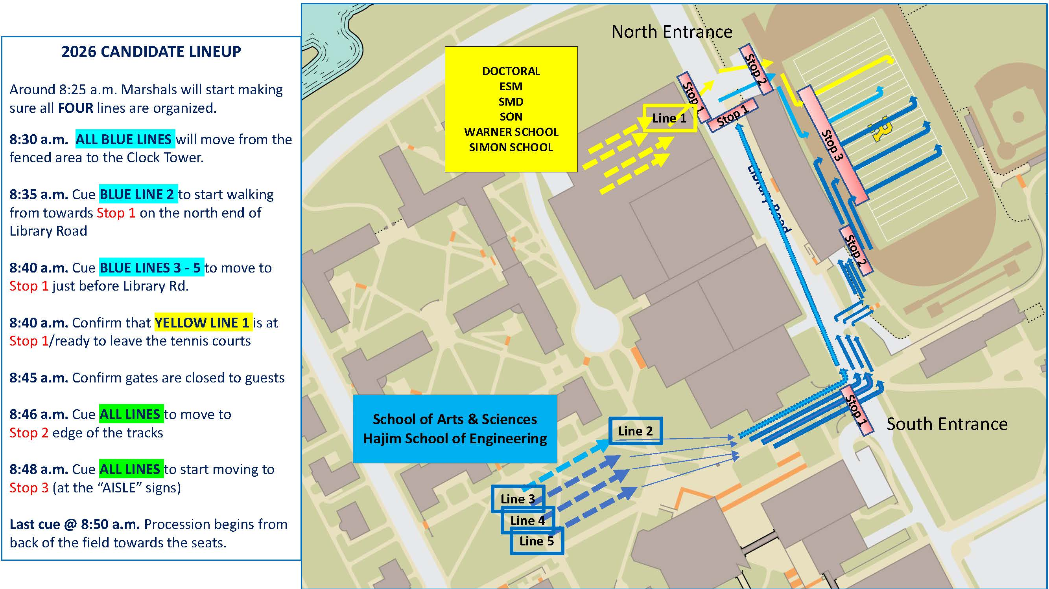
Notes:
Continue to stay in your line, following your marshal, pay attention to stops, and walk quickly.

Slide 9
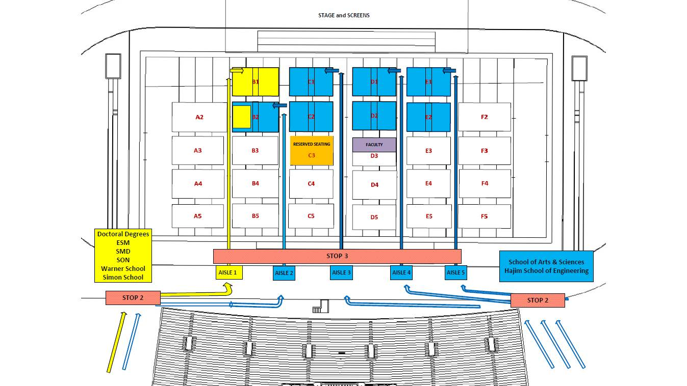
2026 Graduate Procession & Seating
Notes:
If you are in Line 2, you can see that you will walk by your parents if they sit in sections B3, B4, B5, or C4, C5.
Then you can see the seating areas if you are in Lines 3-5 – gives your families an idea of where you will be

Slide 10
Are your guests registered?
Here’s how to check:
Are they listed at the bottom of their confirmation email? It was sent immediately after completing registration.
Ask guests if they received a confirmation email with a QR code, sent to guests immediately after the student completed registration. Guests are encouraged to add their codes to their Apple or Google wallets by clicking the buttons beneath the QR code within the confirmation email.
Go to the Registration Page, click “Already Registered”
  “Click here” link, enter the email address and confirmation number, and click “Log In”.
  Any registered guests will show up at the bottom of the confirmation page.
If you need to add additional guests, click “Modify Registration” and advance
through the Registration pages until the page with the large blue button
at the top for “Guest Registration”.

Slide 11
Commencement Tips for Guests
What time does the processional begin?
8:45 a.m. with Fauver Stadium seating opening at 7:30am; Allow time for parking, walking, and
passing through the security check point.
What is needed to enter the Stadium?
Each guest needs a QR code. This works well using a phone, printed copies are also accepted.
What should guests expect when entering?
All bags may be checked - minimal items should be brought to expedite the process.
Can guests bring outside food or drink?
Outside food or drink is OK for guests but may be subject to screening.
Notes:
- Stadium seating opens at 7:30am - allow time for parking and walking - shuttles available from all parking lots and are ADA accessible
- All guests will also need to go through a security checkpoint - list of prohibited items online, but the less bags and items that are brought with guests, the faster the process will be
Free water in stadium for guests and coffee trucks with items available for purchase
Prohibited items on next slide
-All registrants, including their guests, will receive text alerts if there are changes impacting Friday’s ceremony.

Slide 12
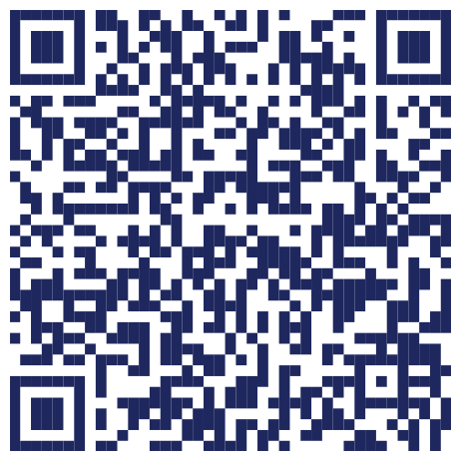
PROHIBITED ITEMS
Bags are subject to search.
NOISEMAKERS
SIGNS
LARGE GOLF UMBRELLAS
For a full list of
prohibited items, scan:
GLASS
WEAPONS
PETS
BOTTLES
Notes:
list of prohibited items online, but the less bags and items that are brought with guests, the faster the process will be
Thank the senior class council - They have planned an amazing senior week which is one of our Rochester Traditions in partnership with Student Activities and Alumni Relations. I am impressed by their programming and so many students coming out to create community for the class of 2026.
Introduction of Matthew Tierney ’25, ’26N:
Please join me in welcoming back one of our own, Matthew Tierney – a proud University of Rochester alumnus.
Matthew graduated in 2025 with not one, but two Bachelor of Science degrees – In Accounting and Biomedical Engineering with a concentration in Neurological Control Systems – and has just completed his Bachelor of Science in Nursing here at URochester. An Eagle Scout and Certified EMT, Matthew has always brought dedication and purpose to everything he pursues.
During his time at URochester, he was deeply involved in campus life as a member of Sigma Phi Epsilon, Club Soccer, and Class Council, serving as both Senior Giving Chair and Programming Chair.
Never one to slow down, Matthew balanced all of this while working in the Emergency Departments at Strong West and Highland Hospital, contributing to our community well beyond the classroom. He also brought his entrepreneurial spirit to DeJoy & Co. Accounting and as co-owner of an HVAC business.
Matthew’s connection to Rochester didn’t end at graduation. He has remained a proud and active member of our alumni community as a member of the Rochester Young Alumni Council and a familiar face at alumni events.
Looking ahead, Matthew will be joining the Med/Surg Flex team as a nurse at Strong Memorial Hospital, continuing his work as a Tax Accountant at DeJoy & Co., and growing his HVAC business.
Please give a warm welcome to Matthew!

Slide 13
Welcome to the
Alumni Family!
Matthew Tierney ‘25
Notes:
After remarks, draw three raffle tickets
Anne-Marie to close with Genesee

Slide 14
The Genesee
As flows the river gathering force,
Along her steadfast way,
May we along life's devious course
Grow stronger day by day.
And may our hearts, where'er we roam,
Forever loyal be
To our beloved college home
Beside the Genesee.
Full many fair and famous streams
Beneath the sun there be,
Yet more to us than any seems
Our own dear Genesee.
We love her banks and stately falls,
For to our minds they bring
Our dear old alma mater's halls
Where sweetest memories cling.
* Traditionally only the first and third verses are sung at University functions.
Notes:
Anne-Marie Algier
Invite senior members of acapella organizations to the stage to help lead the class in the singing of the Genesee
Everyone stand
Pull final grand prize raffle ticket – five preferred seating tickets for commencement ceremony

Slide 15



CONGRATULATIONS
Please head to the New Alumni Welcome Celebration on Wilson Quad to join your class council for a special toast.
Notes:
Medallion to stop at table to get items
Every one else head to new alumni welcome celebration on Wilson quad

