Slide 1
Pcard Policy Updates
March 2025

Slide 2
Pcard Policy Change Highlights
The Pcard policy has been updated to align with industry best practices and peer institutions' purchasing controls.
Below is a summary of key changes:
Software purchases should now generally go through the Purchase Order process or the UR Tech Store, not Pcards. See Restricted Use Guidelines for more details. This gives the University better pricing through volume discounts and ensures proper licensing and IT security review.
Similar policy restrictions apply to other high-risk purchases. We have made it easier to access a complete list of acceptable and restricted use for Pcard payments - see the full list in Restricted Use Guidelines
Pcard transaction reconciliation deadlines will now follow a simpler schedule: all Pcard charges must be reconciled and approved by the end of the following month. For example, March purchases must be reconciled by EOB April 30th.
Any policy violations incurred for restricted use of the Pcard now follow a rolling 12-month tracking period with clear consequences: two violations result in a 10-day card suspension, three violations extend to 30 days. This replaces the previous case-by-case review system and helps cardholders better understand the impact of non-compliance with policy. See the full list in Corrective Actions for Noncompliance

Slide 3
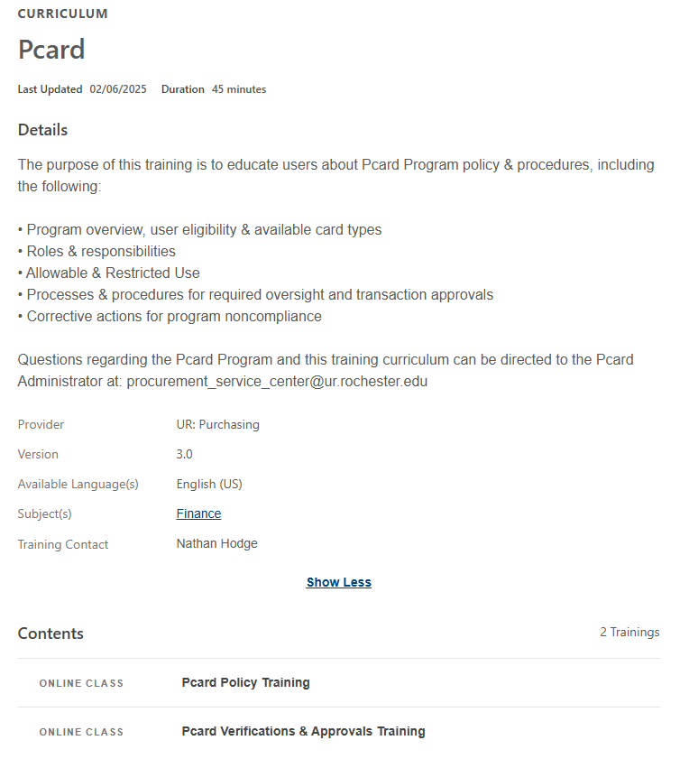
Pcard MyPath Training Updates
MyPath Training Modules
The Pcard Policy and Pcard Verification and Approval training modules were updated and consolidated into a single Pcard curriculum to align to the policy changes

Slide 4
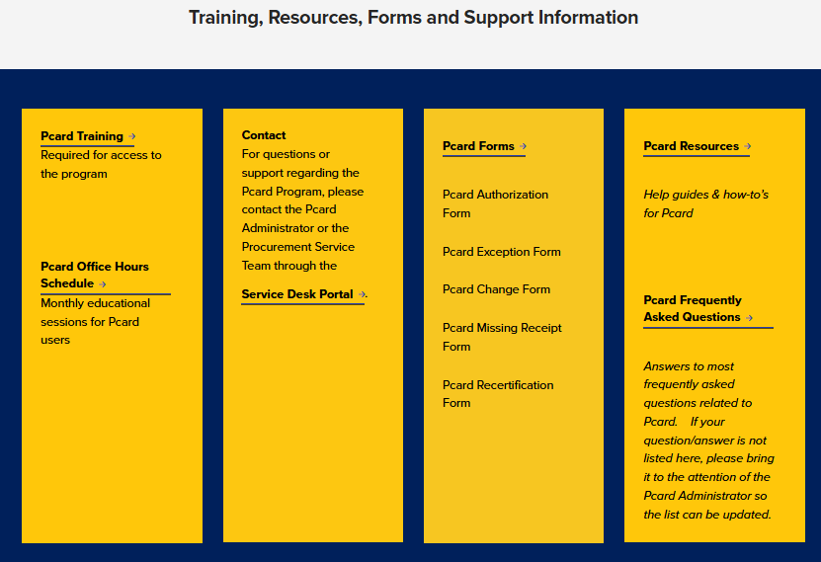
Pcard Website Updates
Pcard Program information consolidated to a single page
Pcard Policy
Pcard Training
Pcard Forms
Pcard Resources
Pcard Office Hours
Pcard Support
Pcard Policy broken out for quick access to the following sections:
Appendix A – Approved and Restricted Use List
Appendix B – Pcard Verification Requirements
Appendix C – General Pcard Procedures
Appendix D – Enforcement and Consequences for Noncompliance

Slide 5
Pcard Policy Updates

