Slide 1
Financial Reporting Updates
April 29, 2025
Carrie Ballou – Assistant Controller, Financial Reporting

Slide 2
Financial Reporting Updates
Workday Business Asset implementation
Maintaining equipment records

Slide 3
Workday Business Assets
The University went live with Workday Business Assets as of July 2024
New fixed assets purchased after 07/01/2024 are registered in Workday Business Assets
Replaces legacy fixed asset system (URFAS) and LLE database
Assets that were maintained in URFAS were fully converted February 2025 in Workday
Assets that were maintained in LLE database were fully converted April 2025 in Workday
URFAS data was feeding into URSpace prior to Workday Business Assets going live

Slide 4
Workday Business Assets
Business Asset operational journals
Allocation was created to move all Business Asset operational journals to a designated OP FAO within each company as part of the common book close
Allocation was created as the transactions were not netting at the FAO level (but net at the UR consolidated reporting level)
Business Asset operational journals are exempt from sponsor billing and do not impact award cost processing
For non-grant reports in UR Financials, you will need to unselect Ledger Account (Exclude) – and journals under Journal Source (Exclude) prior to running reports

Slide 5
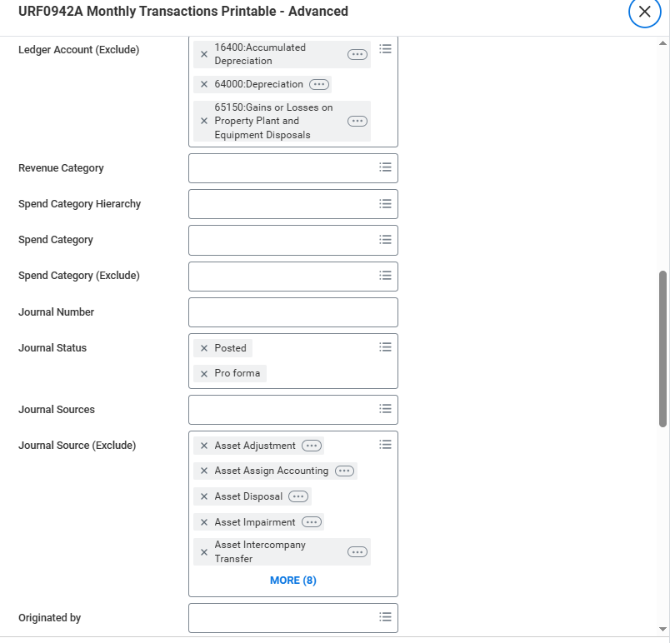
Workday Business Assets

Slide 6
Workday Business Assets
Please reach out to the equipment administrator at equipadmin@finance.rochester.edu for any report issues that relate to Business Assets Journal Sources
Asset Adjustment
Asset Maintain Shares
Asset Transfer
Asset Disposal & Asset Removal
Depreciation & Depreciation Adjustment
Other Journal Sources from Business Assets, see previous slide

Slide 7
Maintaining Equipment Records
Workday Business Assets is not integrating with URSpace
This was in scope for EAMS (URSpace replacement) but project has been placed on hold
Integration is in process of being built to feed data to/from Workday Business Assets and URSpace
Testing and training to URSpace users that update equipment data is targeted for Fall 2025
Project will be going live in Fall 2025
URSpace equipment module will remain locked down until integration is fully functional and live between URSpace and Workday Business Assets

Slide 8
Maintaining Equipment Records
In the interim, please reach out to the equipment administrator at equipadmin@finance.rochester.edu for the following updates
Location (room/building)
Responsible person
Serial number
Disposals
Transfers
Updated equipment listings (these will be generated out of Workday Business Assets, as this is the system of record for the University’s fixed asset)

Slide 9
Maintaining Equipment Records
Department administrators can still access equipment data for URSpace for prior year (need to select previous year):

