Slide 1
Coming in July
TriNetX
A Self-Service Patient Cohort Discovery Tool for Research
Jeanne Holden-Wiltse
Informatics Director
Clinical and Translational Science Institute

Slide 2
URMC part of TriNetX Network for Clinical Trial Invitations from Pharma
Locally a research tool to explore research database of electronic medical records
Enter inclusion and exclusion criteria
Returns number of patients that fit that criteria
Help determine if there are enough patients to propose a new study or join a multi-center study

Slide 3
Types of EMR Data To Explore
Demographics
Diagnosis (ICD-9-CM and ICD-10-CM)
Medications
Procedures
Labs
Visit Types
Data on ~1.5 million patients since Mar 2011
Data updated weekly

Slide 4
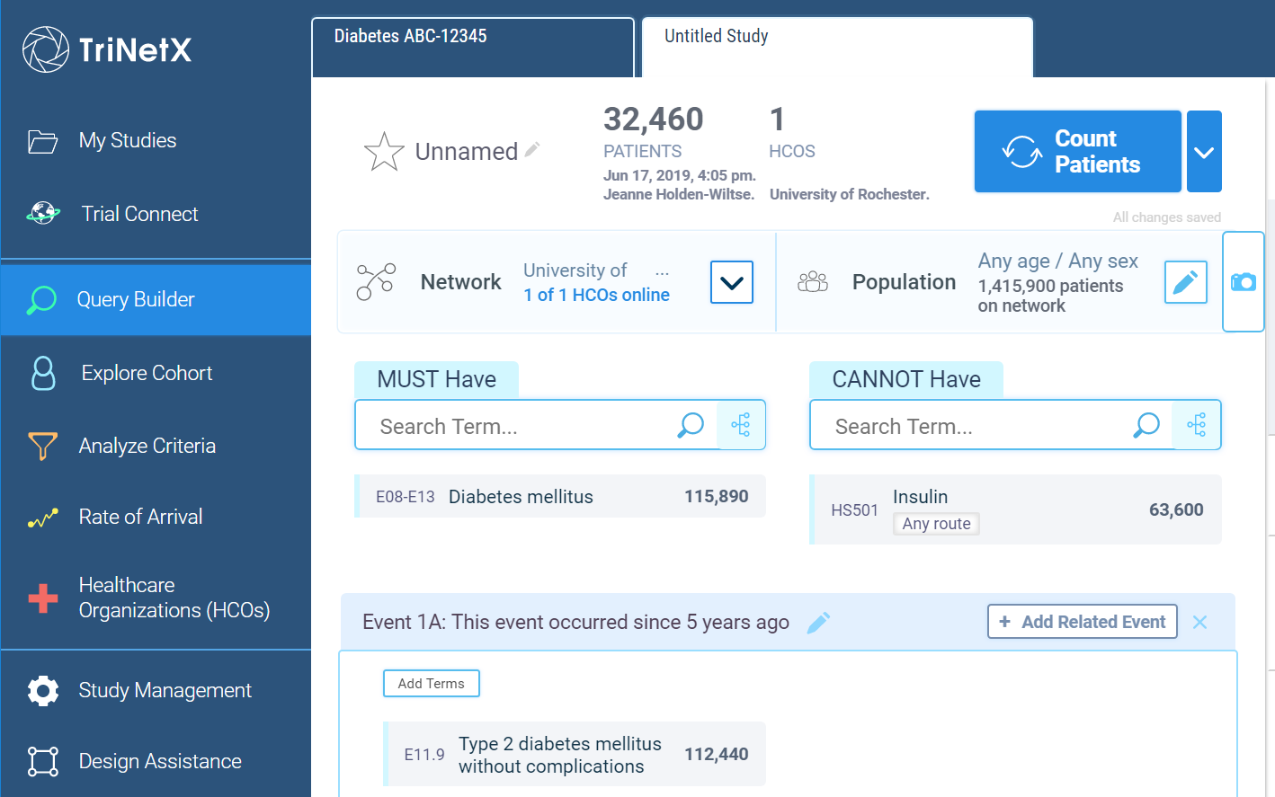
Enter inclusion & exclusion criteria

Slide 5
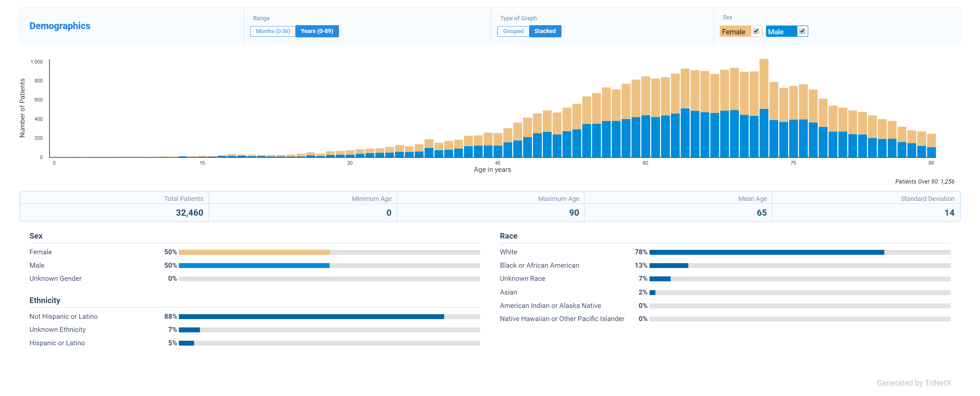
Summary Counts and Demographic Distribution

Slide 6
Request a TriNetx Account
Watch a training video on MyPath
“TriNetX 101 – Basic Functionality Course”
Request Access https://trinetx.urmc.rochester.edu
Or go to CTSI website – Resources-Informatics Consultations
Contact us: ctsi_informatics@urmc.rochester.edu

Slide 7
Stay Tuned
Other tools and resources coming soon from CTSI Informatics
Stay informed
Sign up for weekly CTSI newsletter for updates on CTSI website

