Slide 1
University of Rochester Medical Center
Strategic Account Manager: Andrew Garthwait
Territory Account Manager: Cara Park
Senior Program Coordinator: David Maynes

Slide 2
Outbound Solutions
The better we get to know you and your shipping needs, the more we can help you save money.
OptiFreight® Logistics shipping advice uses historical outbound data to provide valuable service level recommendations

Slide 3
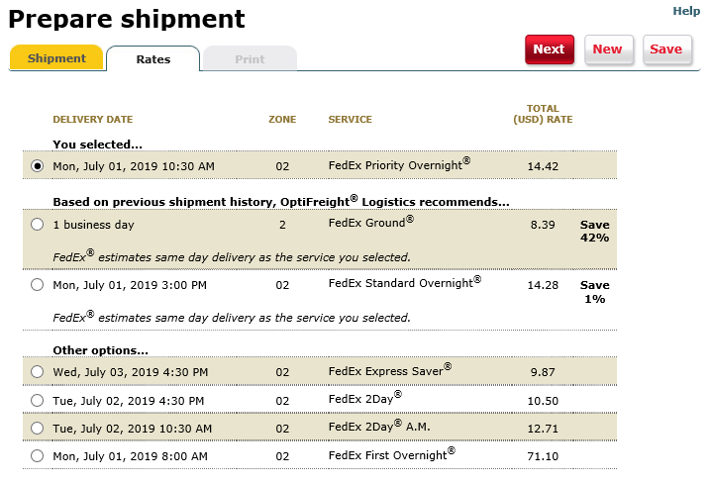
Shipping Advice Savings
OptiFreight Logistics Portal
Current users average additional savings of 17% per package when advice is taken
66% of all express packages can be shipped using a lower cost service level and still arrive the same day
Notes:
Report highlighting realized and missed savings from Shipping Advice per user.

Slide 4
Mode Optimization
We understand not every shipment is created equal…
This is the potential savings with service level shift for all URMC:
Based on all shipments moved in May 2023
Service Level | Cost Per Pack | Package Count | Savings by moving to Ground Service
Priority Overnight | $36.55 | 4,833 | $83,212.41
Standard Overnight | $43.46 | 1,548 | $37,348.61
First Overnight | $187.77 | 38 | $6,400.56
Even slight behavior changes in service selection can make a cost impact.
Notes:
For May:
Rivercampus spend: $9,421.13 / 311 shipments / $30.29CPP

Slide 5
Who to call when you need help
 | Account Management Team: Cara Park cara.park@cardinalhealth.com 607-423-2697 Andy Garthwait andrew.garthwait@cardinalhealth.com | Customer Care OptiFreightWebCustomerCare@cardinalhealth.com
OptiFreight® Logistics Questions | OptiFreight® Logistics program: adding new locations, additional cardinal services, discussing OptiFreight® Logistics savings, large freight, rebates, reviewing & analyzing your invoices and shipping habits, vendor list updates OptiFreight® Logistics invoicing: A/R questions, credits, discussing invoices, rebilling a FedEx direct invoice through the OFL program | OptiFreight® Logistics address book: help or setup OptiFreight® Logistics reports: detailed activity reports, invoice requests OptiFreight® Logistics users: new users, edits of users, password resets, portal or FedEx training
FedEx Questions | FedEx service: additional services and questions, larger scale issues | FedEx service: tracking down a lost or delayed package FedEx shipping: requesting copies of airbills, zone 2 maps FedEx supplies: ordering supplies FedEx address book: help or setup FedEx pickups: delivery exceptions, on-call pickups, scheduling pickups, or issues with pickups

