Slide 1
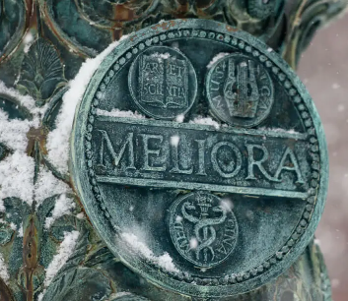
Study Subject Gift Cards
June 2025
Marta Herman
Assistant Director of Accounts Payable

Slide 2
Study Subject Gift Cards
First, as a reminder, for IRB-approved studies, the Participant Payment system is the preferred way to pay study subjects. Importantly, I am not encouraging the use of gift cards. Especially since I’ve seen a lot of unacceptable gift card giving recently.
The only time a gift card can be given to an employee is for study participation.
There are two important responsibilities when payment via gift card is used
The cost of the gift cards cannot be charged to a Grant until the gift card is given to the study subject
  This means that unless the gift cards are going to be disbursed to the study subjects immediately (within the month), then the purchase of the gift cards cannot be charged to the Grant. Instead, the purchase of the gift cards must be charged to an OP and then journaled to the Grant as they are disbursed (for example one journal entry per month for that month’s gift cards given out)
  Based on analysis of gift card transactions, it appears grant administrators are doing a good job of this. Some may have room for improvement, but most are doing this correctly.

Slide 3
Study Subject Gift Cards
#2) There is a second, equally important responsibility that I believe every department needs to refresh on:
Gift cards given to study subjects require the same reporting to Accounts Payable that petty cash reporting requires.
That is, see the Research Subject Payments Procedures.pdf
Page 1 #3) How does the study team complete this reporting for payment made to a study subject using any other payment type (gift cards, petty cash, survey tool, etc.)?
Since there is no University-administered system involved with these other payment methods, departments are responsible for sending the required information to Accounts Payable at AccountsPayable@ur.rochester.edu. The following information must be recorded for each individual paid regardless of dollar amount: First and Last Name, Address, Social Security Number, and Amount paid during the calendar year. Furthermore, a Form W9 must be provided for any subject paid $500.00 or more during the calendar year. This is the same requirement as if payment were completed using a Workday Supplier Invoice Request or the Participant Payment system. That is, the method of payment does not change the reporting requirements required of the department.
A fillable spreadsheet template Reporting of Taxable Payments is available for your convenience.

Slide 4
Study Subject Gift Cards
Resources:
Research Subject Payments Policy
Paying Research Subjects chart of available payment options and contacts
Research Subject Payments Procedures
Reporting of Taxable Payments fillable spreadsheet template
AccountsPayable@ur.rochester.edu
PCard Policy section on Gift Cards: Appendix A Caution Items

