Slide 1
Federal Requirements for public access compliance, biosketches and support
Linda hasman, msls
Liz Grace, MLIS

Slide 2
NIH Public Access policy
What is NIH Public Access Policy?
  All peer-reviewed articles resulting from NIH support must be loaded into PubMed Central within 3-months of acceptance.

Slide 3
Does the policy apply to my article?
The NIH public access policy applies to any manuscript that:
Is peer-reviewed;
And, is accepted for publication in a journal on or after April 7, 2008;
And, arises from:
  Any direct funding from an NIH grant or cooperative agreement active in Fiscal Year 2008 or beyond, or;
  Any direct funding from an NIH contract signed on or after April 7, 2008, or;
  Any direct funding from the NIH Intramural Program, or;
  An NIH employee.

Slide 4
Does the policy apply to my article?
Does NOT apply to:
  Book chapters
  Commentary, opinion, letters
  Dissertations
  Non-Latin script (i.e. Chinese, Russian)
  Accepted for publication before April 7, 2008

Slide 5

Why Is it really important?
The NIH will delay processing of an award if publications arising from it are not in compliance with the NIH public access policy.

Slide 6
how do you comply?
Use one of the four submission methods
You must address the copyright issue:
  Address The Copyright Agreement. When you are negotiating the terms of your publication or copyright agreement, make sure that the agreement includes a stipulation allowing the full text of the paper to be posted to PubMed Central. Note: manuscripts must be made available on PubMed Central no later than 12 months after the official publication date.
    “Journal acknowledges that Author retains the right to provide a copy of the final peer-reviewed manuscript to the NIH upon acceptance for Journal publication, for public archiving in PubMed Central as soon as possible but no later than 12 months after publication by Journal.”
  To avoid miscommunication, awardees may wish to let publishers know a manuscript is subject to the policy before the publisher decides to review it.

Slide 7

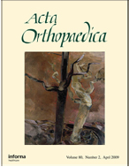
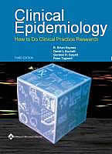

Compliance: Submitting manuscripts
Method A -- Publish in a journal that deposits all NIH-funded final published articles in PMC without author involvement. A complete list of these journals is available at PMC.

Slide 8
Compliance: submitting manuscripts
Method B -- Make arrangements to have a publisher deposit a specific final published article in PMC. This method usually involves choosing the journal’s fee-based open access option for publishing that article. NIH provides a list of publishers that deposit specific final published articles in PMC.

Slide 9
Compliance: submitting manuscripts
Method C -- Author Submission to PubMed Central Using NIH Manuscript Submission System (NIHMS)

Slide 10
Compliance: submitting manuscripts
Method D -- Some publishers will submit manuscript files to NIHMS for the author. The author is responsible for the remaining steps in the NIHMS process.

Slide 11

Compliance: submitting manuscripts
Submitted manuscripts will receive a NIHMS ID immediately.
This number is valid for 3-months
It can be used in RPPRs and grant submissions

Slide 12
What is the Difference between pubmed and pubmed central?
What is the difference between a PMID and PMCID? And, what is the difference between PubMed and PubMed Central?
  PubMed is HBO
    28.4-million citations
    Abstract only
  PubMed Central is PBS
    Free full-text archive
    4.8 million articles

Slide 13

Best Practices

Slide 14

Best Practice 1
Submit manuscript to PMC when the article is accepted for publication
Notes:
We recommend that corresponding authors submit final manuscripts for all NIH supported publications to PMC as soon as the article is accepted for publication. Authors can either submit the manuscript themselves or make arrangements for third party such as an administrative support person or a librarian, to do the submission.
At this time the final manuscript files should be readily available. These files are often difficult to locate when doing a submission at a later date.

Slide 15
Best Practice 1
Elsevier
Wiley
LWW
Informa Health
Nature
Taylor & Francis
Notes:
Many of the larger publishers will submit manuscripts of NIH supported publications to PMC for their authors but there are no guarantees that they will comply with the deadlines NIH requires. Remember that you only have three months after publication to be compliant and it can take a 6-8 weeks for the manuscript to work its way through the system and have the PMC ID number assigned.
Many publishers are confused about when the manuscript needs to be submitted to PMC. They believe that the 12 month embargo period means they don’t need to submit the manuscript until 12 months after publication.
If the publisher does end up submitting the final manuscript, it will override the manuscript submitted by the author.
If you do rely on the publisher for submission be prepared to closely monitor the publication and to contact the publisher if the manuscript has not been submitted to PMC three months after publication.

Slide 16
Best Practice 1
Identify your submission method
  Method: A, B, C, D
Notes:
The only exception to this recommendation is when the article is published in one of the over 500 journals that have committed to submitting final published versions (not manuscripts) of all NIH supported articles to PMC. These journals are sometimes referred to as Method A journals. A list can be found at the URL shown on this slide.
Publications from any of these journals are not required to have a PMCID three months after publication to be compliant. If a PMCID has not been assigned yet, these publications will have the status “PMC Journal – In Process”.

Slide 17
Submitting the Manuscript
If you’re submitting on your own
This is a Four Step Process:
Describe the manuscript
Upload the files
Approve submission
Give final approvals & set embargo period
Notes:
Submitting a manuscript to PMC is a simple four step process. The first three steps can be done by a third party such as an administrative support person, librarian or publisher. However only the author or PI can complete the fourth step which is to first approve the PDF of the submitted files and then the final web version of the paper. Plus, in many cases the PI or author will set the embargo period. The embargo period is the time between the official publication date and when the manuscript becomes publicly available. The embargo period is decided by the publisher but the maximum and the norm is 12 months.
If the author or PI does not approve the submission, the manuscript will not be deposited in PMC and will not be in compliance. The NIHMSID number generated when the submission process starts will not be accepted if the manuscript is stalled in the Submission System for longer than three months.

Slide 18
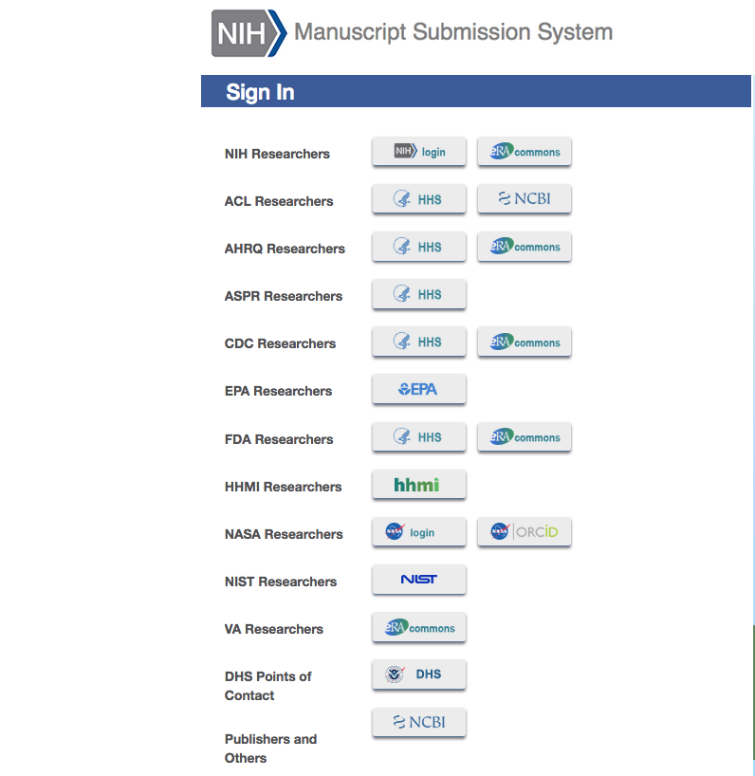
NIH Manuscript Submission System (https://nihms.nih.gov/)
Notes:
PIs, authors or administrators with a Commons account should log into the Manuscript Submission System using that account. Other users can log in with their My NCBI account. If they don’t have a My NCBI account, one can be set up in the PubMed database. Always use the same account when using the Manuscript Submission System. The system keeps track of all your submissions and you can monitor their status.

Slide 19
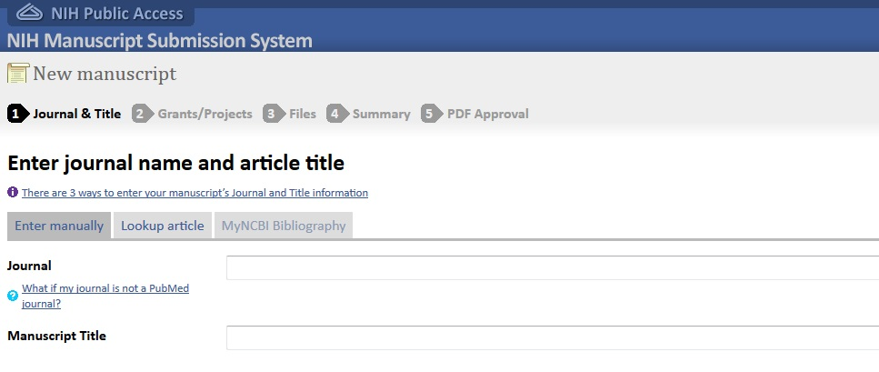
Describe the Manuscript
Notes:
Journal and Manuscript title must be entered. This information can be entered manually or you can use the Lookup Article tab to do an author search for the citation. Authors with MyNCBI accounts can also locate the correct citation in their My Bibliography publication list.

Slide 20
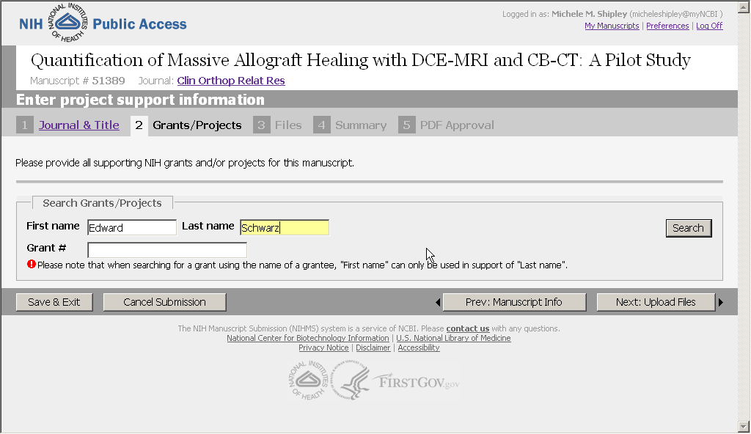
Add PI & Supporting Grant
Notes:
Submitters must enter the grant number that funded the research the article was based on and the PI for the grant. Searching by the PI’s name returns a list of his/her grants.

Slide 21
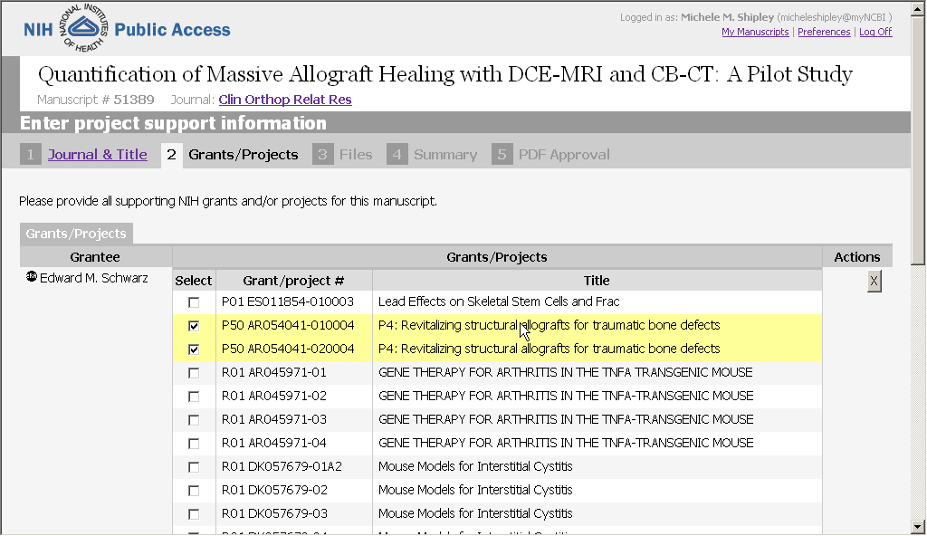
Add PI & Supporting Grant
Notes:
The system pulls information about the PI and his/her grants from the eRA Commons database. Multiple PIs and grants can be selected.

Slide 22
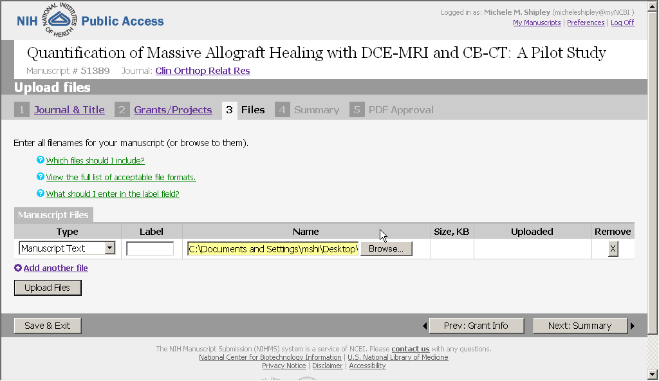
Upload Files
Notes:
Next step is uploading the manuscript files.

Slide 23
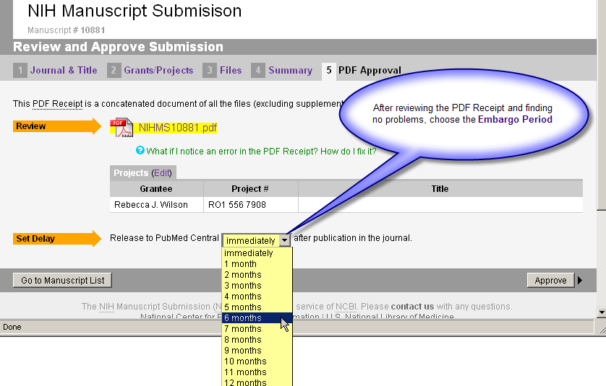
Final Approval by PI or Author
Notes:
If the submission is done by a third party, the PI or author will receive an e-mail from the NIHMS system, directing him/her to review and approve the submitted files and designate the correct embargo period.
Which brings me to Best Practice 2.

Slide 24
Best Practice 2
2. Read & respond to all emails from NIHMS
Notes:
It is extremely important that authors, PIs and submitters read and follow through with all emails from the Manuscript Submission System.

Slide 25
Best Practice 2
nihms-help@ncbi.nlm.nih.gov
Notes:
The Manuscript Submission System may be notifying authors that submitted manuscripts are ready for approval. Two approvals are usually required. If a third party did the original submission, the author or reviewer must approve the submitted files and set the embargo period. A second approval is required several weeks later after the Manuscript Submission System creates the final web version of the manuscript. If these approvals are not given, the manuscript will stall in the system, a PMC ID number will not be assigned and the publication will not be compliant.
The Manuscript Submission System also contacts submitters and authors when there are problems with the manuscript that need attention such as problems with images or missing files. Once again if these problems are not addressed the manuscript will stall in the system.

Slide 26
Best Practice 3
3. Use MyNCBI’s My Bibliography to manage publications & compliance

Slide 27
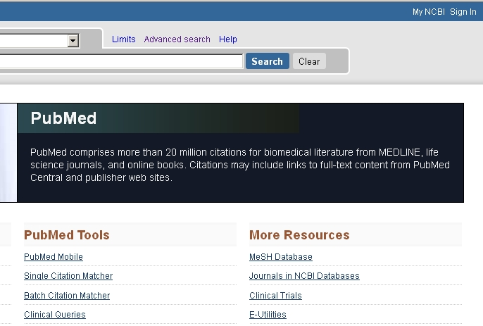
Managing Publications With MyNCBI
Notes:
MyNCBI is a free service of PubMed with many useful tools. You can save PubMed searches and have new citations that meet your search criteria emailed to you periodically. You can permanently save collections of citations and customize your PubMed settings and filters.
My NCBI also has a tool called My Bibliography that NIH researchers are required to use to build and manage their Commons publications list and to manage compliance with the Public Access policy. Publications can not be added to Research Performance Progress Reports (RPPR) manually. They must be entered in the PIs My NCBI My Bibliography.
All NIH investigators or authors must have a My NCBI account that is linked to their eRA Commons account.
If a researcher doesn’t have a My NCBI account they should start by clicking on My NCBI Sign In at the upper right of the PubMed screen.

Slide 28
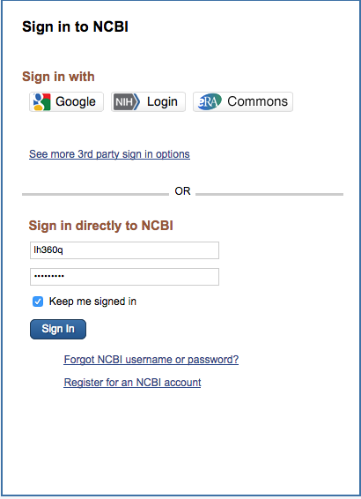
Managing Publications With MyNCBI
Notes:
On the Sign In screen they should choose the “Sign in with NIH Login” option and use their eRA Commons user name and password. This will link the two accounts.

Slide 29
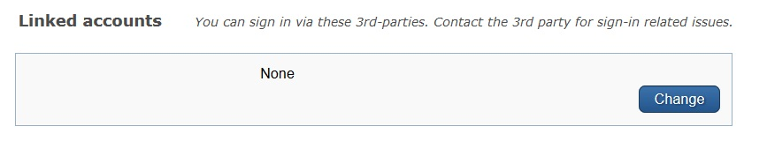
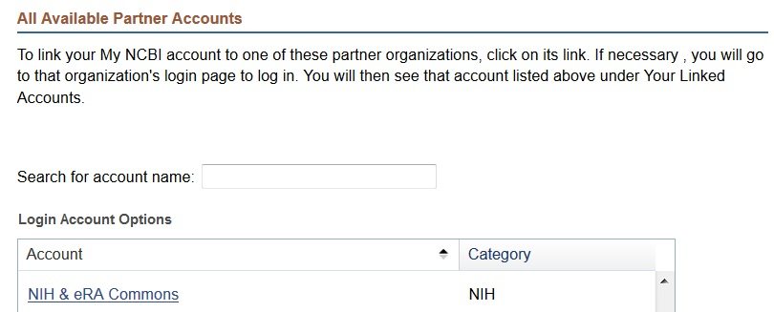
Managing Publications With MyNCBI
Notes:
If a researcher already has a MyNCBI account and it is not linked to his/her eRA Commons account, they can manually link it using their MyNCBI account settings.
In Account Settings click Change under Linked Accounts
Next select NIH & eRA Commons under Partner Accounts & log in with their Commons user name and password
The MyNCBI Help Desk can merge multiple MyNCBI accounts and help with other problems.

Slide 30
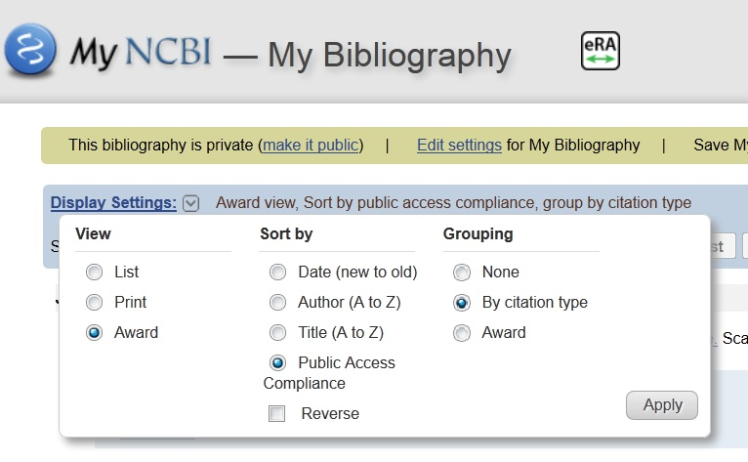
Managing Publications With MyNCBI
Notes:
If the MyNCBI and eRA Commons accounts are linked the eRA icon will appear in the heading of My Bibliography when the Awards display is selected.

Slide 31
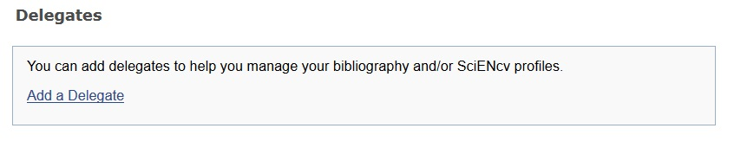
Managing Publications With MyNCBI
Notes:
In Account Settings researchers can also assign delegates to help manage their My Bibliography. Delegates could be administrative support staff or librarians. Miner has a program that partners a liaison librarian with each Medical Center department. The liaison for your department can act as a delegate for any interested researcher who needs assistance in setting up and managing their My Bibliography account.

Slide 32
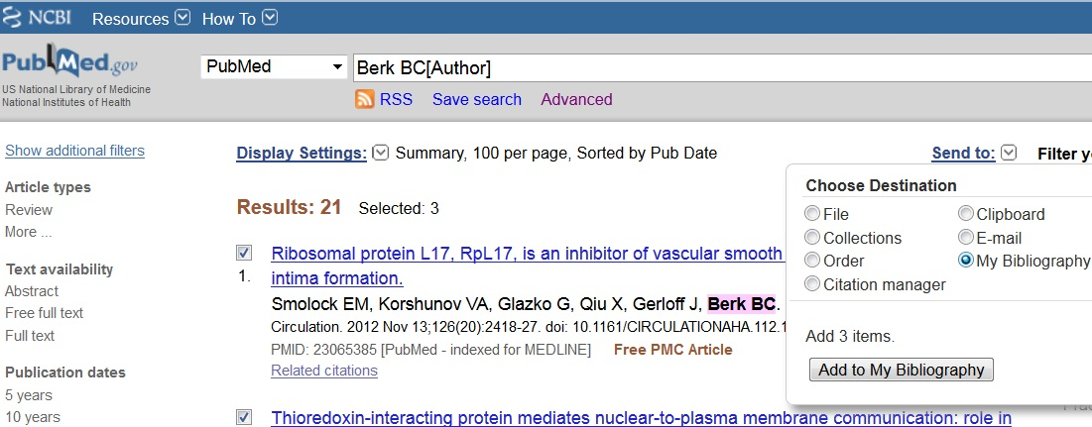
Managing Publications With MyNCBI
Notes:
LIVE DEMO
Once researchers have set up a MyNCBI account, they need to add citations for their publications to MyBibliography. This is easily accomplished. While they are logged in to their MyNCBI account, they can perform an author search for themselves in the PubMed database, select the appropriate citations and send them to MyBibliogaphy using the Send To dropdown menu.
Importing citations from PubMed offers many advantages:
- you can be confident the citations are correct – no typos or other errors
- the Public Access compliance status will be indicated
- the citations will update automatically once a PMCID is assigned and they come into compliance
However, there are also templates in My Bibliography for manually entering publications not found in PubMed, i.e. book chapters

Slide 33
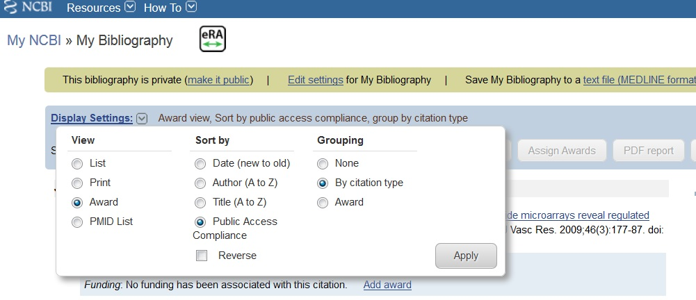
Managing Publications With MyNCBI
Notes:
LIVE DEMO
Using the Award display setting , researchers with their eRA Commons and My NCBI accounts linked are able to see whether their publications are compliant with the NIH Public Access Policy, to start the compliance process and to associate their publications with NIH awards. The eRA icon verifies that an eRA account has been linked to a My NCBI account.

Slide 34
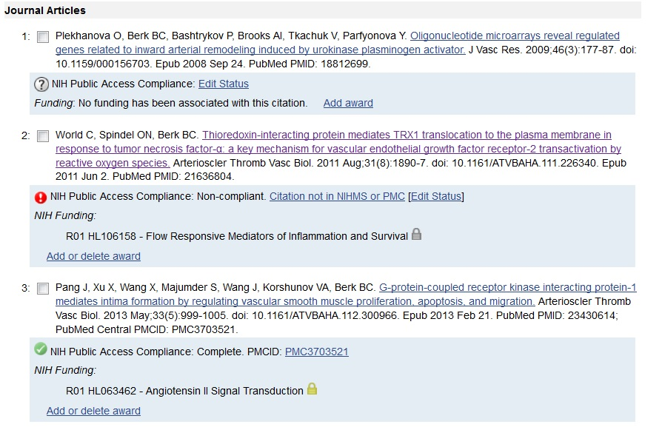
Managing Publications With MyNCBI
Notes:
LIVE DEMO
Compliance status is marked by icons to the left of the citations.
A green dot indicates the publication is compliant; the PMCID number and the NIH award are given.
A red dot indicates that the article is non-compliant. The compliance process can be started by clicking “Edit Status.”
A question mark indicates that compliance with the NIH Public Access Policy cannot be determined without additional information. Click "Edit Status" to enter supporting information for the citation. In this case no NIH award is associated with this publication meaning that no NIH grants were acknowledged in the publication. NIH awards can be added by clicking Add Award. NIH notifies Award owners when citations are associated with their award and adds the citations to the Award owners My NCBI accounts.
You may also see a yellow dot which means the publication was recently submitted to PMC and is in process or a N/A meaning that the publication is not subject to the covered by the Public Access policy, i.e it was published before April 2008, it was not peer-reviewed, etc.

Slide 35
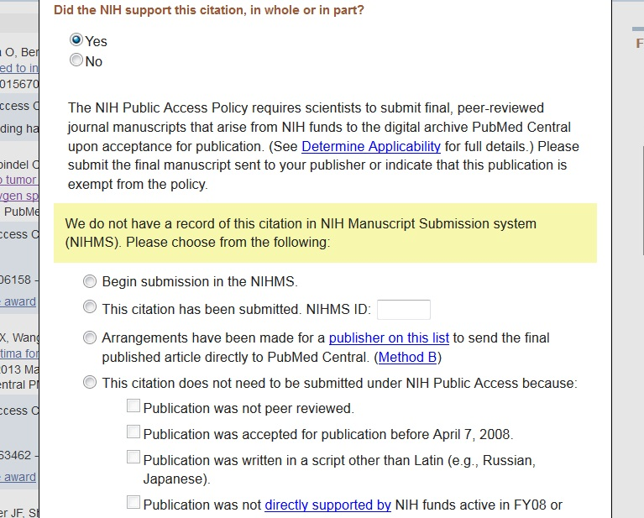
Managing Publications With MyNCBI
Notes:
LIVE DEMO
When publications are marked with a red dot or question mark, researchers can begin the submission process or change the status of the publication by clicking on Edit Status. The pop up box offers several alternatives:
- It can be indicated that the publication was not supported by NIH funding
- If the researchers has the manuscript files available the submission process can be started directly from here
- If the publication was recently submitted, the temporary NIHMS ID can be listed
- The researcher can specify that the publication is not covered by the Public Access policy. Several reasons are listed. This option will change the publication’s status to N/A.

Slide 36
Best Practices
4. Monitor compliance
Notes:
Don’t wait until just before the next progress report or award application is due to worry about compliance. Researchers or their delegates should regularly check the compliance status of their publications. PIs should also monitor the compliance of all publications arising from their award not just the ones on which they are authors. Monitoring compliance is especially important if researchers are depending on publishers to do the PMC submission. It is taking 6-8 weeks for a publication to make its way through the submission process and be assigned a PMC ID because of the increased volume of submissions resulting from NIH’s more serious enforcement of the policy. After the manuscript files have been submitted and the initial approvals given there is nothing we can do to speed up the process.
Tools for monitoring compliance:
- Researchers’ MyNCBI My Bibliography accounts – we already talked about this
- Miner librarians have access to the Public Access Compliance Monitoring database which tracks noncompliant publications for all the UR’s NIH awards. If you would like to receive reports for your department’s PIs contact Linda, me, or the liaison librarian for your department.
- Your liaison librarian can also help set up saved PubMed searches that will notify you or your researchers when new papers are published authored by the researcher or acknowledging a NIH award held by your department.

Slide 37
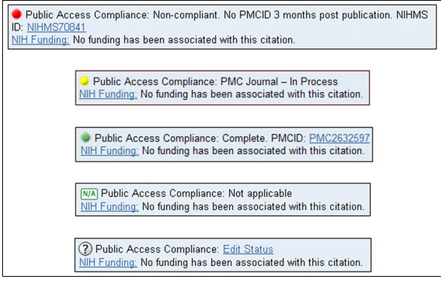
Monitor compliance

Slide 38
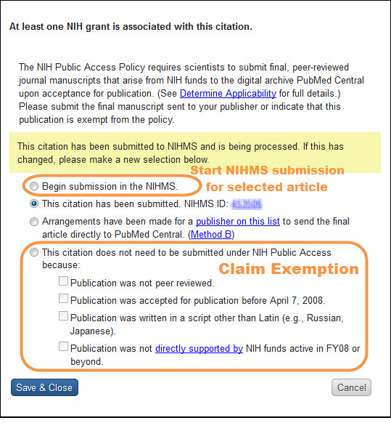
Monitor compliance

Slide 39

Demonstrating compliance
Compliance is demonstrated by providing a PMC ID number for all relevant articles cited in progress reports, new applications and renewals

Slide 40
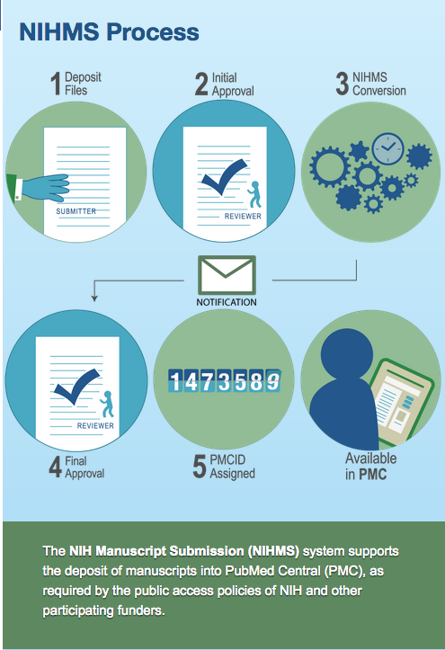
Submission Process

Slide 41
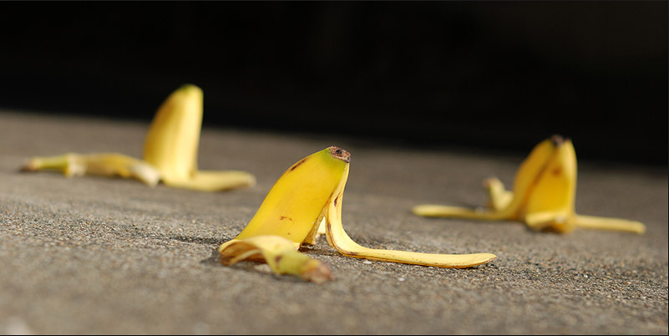
Pitfalls ahead

Slide 42
Help! My paper is already noncompliant!
Contact the journal
Determine the embargo
Double-check copyright
Determine responsibility
Deposit the manuscript via Method C
Notes:
Contact the journal -- The first step you take should be to contact the journal (usually you can contact the editor with whom you have communicated previously) and request permission (it is best if the permission is in writing) to deposit the manuscript into NIHMS-PubMed Central PMC. Even if the publisher offers to upload the article for you, in the interest of timeliness, it is suggested that you instead upload the manuscript yourself.
Determine responsibility -- Are you the only author on this publication? If not, then multiple investigators will be listed as non-compliant, and it will speed the process of compliance if a single person is determined responsible for bringing the article into compliance. NIHMS will not allow duplication of manuscripts in the system, so there are no compliance issues surrounding multiple uploads; however, there is no reason to duplicate efforts.

Slide 43
Help! My NIHMS ID is out of date
After three months, your manuscript becomes “stalled”. Contact NIHMS to “claim” the manuscript.

Slide 44
Help! I can’t get my hands on the manuscript!
First, let’s define what we mean by final-accepted manuscript:
  “The Investigator’s final manuscript of a peer-reviewed article accepted for journal publication, including all modifications from the peer review process.”
Contact the publisher, see if they can upload the manuscript.
Contact your co-authors.
Notes:
The manuscript should also include:
figures, charts, tables and/or images
supplemental materials associated with the work
title page
names and affiliations of the authors
the corresponding author's name and email address
grant award acknowledgements

Slide 45
Help! The wrong version was uploaded!
If you catch it in time, do not approve the manuscript
If it’s too late, contact NIHMS, they can re-open your submission.

Slide 46
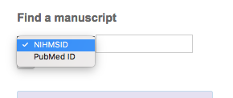
Help! How do I find the nihms id?
Check MyBibliography
Use the PMCID-PMID-DOI Converter
Use NIHMS

Slide 47
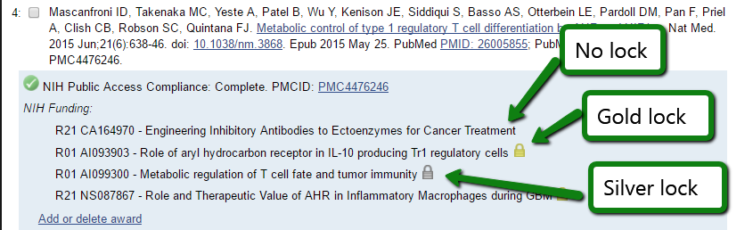
Help! How do I disassociate an article from a grant?
Gold lock = Connection made in NIHMS. Contact the NIHMS help desk if the grant should be removed from the publication.
Silver lock = Connection made in Commons on a progress report. The only way to change this would be to resubmit the report.
No lock = Connection was likely made by an author in My Bibliography.
Notes:
You can remove the connection following the steps below.
If there is no lock, you can remove the grant from the publication, by clicking, "Add or delete award". Then find the award on the list and uncheck it. Then click "save".

Slide 48
How can miner help?
  Monitor your department’s non-compliant papers/authors
  Facilitate contacting publishers
  Upload (or assist) loading your manuscripts
  Classes
  Website
  Stay on top of new compliance policies
    Wait! What? New policies???

Slide 49
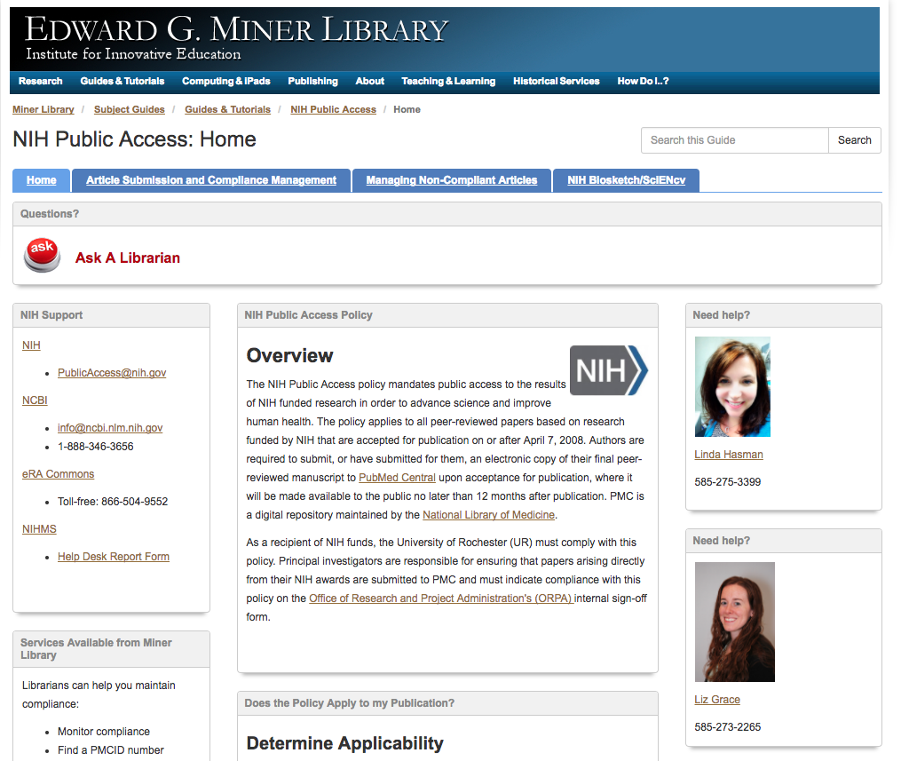
NIH public access Guide

Slide 50
Agency | Article | Data
ACL/ NIDILRR (HHS/NIH) | PMC | Interuniversity Consortium for Political and Social Research (ICPSR)
AHRQ | PMC | Varied
HHS, Office of the Secretary for Preparedness and Response (ASPR) | PMC | Scientific data repositories (data.gov data registry)
EPA | PMC | Varied
CDC | CDC Stacks, PMC | Multiple solutions + data registry
DoD | Defense Technical Information Center (DTIC)
FDA | PMC | OpenFDA
NASA | PMC, PubSpace | NASA archives, or other repository
NIST | PMC | Varied
NIH | PMC | Varied
NSF | NSF-PAR | Varied
Smithsonian Institution (SI) | Clearinghouse for the Open Research of the US (CHORUS) | Varied
USDA | PubAg | Varied
VA | PMC | Varied
Notes:
WH directive from the Office of Science and Technology in 2013 mandating that federal agencies who award more that $100 million in research funds need to come up with a plan to make data and resulting publications accessible to the public.

Slide 51
MyNCBI/MyBibliography/
Biosketch/sciencv
My NCBI is a tool that offers many useful features:
Saving PubMed searches. (And, automatically have search results sent to you)
Saving Collections of citations found in PubMed.
Customization of the filters and results display in PubMed.
My NCBI has a tool named MyBibliography which allows you to save your citations either directly from PubMed or by manually entering them. Once citations are in My Bibliography you can easily:
Monitor whether your publications comply with the NIH Public Access Policy
Start the compliance process for journal articles
Associate your publications to awards
MyNCBI
Notes:
<Live demo>

Slide 52
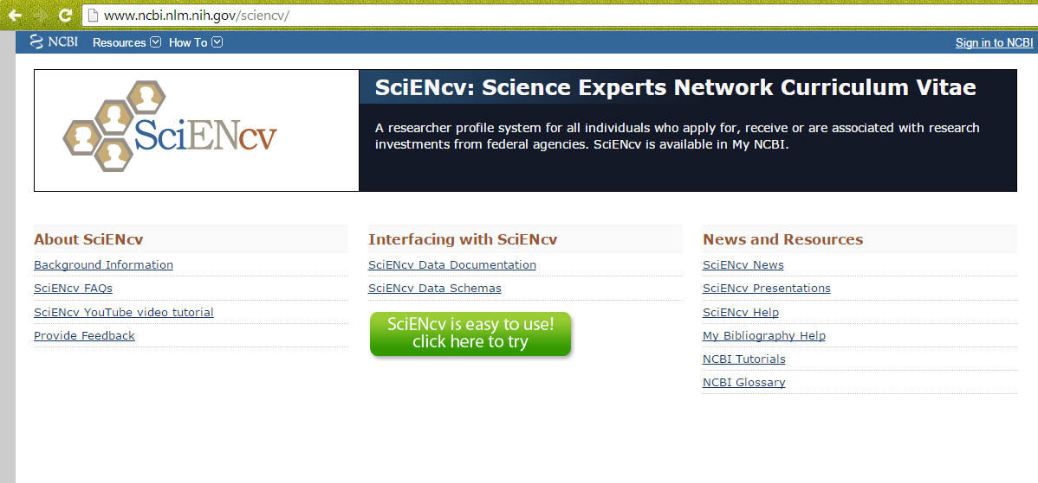
Science Experts Network Curriculum Vitae: SciENcv
SciENcv is a tool for biosketch management and generation.
SciENcv is located in My NCBI, a personal research dashboard from NCBI.

Slide 53
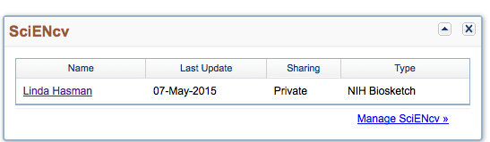
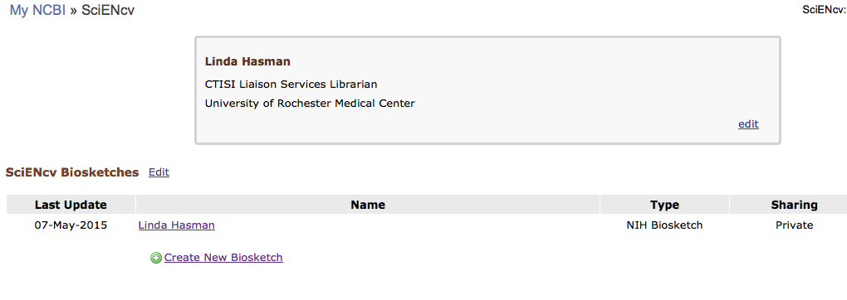
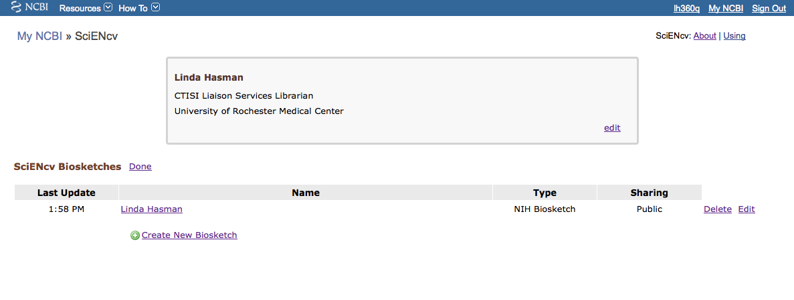
First, click on the link to Manage SciENcv.
In the SciENcv Biosketches page, click on Create New Biosketch.
Note: Edit or Delete by clicking on the Edit link above the list of biosketches to reveal those options.

Slide 54
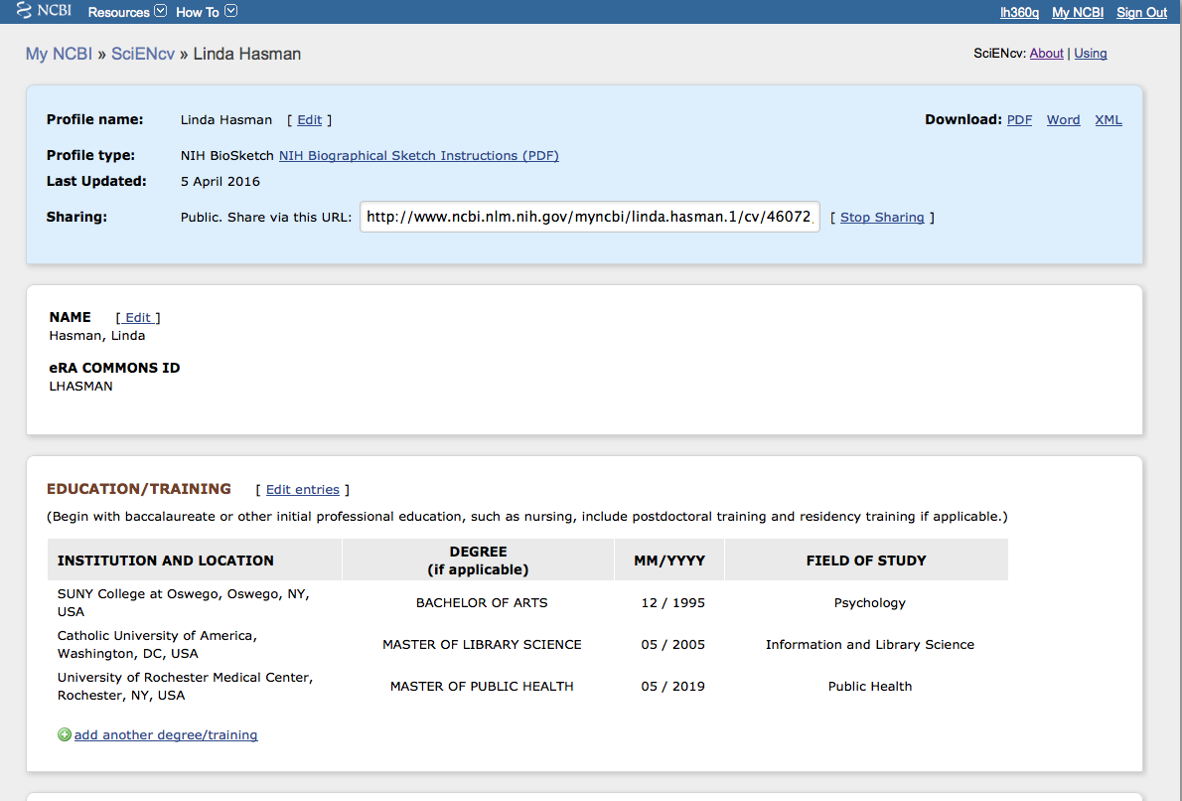
Generate your biosketch
Wait for your biosketch data to be imported from eRA Commons
Sections:
  Name
  Education/Training
  Personal Statement
  Positions and Honors
  Selected Peer-Reviewed Publications & Contribution to Science
  Research Support

Slide 55
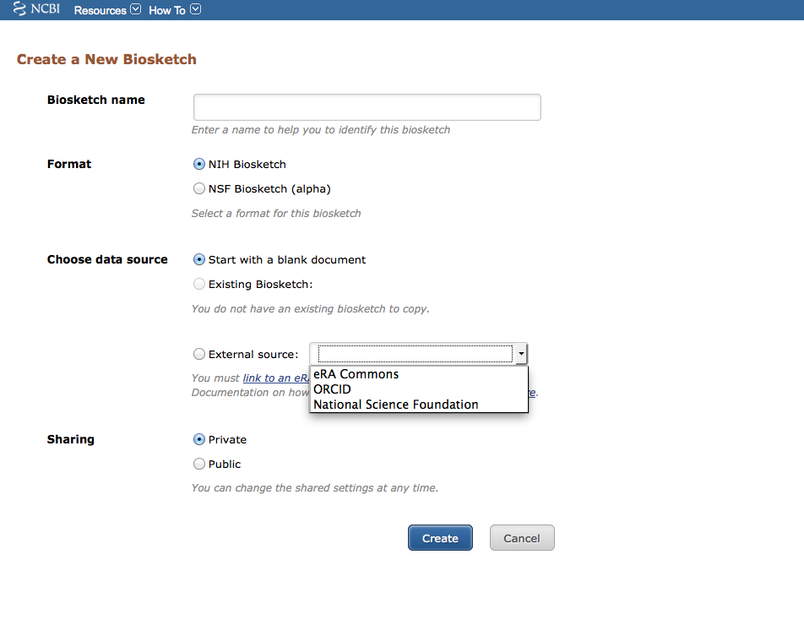
Choose source of data (external source)
Enter name of biosketch
Select NIH Biosketch
Select source: eRA Commons
Choose Public or Private
Click CREATE

Slide 56
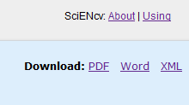
Edit your biosketch
Edit each section as necessary
  Edit within each section
  Edit by downloading into Word, then copy and paste into SciENcv to save and print.

Slide 57
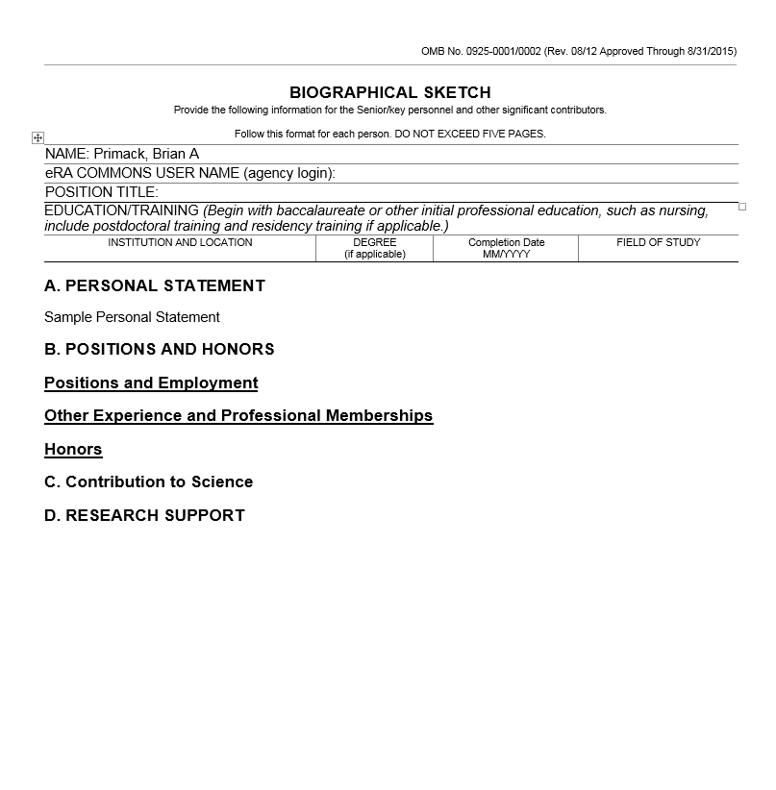
Baseline
A
B
C
D
Primack BA

Slide 58
Formatting: Font

Slide 59
A. Personal Statement
Briefly describe why you are well-suited for your role in the project described in this application. The relevant factors may include aspects of your training; your previous experimental work on this specific topic or related topics; your technical expertise; your collaborators or scientific environment; and your past performance in this or related fields (you may mention specific contributions to science that are not included in Section C). Also, you may identify up to four peer reviewed publications that specifically highlight your experience and qualifications for this project. If you wish to explain impediments to your past productivity, you may include a description of factors such as family care responsibilities, illness, disability, and active duty military service.
Primack BA

Slide 60
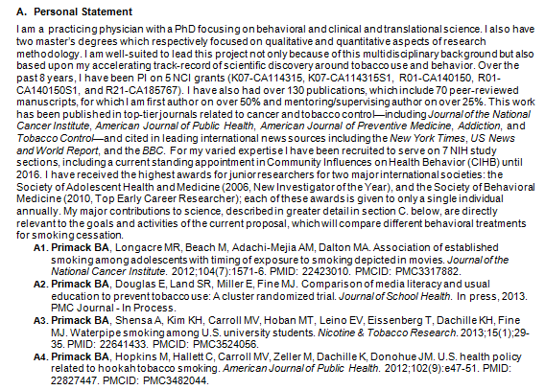
Example
Primack BA

Slide 61
B. Positions and Honors
List in chronological order previous positions, concluding with the present position. List any honors. Include present membership on any Federal Government public advisory committee.
Primack BA

Slide 62
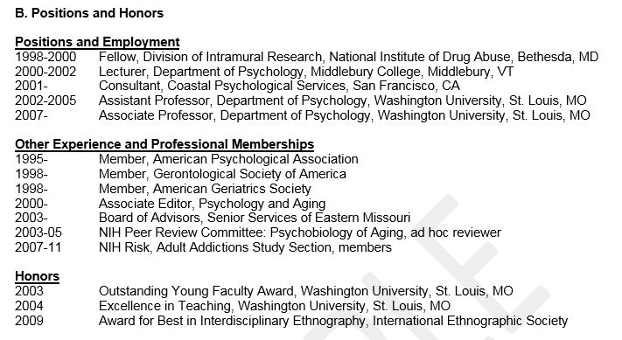

Example
http://grants.nih.gov/grants/funding/424/index.htm#biosketch

Slide 63
C. Contribution to Science
Briefly describe up to five of your most significant contributions to science. For each contribution, indicate the historical background that frames the scientific problem; the central finding(s); the influence of the finding(s) on the progress of science or the application of those finding(s) to health or technology; and your specific role in the described work. For each of these contributions, reference up to four peer-reviewed publications or other non-publication research products (can include audio or video products; patents; data and research materials; databases; educational aids or curricula; instruments or equipment; models; protocols; and software or netware) that are relevant to the described contribution. The description of each contribution should be no longer than one half page including figures and citations. Also provide a URL to a full list of your published work as found in a publicly available digital database such as SciENcv or My Bibliography, which are maintained by the US National Library of Medicine.
Primack BA

Slide 64
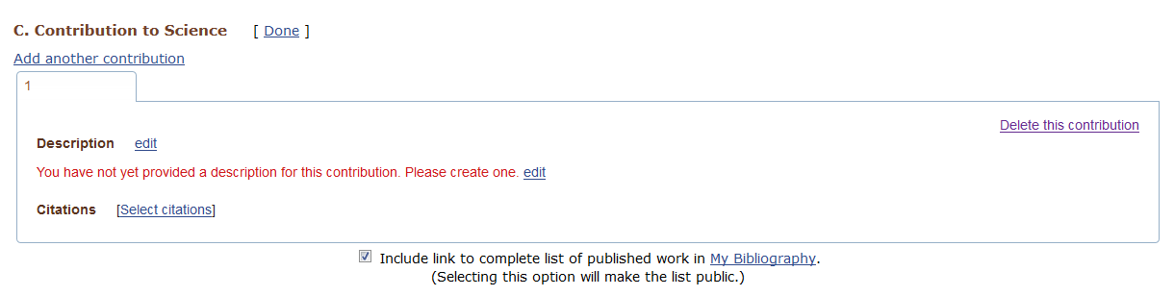
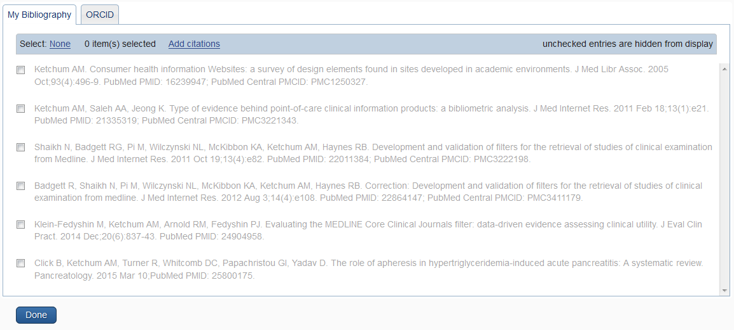
C. Contribution to Science: publications
Complete your “Contribution to Science” under Description.
Next to “Citations,” click on “Select citations.”
My Bibliography will present your publications.
Select up to 4
Checkmark option to include a link to all your publications.

Slide 65
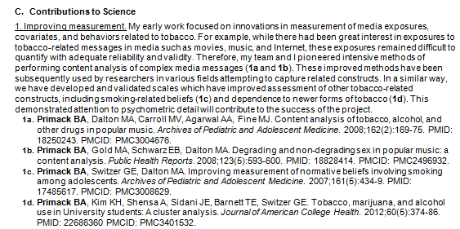
C. Example with bolding and citations
Primack BA

Slide 66
D. Research Support
List both selected ongoing and completed research projects for the past three years (Federal or non-Federally-supported). Begin with the projects that are most relevant to the research proposed in the application. Briefly indicate the overall goals of the projects and responsibilities of the key person identified on the Biographical Sketch. Do not include number of person months or direct costs.
Primack BA

Slide 67
D. Example
http://grants.nih.gov/grants/funding/424/index.htm#biosketch

Slide 68
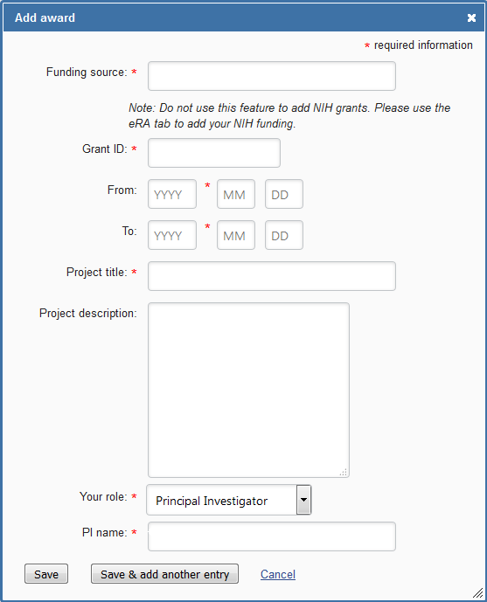
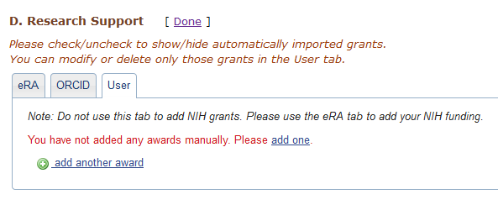
Importing grants
Download awards from either eRA or ORCID.
The User tab provides access to the “Add award” form for manual input.
Entering data via the tabs provided assures proper NIH formatting.

Slide 69
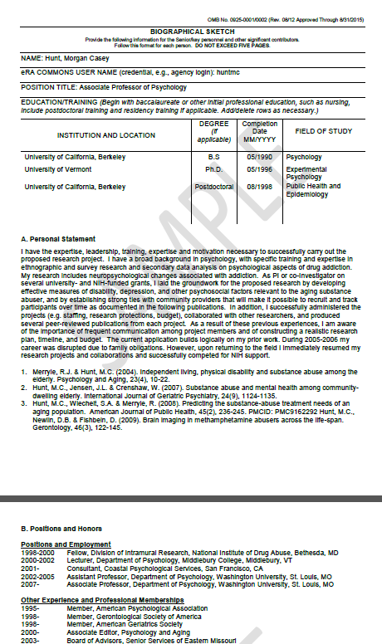
Final Biosketch: PDF
(NIH sample)
http://grants.nih.gov/grants/funding/424/index.htm#biosketch
Sample:
https://grants.nih.gov/grants/funding/phs398/biosketchsample.pdf

Slide 70
Tips
Tailored Personal Statement section
Get to know MyBibliography in NCBI
Positions and Honors is similar, chronological order
Contributions to Science is in sections with up to 5 papers for each idea/contribution to science.
Link to full bibliography at end of Contributions section
Save all biosketches in SciENcv for editing for future biosketches. Keep all Word versions in a folder to help cut and paste
Devise file naming convention for saved biosketches
Primack BA

Slide 71
SciENcv/biosketch/myncbi…oh my!
Miner can help:
  Guidance on setting up biosketch
  Use SciENcv to create biosketch
  Link eRA to MyNCBI/MyBibliography
  Help create public links to MyBibliography
Notes:
Biosketch is designed to highlight accomplishments, not a list of publications
→Guidance with – create, format, import publications and grants, how to separate authored vs. unauthored publications
-->

Slide 72
Questions?
Linda Hasman, MSLS
linda_hasman@urmc.rochester.edu
275-3399
Liz Grace, MLIS
elizabeth_grace@urmc.rochester.edu
273-2265

