Slide 1
On–Off–Around (Modified Off) Campus
September 2023

Slide 2
Agenda
Rate Agreement Review
Definition of Off-Campus
Parameters of Modified Off-Campus

Slide 3
Rate Agreement Review
Current Agreement Executed in FY2014, effective July 2014, extended in FY2019 through FY2023
Currently we are in a “Provisional” Period, whereby the FY23 rate becomes our FY24 rate, until amended
That amendment is expected to occur sometime between now and June 2024
All Awards executed during the current rate agreement carry the final year rate until they terminate
All proposals and budgets are submitted using this provisional rate
When new rates are negotiated a communication will occur.

Slide 5
Definitions of Off-Modified Off Campus

Slide 6
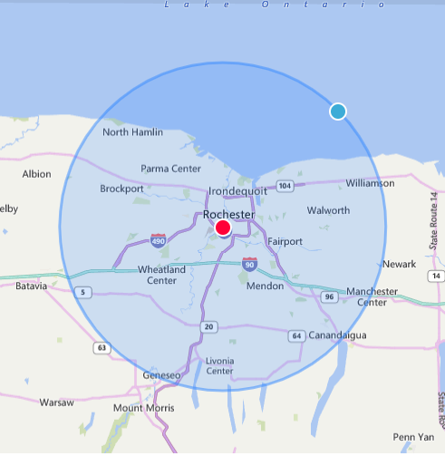
Parameters of Modified Off-Campus

