Slide 1
CTSI ctsi.urmc.edu
Carrie Dykes
Director of Research Services

Slide 2
UR CTSI Pilot Awards for Translational Science
Letter of intent: October 21
Full proposals due January 27

Slide 3

Coordinator Trainees
Next class- January
Post jobs- October
Get a trainee- March
Promote to human subject research specialist 1- July
Email: joanne_vanbuskirk@urmc.Rochester.edu
This Photo by Unknown Author is licensed under CC BY

Slide 4
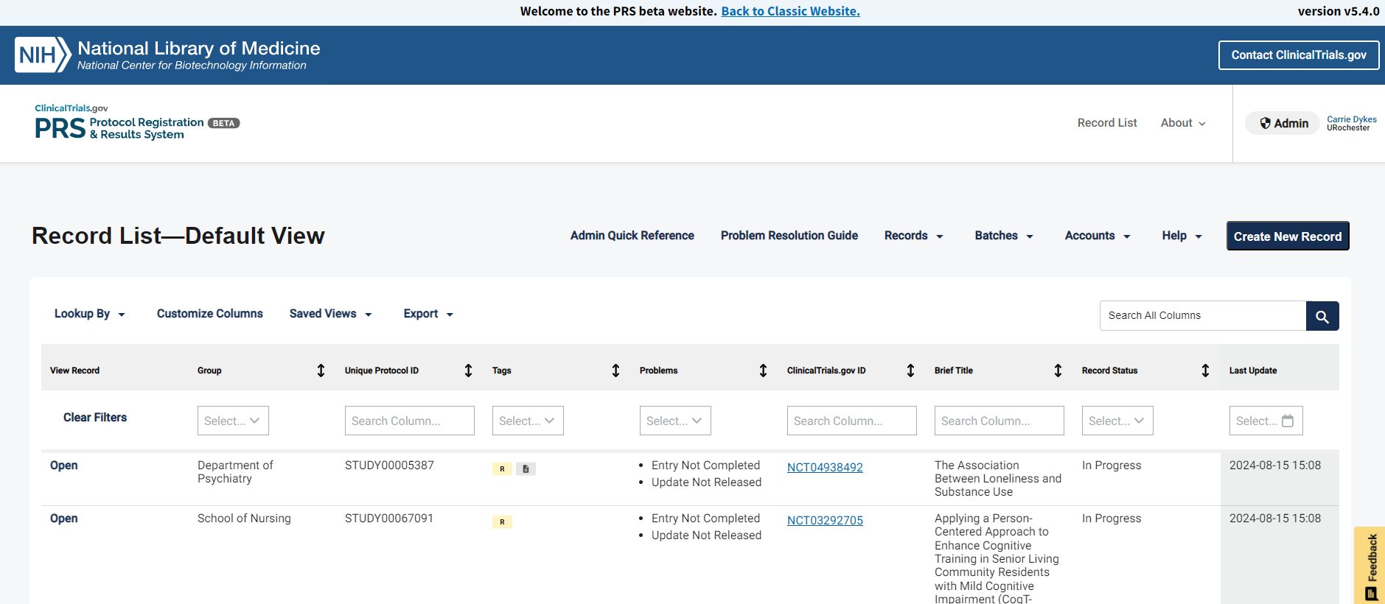
ClinicalTrials.gov
Set to PRS beta-use for trial registration
Use Classic for results reporting

Slide 5
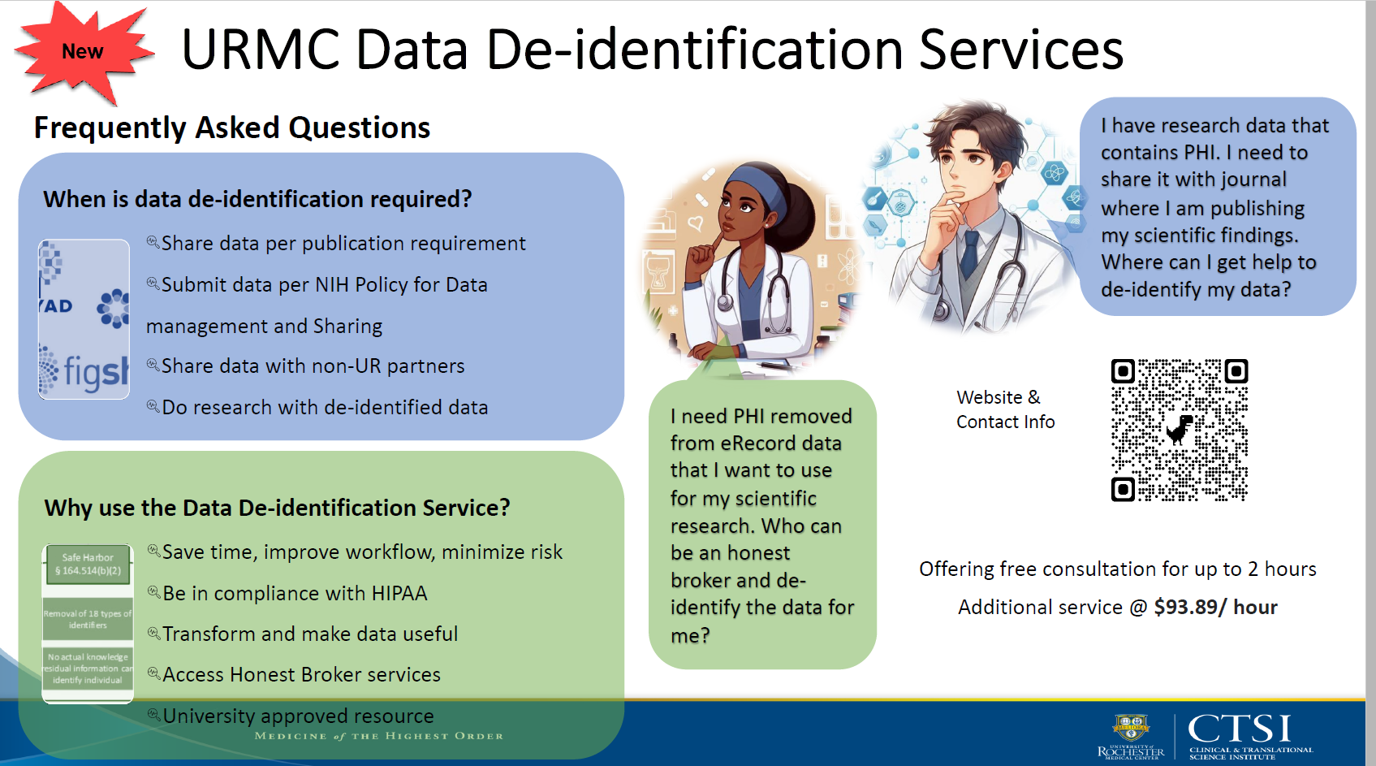

Slide 6
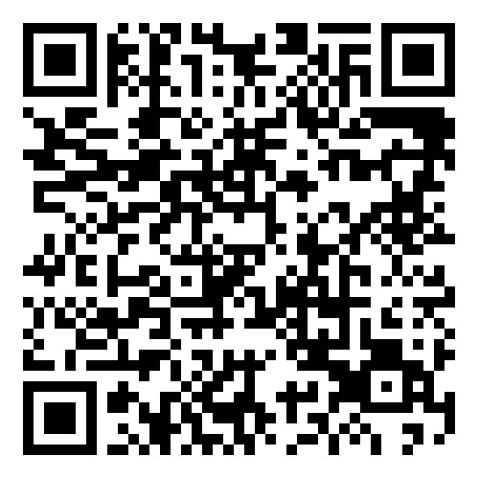
Translational Science Day
REGISTER!
SHARK TANK!
3 minute theses
SCORE workshop
CBPR panel and workshop
RESIN leadership workshop
October 29, 2024
Keynote speaker: Dr. Jin Xiao, winner of the 2024-25 Robert G. Holloway KL2 Alumni Lectureship in Clinical and Translational Research

Slide 7
Research Fair
Biostatistical Consulting Service
Center for Advanced Brain Imaging and Neurophysiology (CABIN)
Center for Advanced Research Technologies (CART)
Center for Health and Technology (CHeT)
Center for Integrated Research Computing (CIRC)
Clinical Trials Processing Laboratory
(EDRA)
Environmental Health & Safety
Office of Health Equity Research (OHER)
Office for Human Subject Protection (OHSP)
Office of Research and Project Administration (ORPA)
Quality and Mixed Methods Research Center
University Committee on Animal Resources (UCAR)
URMC Clinical Labs
UR Ventures
Emergency Department Research Associate Program
Inhalation Exposure Facility
Miner Library
CTSI
  Clinical Research Center (CRC)
  Human Subjects Research Coordinator Training
  Informatics and Analytics
  Office of Clinical Research (OCR)
  Office of Regulatory Support (ORS)
  Recruitment and CTSA Hub Liaison Team
  Research Help Desk
  Translational Science Pilot Studies Program

Slide 8

For More Information
Email: researchhelp@urmc.rochester.edu
Sign up for Weekly Update
https://rochester.us6.list-manage.com/subscribe?u=85ca914d3653b31ff7ca776b9&id=65bec3c724
Notes:
If you would like any more information about the CTSI or institutional research resources contact the Reseach Help Desk and the email or phone number on the screen.
Thank you.

