Slide 1

Universal OnCore Use at URMC
September 2024 Update

Slide 2
Universal OnCore Use Policy
May 2024
Policy drafted and circulated to OCR and CTSI for review and comments
June 2024
Policy shared with CRRPIT for review and comment
July 2024
“Optimizing Clinical Trials Management @UR” Universal OnCore use justification presented at MedSAC
August 2024
September 2024
Policy finalized and published online: Universal OnCore Use Policy
Working with CTSI Communications team to spread the word.

Slide 3
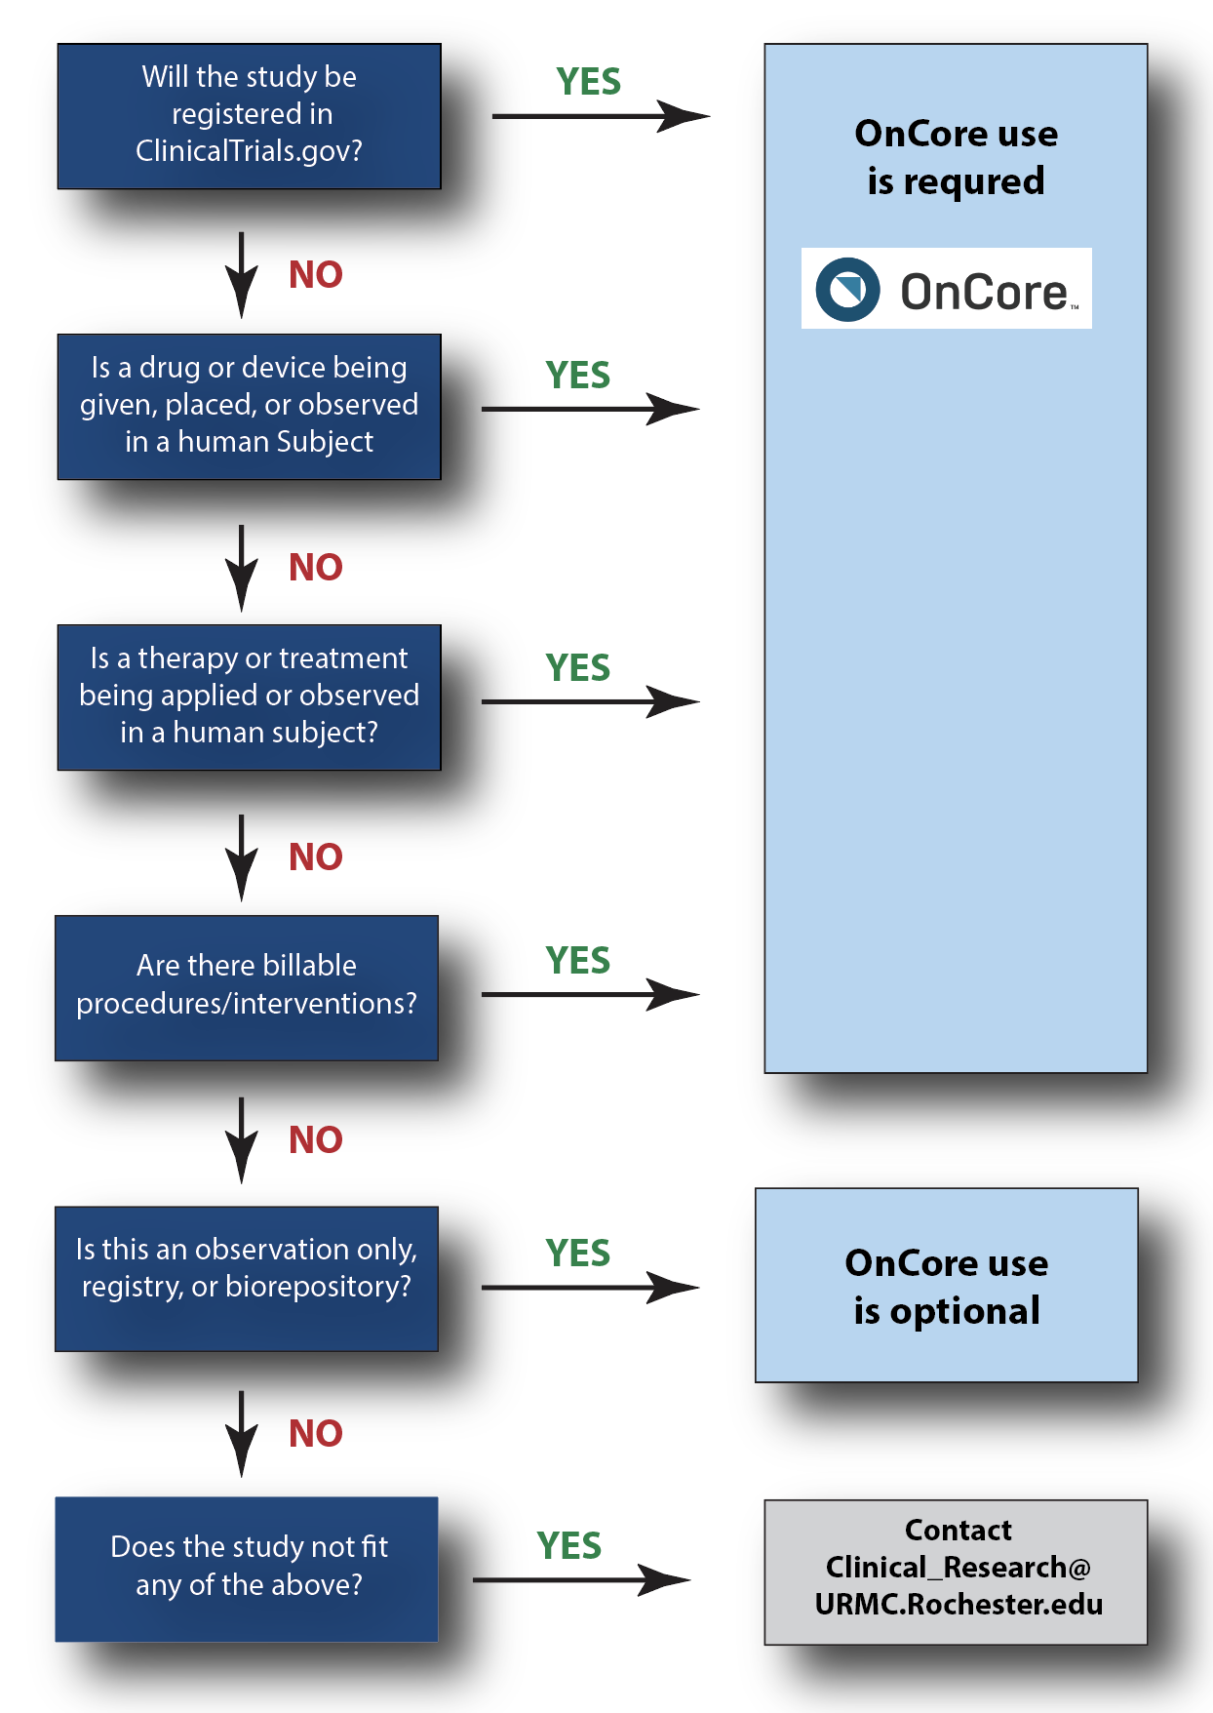
Goal:
All Qualifying Studies in OnCore by July 2025

Slide 4
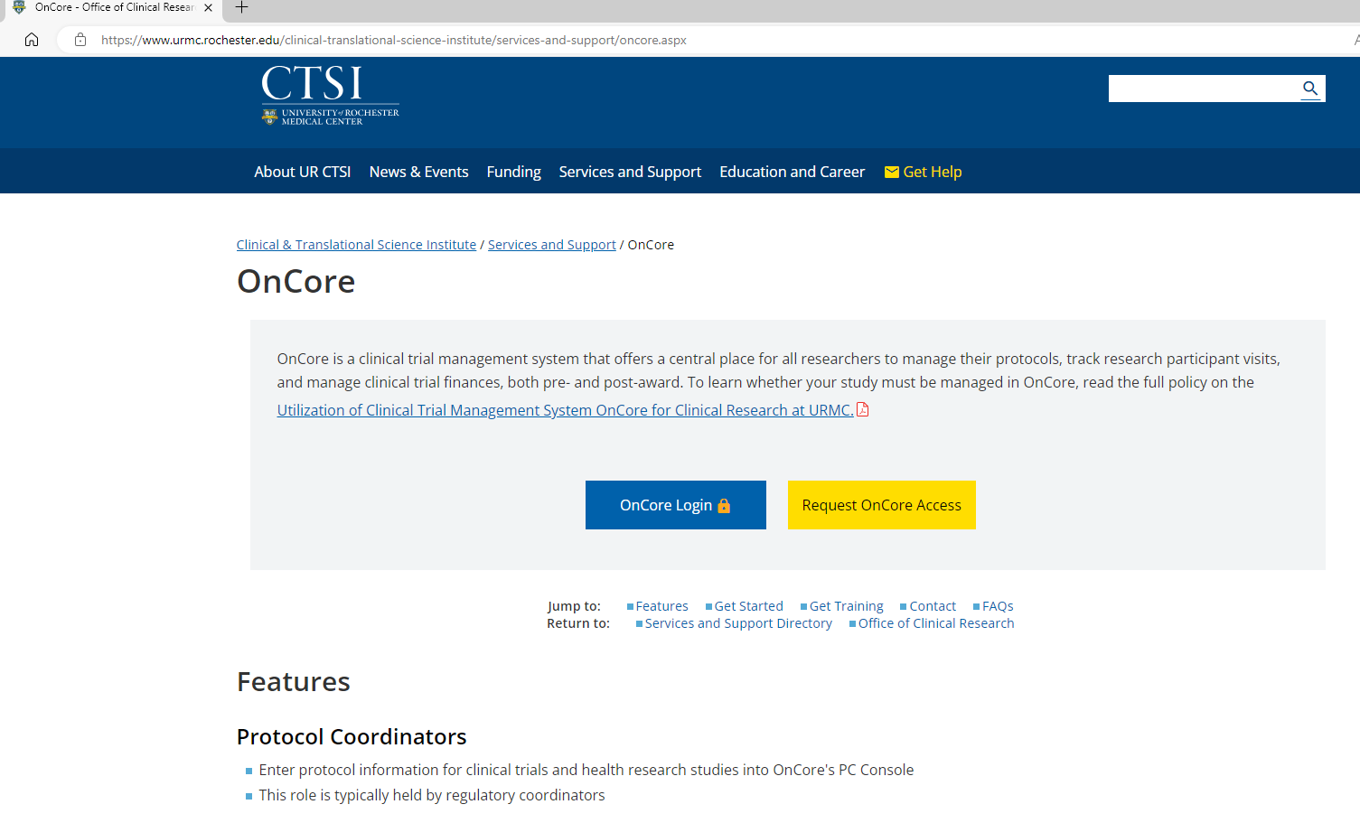
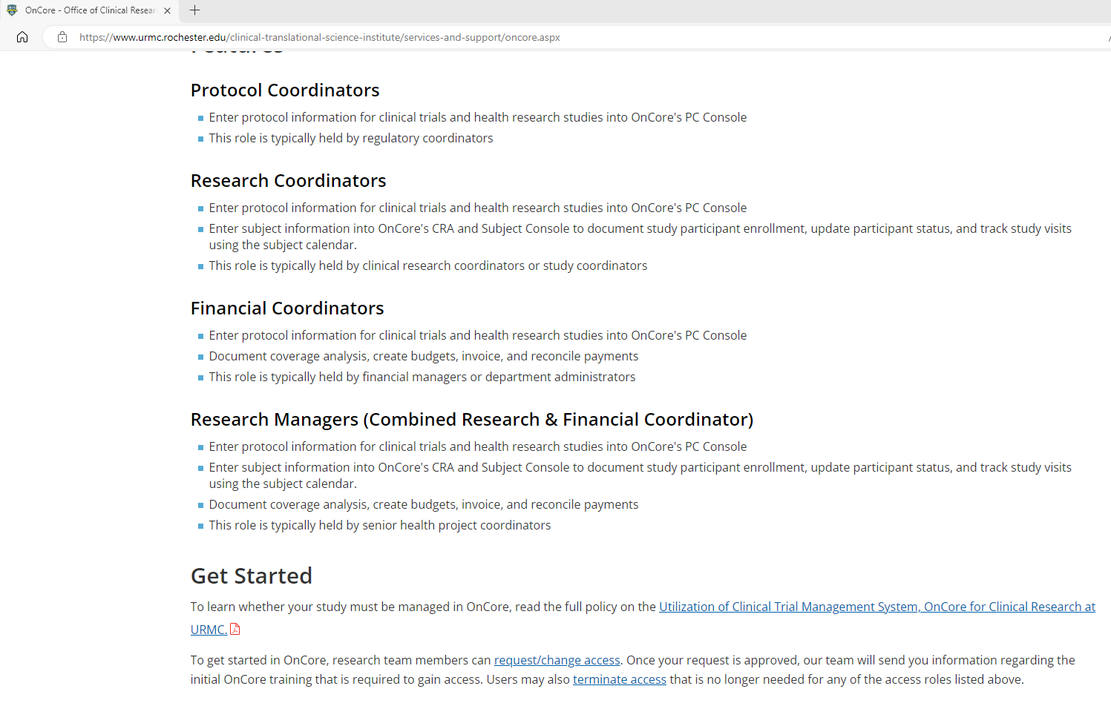


Where to find more information?
Look for communication:
Faculty@
URMC This Week
Levy Letter
WCI Update
UR CTSI Weekly Update
Research Liaison Email
OCR Exchange

Slide 5

Preparation for Implementation
OnCore Use Survey – March 2024
Departmental/Divisional meetings to gather input and improve communication
  “We Can’t Fix It If We Don’t Know It’s Broken”
OCR Staff additions
Develop New Training Opportunities
Health Check (review) of current OnCore practices and integrations

Slide 6
Implementation Plan
OnCore Re-RollOut will be split into 3 phases:
4Q 2024
1Q 2025
2Q 2025
Preparation and Clean Up
Group Re-fresher training
1:1 Support
Communication
Feedback Gathering
Tidying up OnCore
Series of group refresher courses offered both virtually and in-person
Work with individual research teams on new protocols to ensure team is confident and prepared for OnCore use

Slide 7
Desired Outcomes
Dashboards and Reporting: Develop reports and dashboards to provide clear and comprehensive information to research team leadership and university leadership.
Provide metrics to allow research teams to make data-driven decisions regarding their portfolio and the best use of their resources
Target and track enrollment for all trials
Increase clinical trial cost recovery
Begin cost recovery for Advarra applications through $2500 CTMS start up fee for industry-only studies

Slide 8
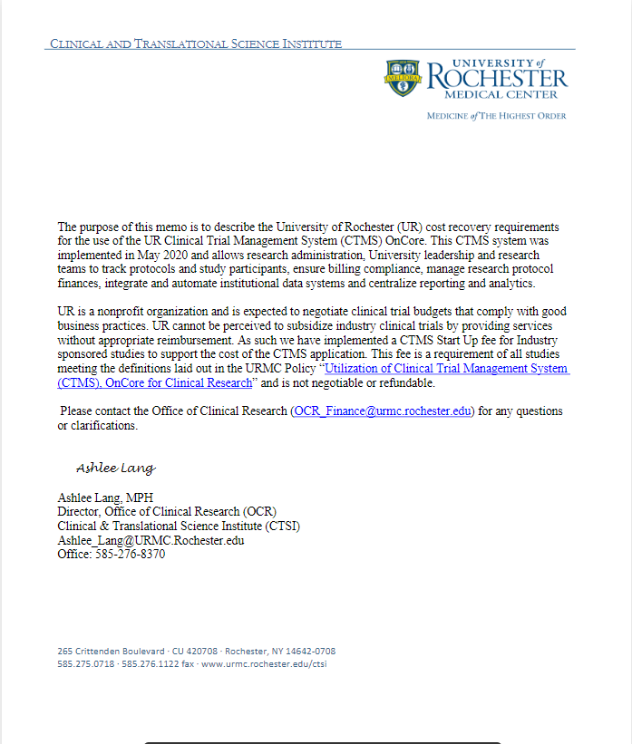
NEW CTMS Start up Fee
1) For departments using OCR for budgeting: OCR has began charging all new industry-sponsored trials a one-time $2500 CTMS Start Up Fee (including indirects/OH)
For departments handling their own budgeting: the CTMS fee plus indirects should be negotiated in your budget as a pass-through to the sponsor. OCR has provided a memo for use when communicating with the sponsor.
The CTMS Start Up Fee will be billed upon calendar completion through CTSI in the same manner as the other OCR Finance services.
(6) OCR Shared Information for Departments | Powered by Box

