Slide 1
Research Security Standards
September 24, 2024

Slide 2
Research Security Program Background
NSPM-33 directive first issued January 2021
Implementation guidance issued by OSTP January 2022 on “Research Security Programs”
Draft research security program requirements issued by OSTP February 2023
Subject to various criticism (lack of risk-based approach, lack of consistent terms, lack of clarity in some areas)
Guidelines for Research Security Programs at Covered Institutions (July 9, 2024)

Slide 3
Research Security Program Updated Standardized Requirements
Cybersecurity
Foreign Travel Security
Research Security Training
Export Control Training
Implement cybersecurity program consistent with a NIST resource
NIST resource is not yet published
Training for covered individuals
Travel reporting program for covered individuals if required by federal award
Training for covered individuals
Option to use NSF training modules, other options, or combination
Training for covered individuals who research using export-controlled technologies
Options available

Slide 4
Implementation Timing
Agencies to submit plans to OSTP within 6 months of July 9, 2024.
Plans will be effective “no later” than six months after plan submission
Agencies to ensure institutions adequate time, but “not more than 18 months” of effective date of their plans to implement requirements

Slide 5
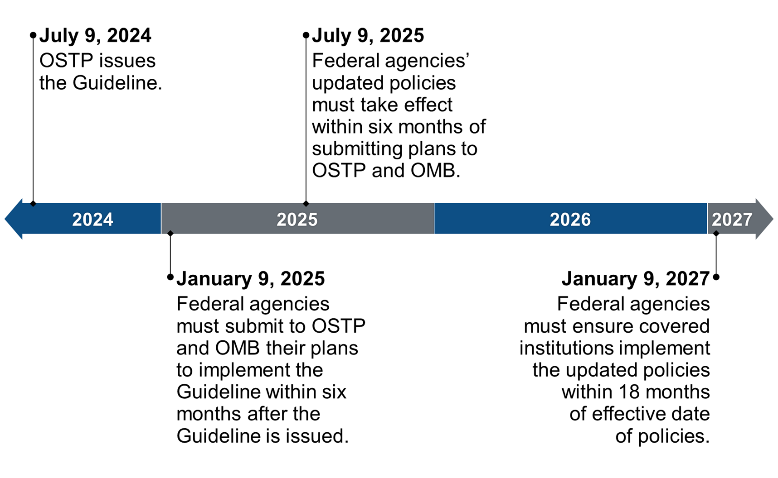

Slide 6
“Covered Individual”
Covered Individual means an individual who (A) contributes in a substantive, meaningful way to the scientific development or execution of a research and development project proposed to be carried out with a research and development award from a Federal research agency; and (B) is designated as a covered individual by the Federal research agency concerned

Slide 7
Key Questions
Covered Individuals: How broadly will this be implemented / interpreted by agencies? Students included?
Foreign Travel: How will this be communication in an award? Will this become standard term? Will personal travel require reporting? Personal travel with incidental work?
Cybersecurity: How broad or specific will requirements be?

Slide 8
Additional Information
For updates, review the Vice President for Research website

