Slide 1
OVPR Updates | InfoReady
September 2025 CLASP Meeting

Slide 2
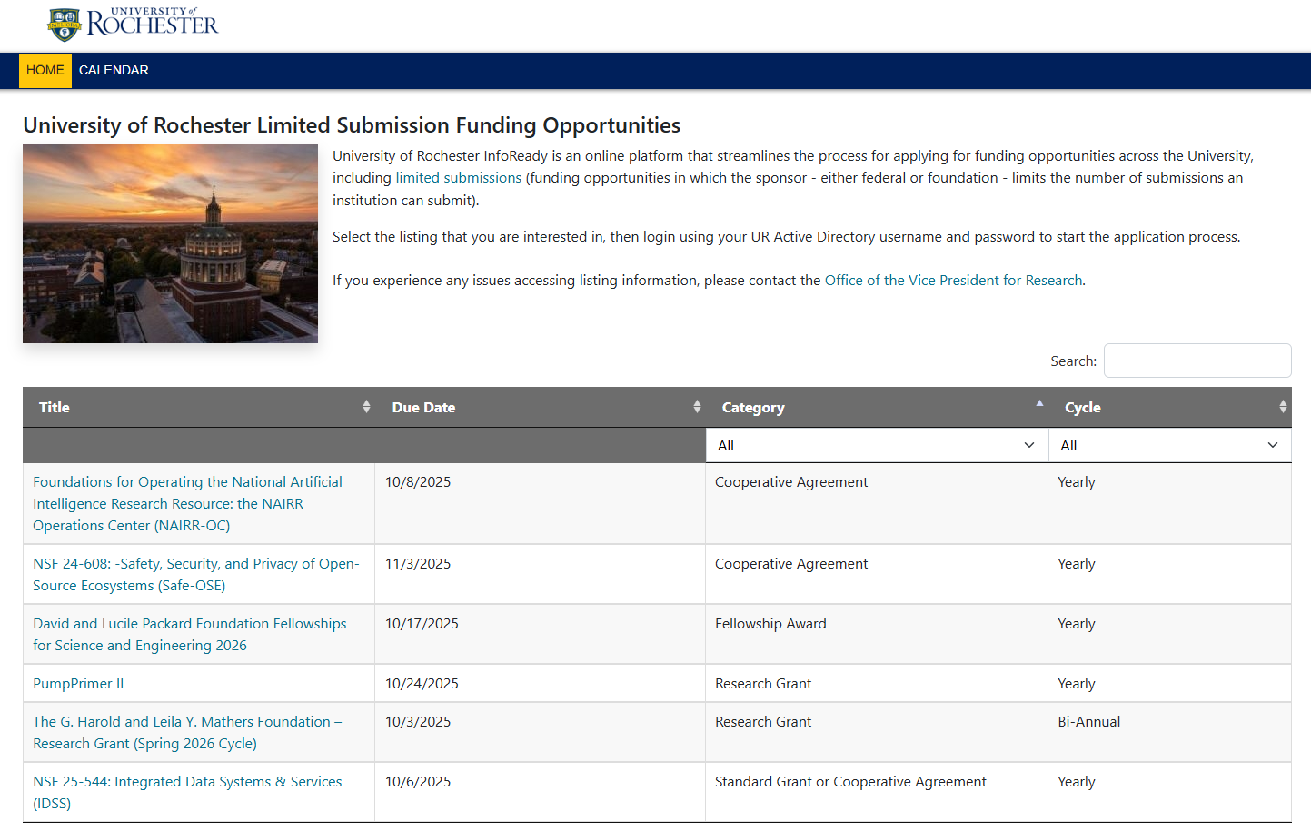
InfoReady
Web-based platform
Manages internal funding competitions (URAs, Furth Fund) and limited submissions
Streamlines submission, review, and approval of proposals
Online application intake (no more email)
Automated routing and notifications
Ability to assign a proxy

Slide 3
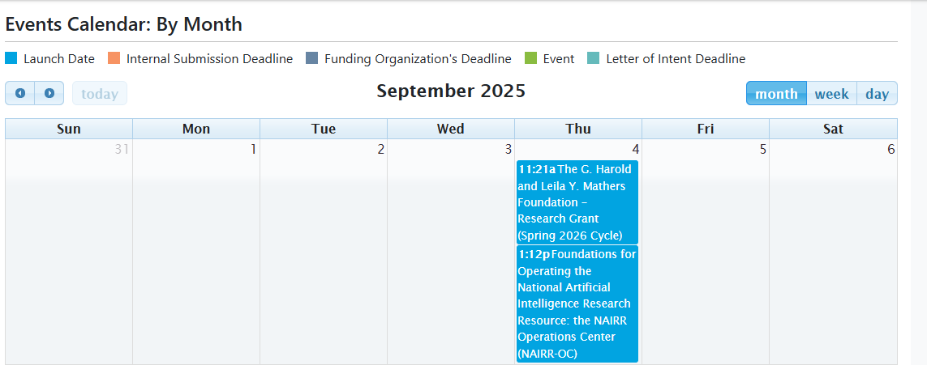
Browse the homepage or calendar for open opportunities (no login required)

Slide 4
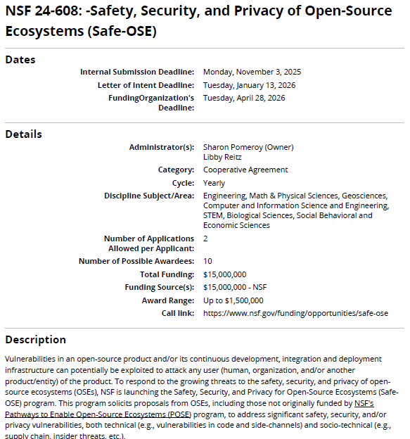
View funding opportunity information and requirements

Slide 5
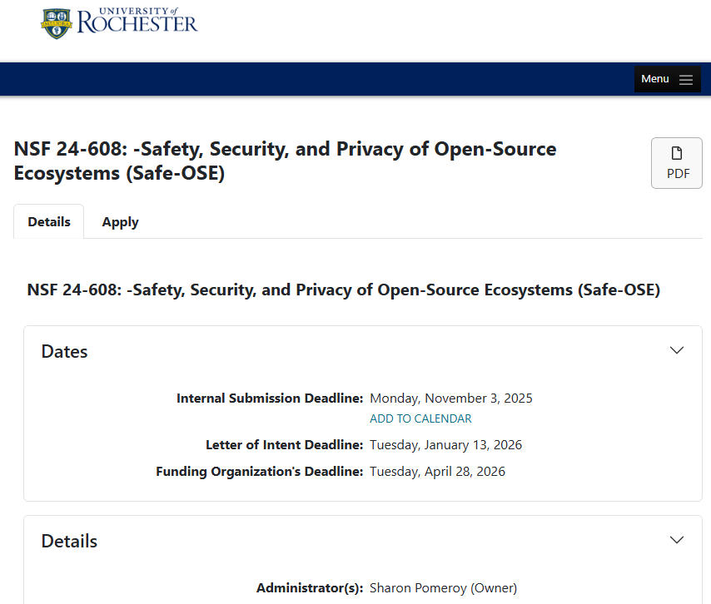
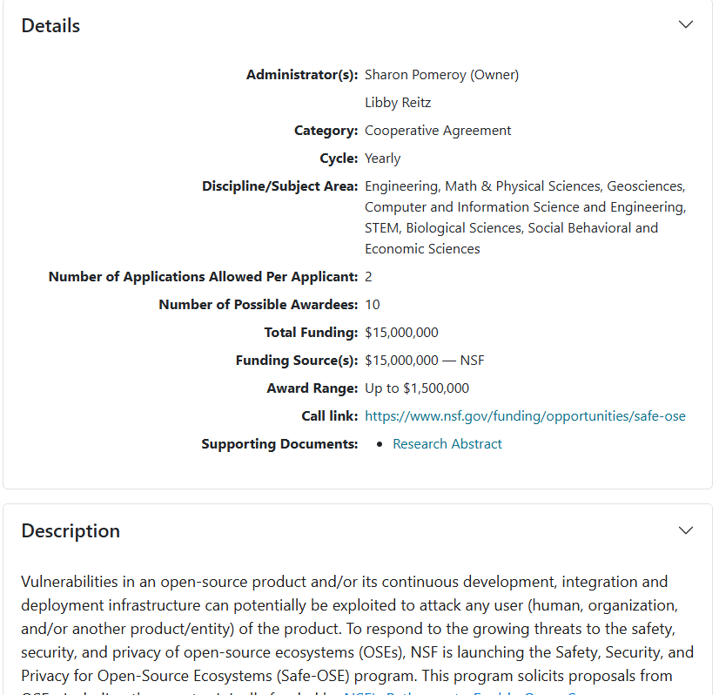
View funding opportunity information and requirements

Slide 6
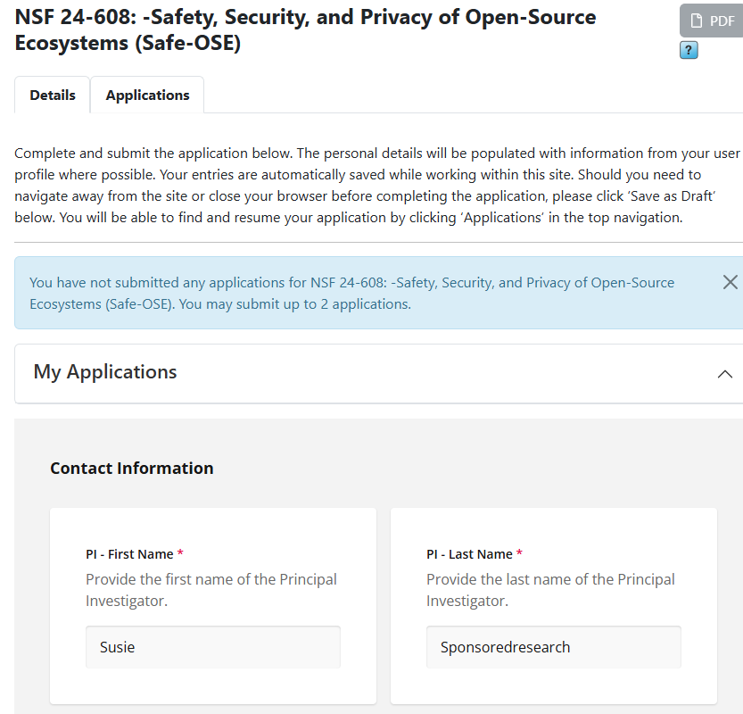
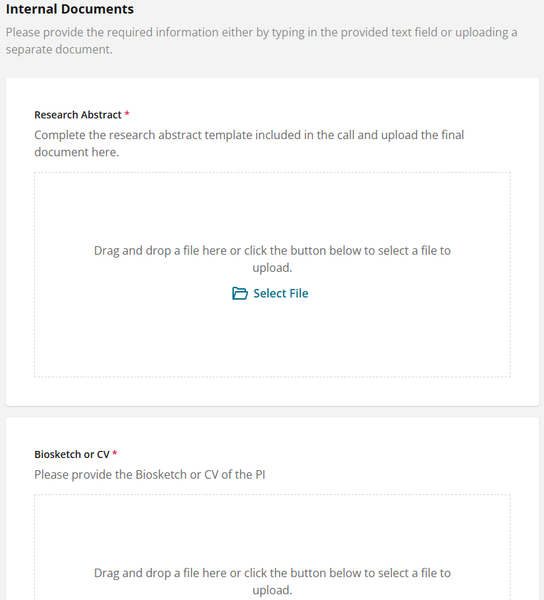
Apply for open funding opportunities:
Complete online form and upload required documentation
Preview final application prior to submission
Ability to save as a draft and come back to

Slide 7
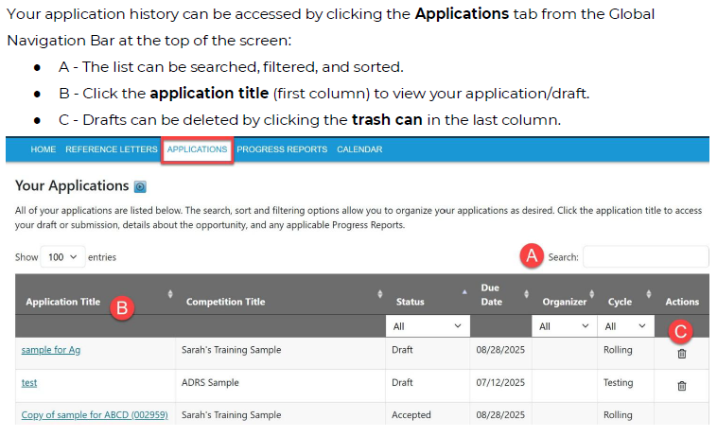

Application history available!
Designate a Proxy

Slide 8
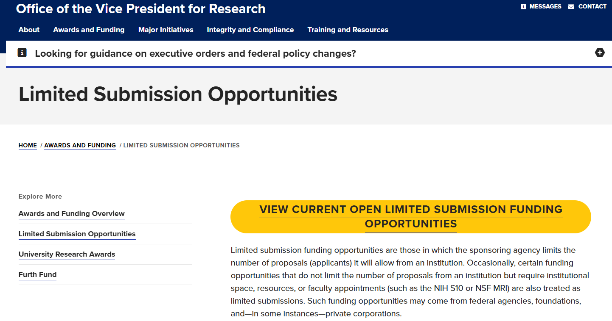


Access InfoReady through OVPR website
Or through NOFO via VPR Funding Opps Listserv

Slide 9
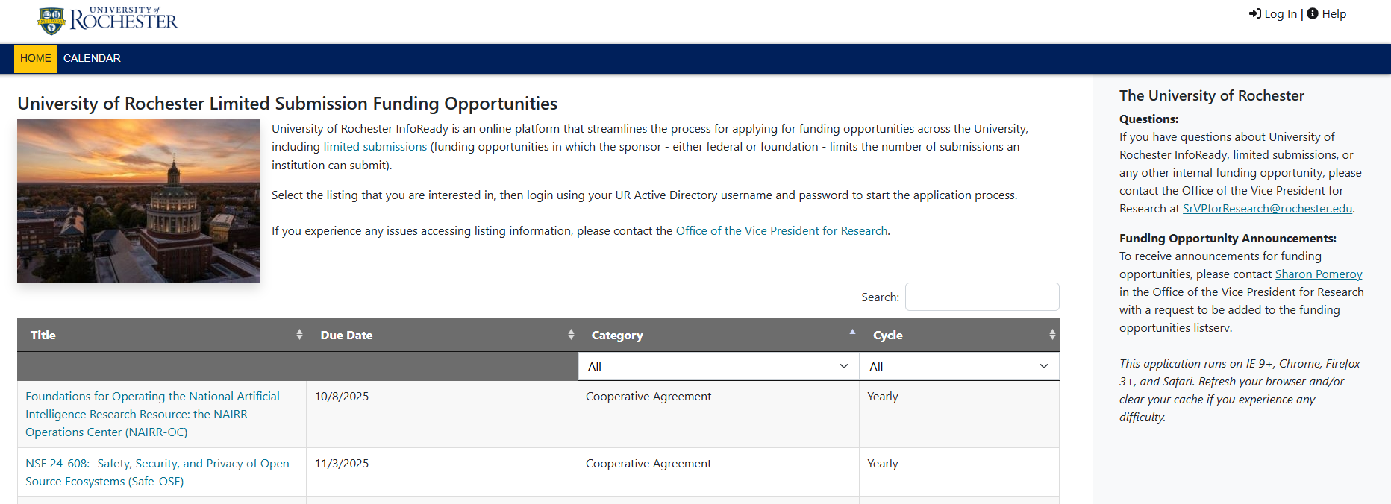
Once on the University of Rochester InfoReady homepage, click Log In at the top right-hand corner of the screen

Slide 10
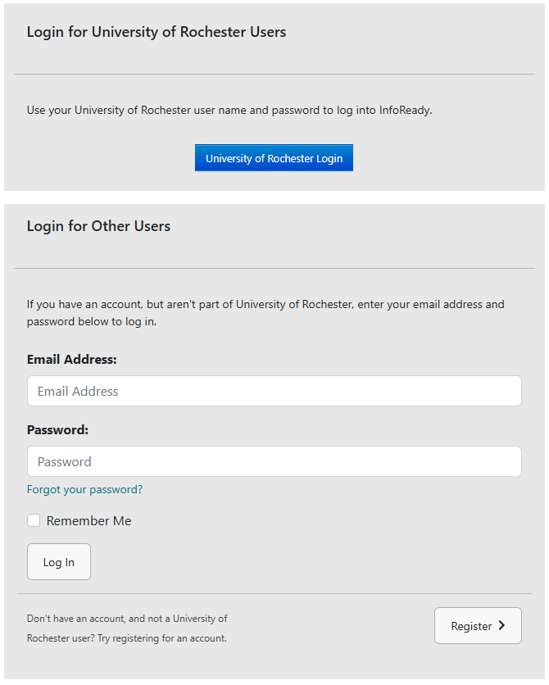
Login through SSO
Brand new users register here

