Slide 1
Hazard Assessment Tool & Training Indicator
Developed by Environmental Health & Safety (EH&S)
1

Slide 2
What is this?
EH&S developed a tool within MyPath to assist University employees and supervisors in determining their required EH&S safety training.
It is based on the safety risks an employee might be subject to in their work environment, such as hazardous materials, processes and equipment.
A PDF document will be generated at the end listing the required safety training curriculum tailored to their job hazards.
2

Slide 3
What do I need to do?
New employees should complete the assessment WITH their supervisor to help them understand the hazards in their job. This will help the supervisor and employee discuss what their job entails and what hazards they are potentially exposed to and how to stay safe on the job.
Current employees should complete the assessment on their own during normal work hours and then share the output with their supervisor.
3

Slide 4
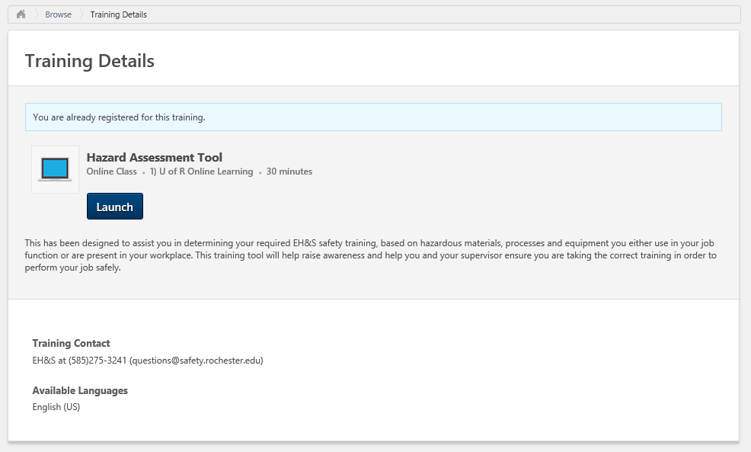
Where is the tool located?
Located in MyPath
The tool is entitled “Hazard Assessment Tool”.
4

Slide 5
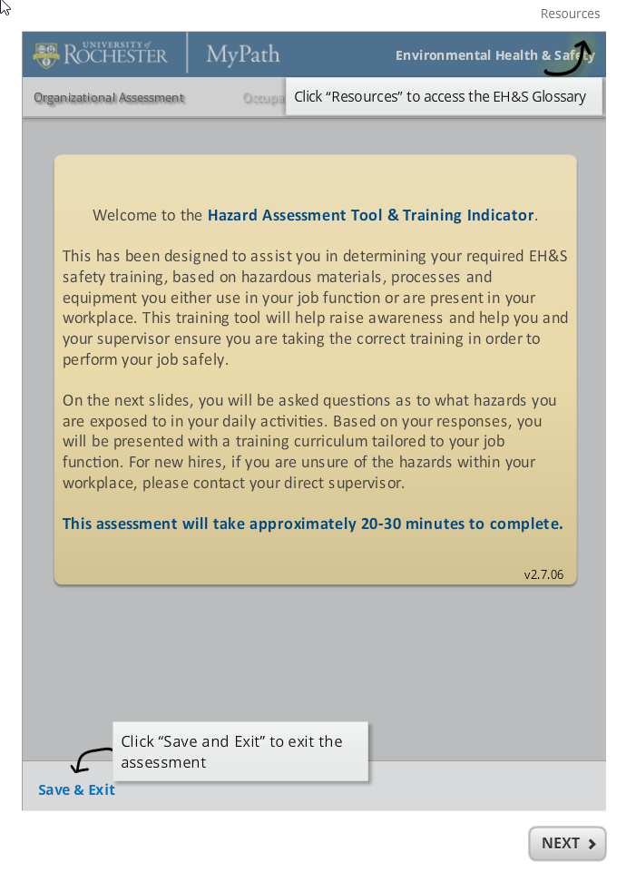
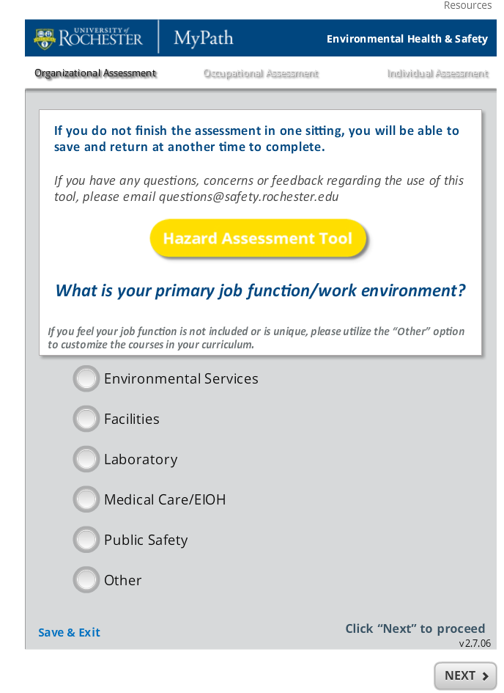
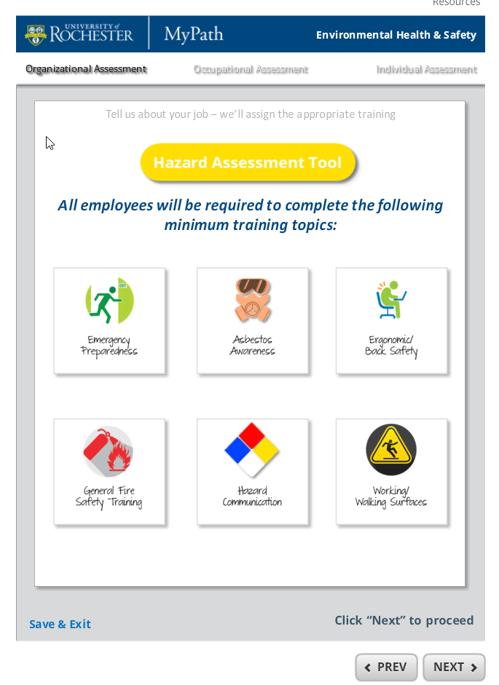
Introductory pages
5

Slide 6
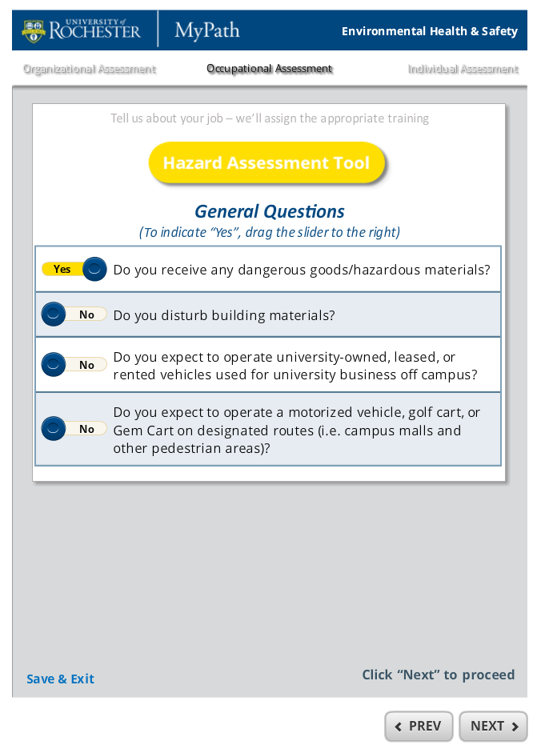
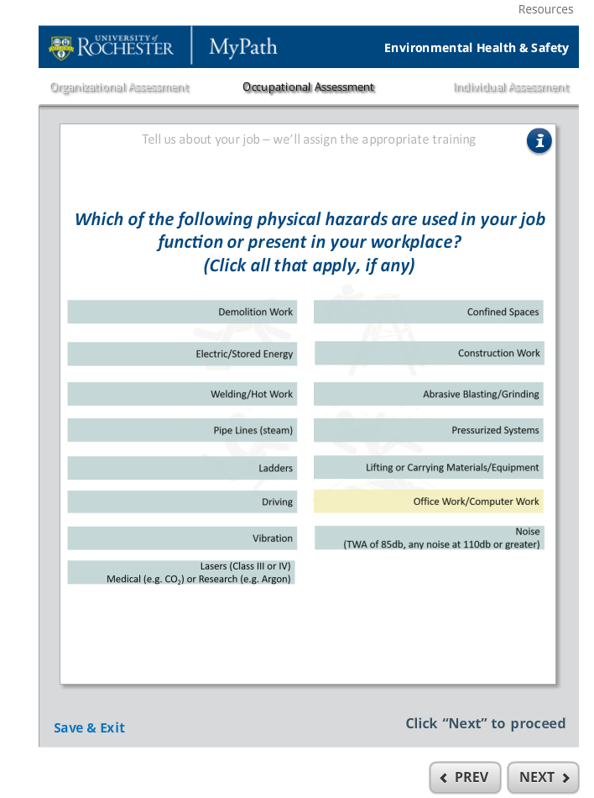
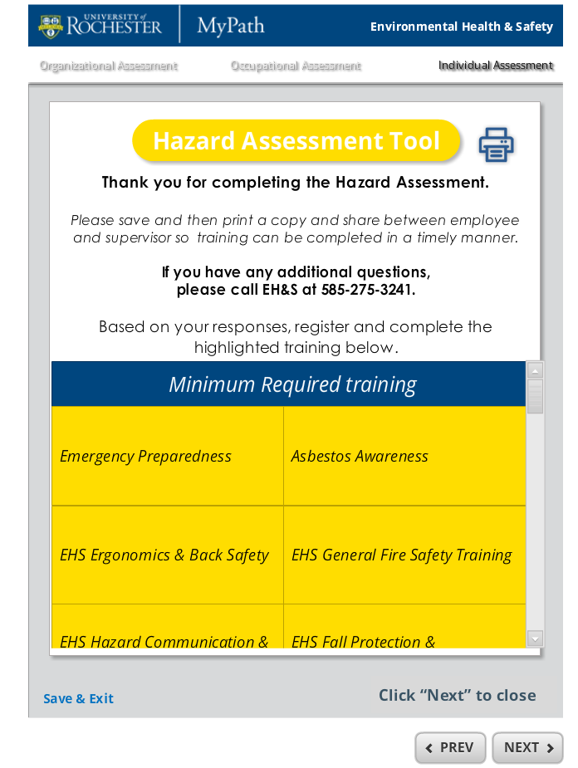
Sample pages
6

Slide 7
What else do I need to know?
Assessment will take approximately 20 minutes to complete.
This is not mandatory but highly recommended.
General questions – 275-3241
EH&S Webpage: https://www.safety.rochester.edu/training/HazAssessmentTool.html
Listing of FAQs - https://www.safety.rochester.edu/training/FAQs.pdf
Thank you!
7

