Slide 1

Office of University Audit Update
On-Demand Training Session
Salim Alani, Executive Director, Office of University Audit
Chris Butler, Senior Audit Manager, Office of University Audit

Slide 2
Agenda
  Three Lines of Defense
  Policy Awareness Related to Common Internal Audit Findings and Areas of Audit Focus

Slide 3
Key Takeaways
Departments, along with Central and Company Finance Offices, play a critical role in risk management.
Risk management includes all risks, not just financial.
Policy awareness is essential for effective risk management, particularly as we maintain operations during the COVID-19 crisis.
Policy awareness does not require an “expertise”, but means being familiar enough to identify potential issues and to alert others as appropriate

Slide 4
  Three Lines of Defense

Slide 5
Three Lines of Defense Model

Slide 6
Three Lines of Defense and Risk Management
Includes all types of risk:
Financial
Reputational
Strategic
Regulatory
Operational

Slide 7

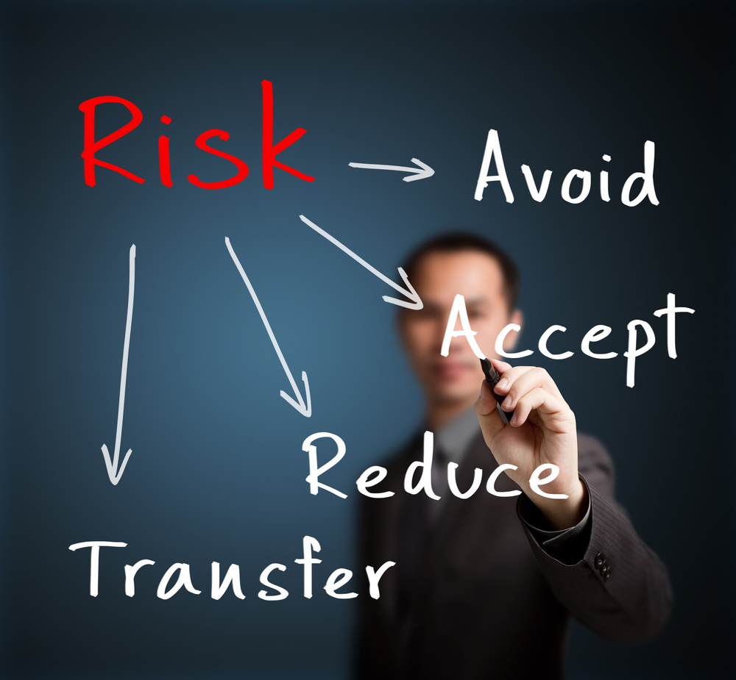

Three Lines of Defense and Risk Management
How are Risks Managed?
Notes:
How are Risks Managed?
Risk Avoidance – Not always an option
Risk Acceptance – Often means doing nothing or very little
Risk Transfer – Achieved through insurance, for example
Risk Reduction – INTERNAL CONTROLS!!!!!!!

Slide 8
Three Lines of Defense and Risk Management
How are Risks Managed?
Notes:
How are Risks Managed?
Risk Avoidance – Not always an option
Risk Acceptance – Often means doing nothing or very little
Risk Transfer – Achieved through insurance, for example
Risk Reduction – INTERNAL CONTROLS!!!!!!!

Slide 9

Three Lines of Defense and Risk Management
I LOVE POLICIES AND PROCEDURES!
POLICIES AND PROCEDURES ARE MY FAVORITE!

Slide 10
  Policy Awareness Related to Common Internal Audit Findings and Areas of Audit Focus

Slide 11
Policy Awareness
Data Classification, HIPAA, and Payment Card Industry (PCI) Policies
Applies to a wide range of regulatory requirements
Protected Health Information (PHI)
Personally Identifiable Information (PII)
Student information
Research data
Credit card handling / use
These policies are essential for protecting against
Data breach
Regulatory noncompliance / fines and penalties
Reputational damage

Slide 12
Policy Awareness
Signature Authorization Policy
Provides instruction for:
Which employees are authorized to sign contracts
  University/Medical Center Officers and Deans
  Chair/Unit Heads/Faculty do not have authority
Internal Consultation and/or Legal Counsel reviews
Written delegations of authority
Applies to all contracts between the University and Others (employees, vendors, other entities, etc.)
Supplier Invoice Requests (SIRs) can be used to identify non-compliance

Slide 13
Policy Awareness
Computer Equipment Purchases
Best Practices:
Purchase through UR Tech Store
If purchased through third party, notify your central IT organization
Avoid purchasing through the employee expense reimbursement process
Essential for ensuring devices are imaged properly, secured (i.e., encrypted) and capitalized / tracked

Slide 14
Policy Awareness
Taxable Payments to Individuals Policy
Requires:
IRS and State reporting of income
  Honoraria, Consulting/Contractor & Subject Fees
  Monetary prizes, awards & gift cards/certificates
  Gifts (in excess of nominal value)
Additional forms and processing by Payroll and AP
Policy awareness is key to identify taxable payments before they are paid

Slide 15
Policy Web Links and Contacts
http://sites.mc.rochester.edu/departments/hipaa/
HIPAA contact information included on web page
https://www.rochester.edu/adminfinance/treasury/pdf/Payment-Card-Policy.pdf
PCI / Treasury contact information included in Policy
https://tech.rochester.edu/policies/data-security-classification-policy/
IT Security contact information included on web page
https://www.rochester.edu/adminfinance/finance/policy-on-contracts-signatures-and-financial-authority/
Office of Counsel contact information included in Policy
https://www.rochester.edu/adminfinance/finance/employee-reimbursements/employee-reimbursements-policies-and-procedures/
Accounts Payable contact information included on web page
https://tech.rochester.edu/services/ur-tech-store/
Tech Store contact information included on web page
https://www.rochester.edu/adminfinance/finance/taxable-payments-to-individuals/
Accounts Payable contact information included on web page

Slide 16
Thank you!

