Slide 1
Research Security Program Implications
CLASP Monthly Meeting
January 31, 2023

Slide 2
Research Security Programs
NSPM-33 Purpose: Provide clarity regarding research security program requirements, how research organizations will be expected to satisfy the requirements, and how agencies will contribute to program content development.
Security program content (research organizations over $50M in federal funding for each of the previous 2 fiscal years)
Cybersecurity
Foreign travel security
Research security training
Export control training, as appropriate

Slide 3
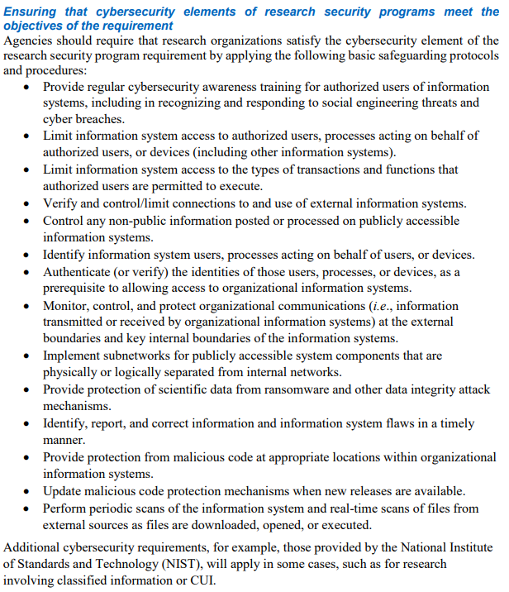
Research Security Programs: Cybersecurity

Slide 4
Foreign Travel Security
Research organization must maintain international travel policies including:
Organizational record of covered international training by faculty and staff (optional disclosure/authorization requirement in advance of training)
Security briefings
Electronic device security (smartphones, laptops)
Pre-registration requirements
Notes:
Transformational for a lot of organizations

Slide 5
Research Security & Export Controls
Need research security point of contact (with contact info)
Research organizations must provide training to relevant personnel on:
Research security threat awareness and identification
Consider incorporating research security into Responsible Conduct of Research (RCR) training
Conduct tailored training in the event of a security incident
Export control training (as appropriate)
Train relevant personnel on requirements and processes for reviewing foreign sponsors, collaborators, and partnerships
Ensuring compliance with export control requirements and restricted parties lists
Notes:
Point of operational training or didactic?

Slide 6
Conclusion and Key Messages
NSPM-33 compliance will require expanded effort and resources (and communications)
Overall risk-based approach will be critical (nondiscriminatory)
Link training wherever possible (faculty, staff, students)
Mandatory training for “covered” individuals
Planning timeline? (Winter/Spring 2024)

Slide 7
Next Steps
OSTP/White House to issue additional guidance
Working Group will be established (Office of Research, IT, Global, ORPA, Finance, Deans’ reps)
Develop roadmap and needs assessment
Outreach to peers, consultants, university associations (AAU, COGR, FDP)
Initial broad communication
Then to faculty (webinar by senior leaders) and research administrators (CLASP monthly meeting) when additional guidance is issued

