Slide 1

NIH Common Forms FAQs
January 27, 2026
CLASP Monthly Meeting
Emily Billotti

Slide 2






Helpful External Links
NOT-OD-26-018 – NIH announces Common Forms Implementation
Frequently Asked Questions
Biographical Sketch Common Form in NIH Forms Directory
NIH Biographical Sketch Supplement in NIH Forms Directory
Current and Pending (Other) Support (CPOS) Common Form in NIH Forms Directory
SciENcv Helpdesk (technical questions): nlmsciencv@mail.nih.gov OPERA Common Forms Email (policy questions): nihosbiosketch@nih.gov

Slide 3
UR Resources Available
Library Support:
UR Libraries Data Services
Medical Center Support Request
Or
Linda Hasman: linda_hasman@urmc.rochester.edu
Research Security at the University of Rochester
Colleagues who submit to NSF

Slide 4
FAQ Outline
Appointment disclosure guidelines
Subaward support on CPOS
Clinical trial cost estimate on CPOS
Faculty requests to ORPA to review forms
Credential/Account trouble – SciENcv/MyNcbi/eRA Commons/ORCID
Contributions to Science references
“Current” flag in biosketch positions
Disclaimer: this is an evolving topic - all answers reflect our current understanding as of today and are subject to change, some questions may need further research

Slide 5
Appointment disclosure guidelines – NIH FAQ
Professional appointments: formal appointments outside of one's primary place of employment that are due to one's professional expertise and generally temporary in nature, including but not limited to:
Editorial service for journals
Serving on municipal, state, or federal advisory boards
Holding offices in professional societies
Report on all professional appointments that have been active in the last three years
Older professional appointments are not required, but may be included if relevant to the specific application
Other types of appointments that are typically with one's primary place of employment (i.e., academic and institutional appointments), must be listed for a period that covers the duration of one's professional career
All professional appointments at a primary place of employment, not just at UR

Slide 6
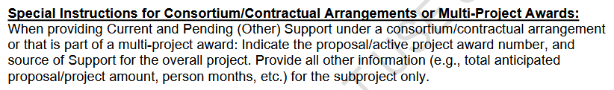
Subaward/Multi-Project Support on CPOS
Overall project:
Proposal/active project award number
Source of Support
All other information for the faculty member’s piece only

Slide 7
Clinical trial cost estimate on CPOS
Use enrollment target and budget to estimate total support

Slide 8
Faculty requests to ORPA to review forms
ORPA is available to receive and field specific questions that come up during form preparation, but not to review completed forms prior to application routing
ORPA will review included attachments for formatting during application review
Reminder - faculty are ultimately responsible for all attachments’ compliance with instructions within applications

Slide 9
Credential/Account Linking Issues
ORCID ID needs to be linked with both eRA Commons and SciENcv, by the faculty member (cannot be delegated)
Pick ONE login method and stick with it forever
Documents in SciENcv are linked to the login method
Possibility that the faculty member has a previous MyNCBI account already linked to ORCID ID
SciENcv Helpdesk: nlmsciencv@mail.nih.gov

Slide 10
Contributions to Science references
Question in with OPERA regarding referencing the 5 closely related products in the Contributions to Science
Still pending response
Colleagues at other institutions have heard affirmatively from NIH OPERA that only the 5 other significant products can be referred to in the Contributions to Science
References to closely related products should be in the Personal Statement, per external colleagues.

Slide 11
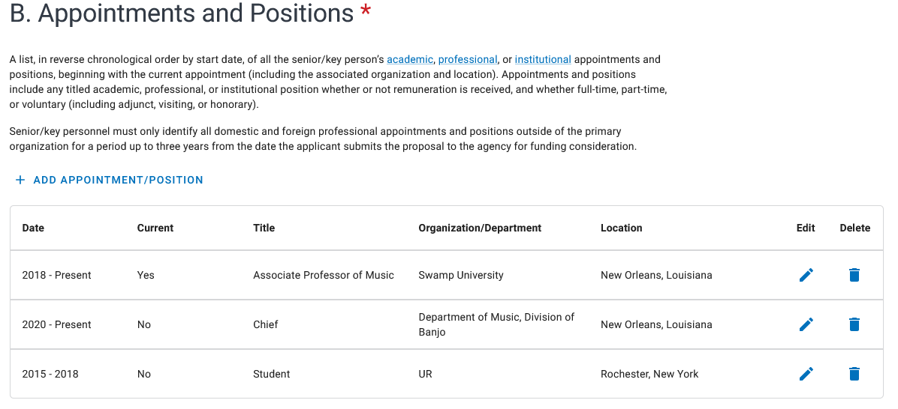
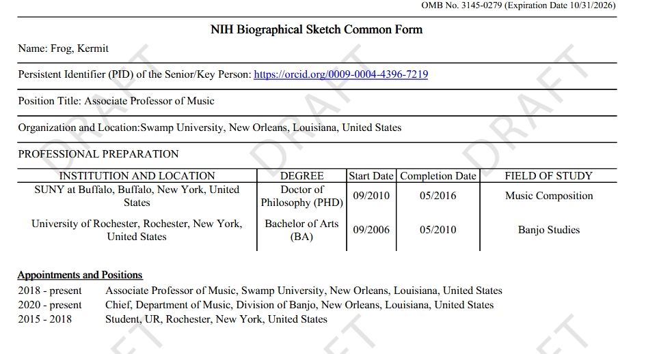

Current flag in Biosketch positions
Form says “current,” but you can only select one position. Form entry vs. downloaded form discrepancy.

Slide 12
Biosketch (and Biosketch Supplement)
Prior NIH Biosketch Format
Header – name, eRA Commons Username, Position Title
Education/Training Block
A. Personal Statement
Allowed citations - up to 4 products
Allowed ongoing and recently completed projects
B. Positions, Scientific Appointments, and Honors
C. Contribution to Science
Allowed citations - up to 4 citations per contribution
Common Form Biosketch
Identifying Information – Name, ORCID ID, Position Title
Organization and Location
Professional Preparation
Appointments and Positions
All at URochester primary employment appointments
Last three years of external professional appointments
Products
Up to 5 closely related
Up to 5 other significant
Certification
NIH Biosketch Supplement
Personal Statement – 3,500 characters
Honors – 15 entries maximum
Contributions to Science – reference products, but do not cite directly, 2,000 characters for each contribution
Notes:
-

Slide 13
Significant Changes to Biosketch
Personal Statement, Honors, Contributions to Science moved to the supplement
No place to address current or prior funded projects related to the work proposed
Incorrect: current and prior funding over the past three years may be addressed in the personal statement.
Products:
Changed significantly in biosketch
Citations no longer allowed in Contributions to Science – includes reference via PMCID

Slide 14
Current and Pending (Other) Support
Old NIH Format
Current/Pending
Title
Major Goals
Status of Support
Project Number
Name of PD/PI
Source of Support
Primary Place of Performance
Start and End Dates
Total Award Amount
Person Months
In-Kind
Overlap
Signature
Common Form
Proposals and Active Projects
Title
Status of Support
Project Number – overall project
Source of Support – overall project
Primary Place of Performance
Start Date
End Date
Total Anticipated Amount
Person Months
Overall Objectives
Statement of Potential Overlap
In-Kind
Certification

Slide 15
REMINDER
Senior/key persons must certify that the information is current, accurate and complete.
Notes:
A final reminder from ORPA and the Research Security Officer. The certifications required as part of the Common Forms are personal assurances by the individual named on the form that the information included is current, accurate, and complete. All three of these elements are crucial to get correct.
If information is found to not be current, accurate, or complete, the senior/key person who certified can be subject to prosecution under several federal statutes, including the False Claims Act.
Individuals should understand federal agencies have the ability to verify whether the information in the required disclosures is current, accurate, and complete by utilizing publicly available information and other information available to the agencies, including publicly posted CVs, affiliations listed in publications, etc.

Slide 16


Questions?

