Slide 1
OVPR – Funding Updates
University Research Awards – deadline this Friday, 1/30/26
Open limited submission opportunities
Title | Discipline / Focus | Internal Deadline
Sinsheimer Fund 2026 Scholar Award | Prevention or cure of disease | 1/30/2026
St. Baldrick’s Foundation Infrastructure Grant | Pediatric cancer research | 2/06/2026
NEA Research Labs | Arts and health, arts and the economy, arts and education | 2/13/2026
Susan G. Komen Foundation Research Grant | Breast cancer | 2/20/2026
NIH Shared Instrumentation Grant (SIG) Program (S10) | Instrumentation | 3/16/2026
NIH Seed Instrument Support (SIS) Program | Biomedical research instrumentation | 3/16/2026

Slide 2
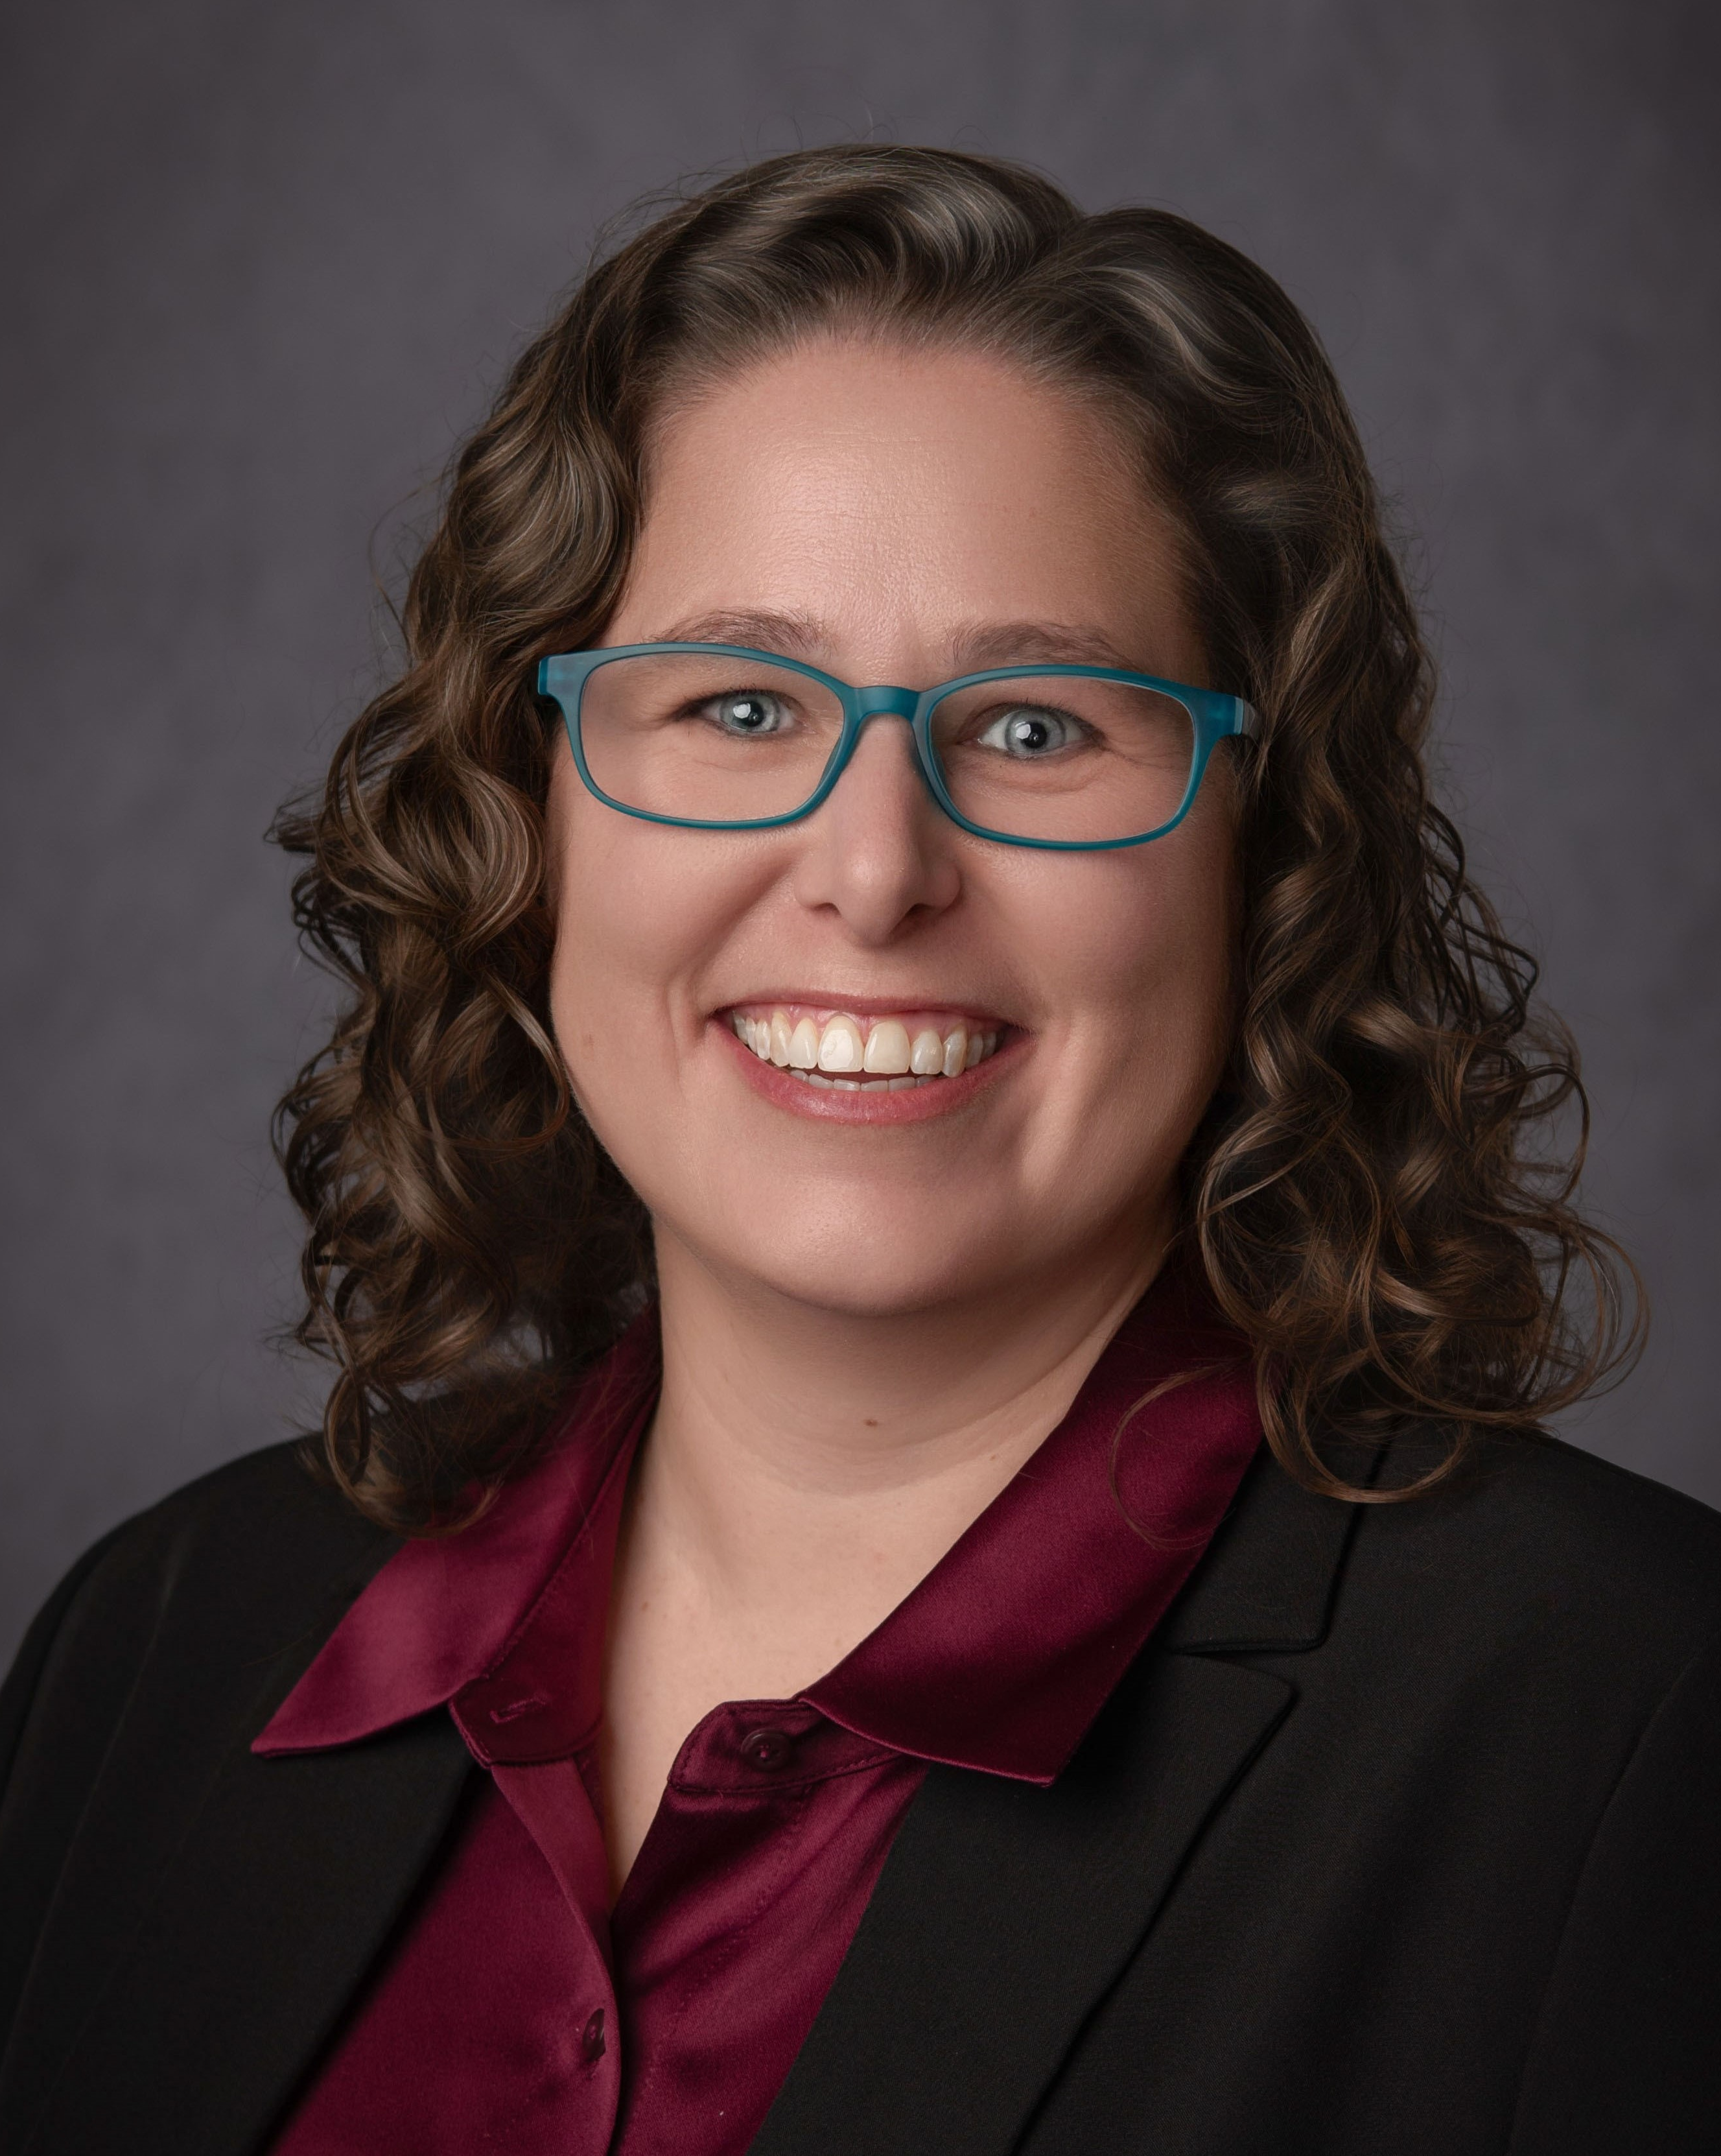
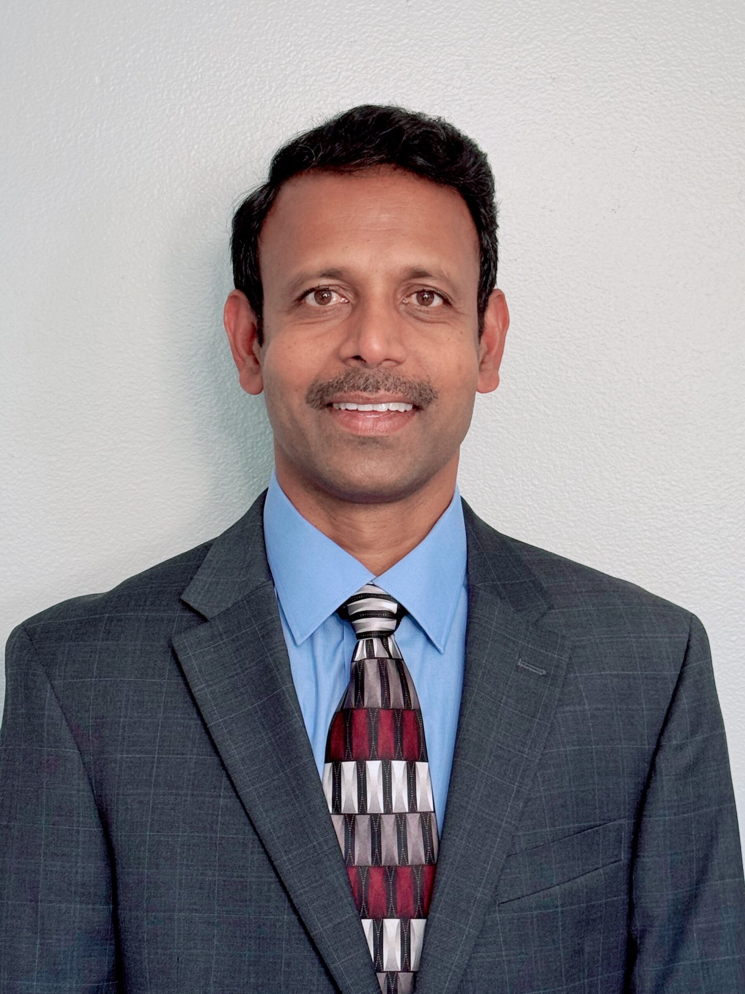
OVPR – Leadership Updates
Sarah Mumford
Associate Vice President, Human Subject Protection
Pradeep Dumpala
Director, Animal Resource

