Slide 1

Sponsored Research Internal Controls, Compliance Reviews, Updates/Tips
CLASP PRESENTATION – February 24, 2026
Office of University Audit (OUA):
Christopher W. Butler, Chief Audit Executive
Shirley Brown, Audit Manager
Kimberly Davis, Sr. Internal Auditor

Slide 2
Sponsored Program Award Management – Roles & Responsibilities; Partners
ORPA (Office of Research and Project Administration) – includes pre-award activities, identification of funding opportunities, grant and contract operations, training, and research outreach.
Faculty Members/Investigators
ORACS (Office of Research Accounting and Costing Standards) - Post-award activities:
Prepares and submits financial reports, Cash management, works with departments for the award close-out process.
Global Engagement, Legal Counsel, ORISE, Deans’ Offices, Accounts Payable, Purchasing, Administration & Finance, etc.
myURHR Administrators Best Practice Workgroup
Department / Research Administrator: Awareness of issues – Share in policy development – Proactively maintain up-to-date knowledge – Inform faculty of rules and regulations – “Gate keeper”
2

Slide 3
Sponsored Research - Types of OUA Reviews
Horizontal Audits - Reviews a key risk area across multiple departments/areas (e.g. Effort Reporting Policy Compliance)
Full Scope Departmental Audits - Reviews various key risk areas within a specific department/area (e.g. Direct Costs, Service Centers, Sub-Awards, etc.)
Risk based methodology used to select departments to review based on:
Funded sponsored research programs
Clinical Trials
Audit history
Consultation & Outreach
Data Analytics - Reviews system/application transaction data for actionable insights, useful information, outliers, or anomalies
3

Slide 4
Sponsored Research - Expected Key Internal Controls
Internal controls are policies, procedures, and checks implemented by management
to ensure reliable financial reporting, operational efficiency, and compliance with
laws, while safeguarding assets against fraud and errors.
Some important expected key controls that your departments are responsible for ensuring are in place and being followed – next slide:
4

Slide 5
Sponsored Research - Expected Key Internal Controls
Internal Control | UR Policy | Link to document | Comments
1a. Management of Effort Commitments: “Required Internal Control related to Management of Faculty Member/Investigator Effort Commitment” | University’s Effort Reporting Policy: Section D and Appendix | https://www.rochester.edu/orpa/_assets/pdf/policy_EffortReportingPolicy.pdf Supplementary OUA expectations document, “Required Department Internal Controls for Sponsored Research Effort Reporting Policy Compliance: Required Departmental Internal Controls for Sponsored Research Effort Reporting (.pdf) February 2026 | Reviewed by University Audit as part of our Sponsored Research audits Details – next slides
1b Changes to Previously Certified Effort Payroll Accounting Adjustments (PAAs) (Previously “Reallocations”) | University’s Effort Reporting Policy: Section E6 | Supplementary OUA expectations document, “Required Department Internal Controls for Sponsored Research Effort Reporting Policy Compliance: Required Departmental Internal Controls for Sponsored Research Effort Reporting (.pdf) February 2026 | Reviewed by University Audit as part of our Sponsored Research audits -Details – next slides
1c. Certification of Effort | University’s Effort Reporting Policy: Section E |  | ORACS kicks off this process and reviews Details – next slides
2. Fiscal Management (FAO controls) |  | OUA Guidance Document: https://www.rochester.edu/adminfinance/audit/wp-content/uploads/2024/06/FAOManagement-InternalControls-Feb2017.pdf | Reviewed by University Audit as part of our Sponsored Research audits Details – next slides
5

Slide 6
1a. Effort Reporting Policy Compliance - Management of Faculty Member/Investigator Effort
Commitment
Departmental Research Administrator or Financial Administrator responsible for grants must show evidence of a departmental process to actively and routinely monitor and verify effort and payroll allocations of all departmental faculty members / investigators (named on at least one award as key personnel).
Policy Objectives:
Faculty member/investigator is not overcommitted
Effort/payroll allocations are reasonable reflections of the actual work performed
Any variance from committed effort requiring sponsor approval is identified and approved – policy has specifics requirements
Timely changes in payroll allocations are identified and updated (90 days, similar to cost transfers)
Audit Procedure:
OUA will review the Department’s Internal Control Procedures for Monitoring Effort & Payroll Allocations – refer to the next slides.
6

Slide 7
1a. Effort Reporting Policy Compliance - Management of Faculty Member/Investigator Effort
Commitment - Definitions
Effort | Source | Description
Committed | Per the Award | Effort promised in the award (agreed to by the Sponsor and PI); IORA system and also government web sites to obtain this information directly from the awards.
Reported | Per myURHR Workday | Effort/payroll allocation in myURHR (Workday) URHCM0391b Effort Distribution by Fiscal Period used to obtain effort/payroll allocations for selected researchers. (This report includes Salary Over the Cap and Cost Sharing)
Actual Devoted | Per the Researcher Interview | Actual work performed according to the faculty member/investigator or other responsible person with suitable means of verifying effort. All Total University Effort (TUE) - Sponsored Research, proposal writing, teaching, professional development, administrative duties, clinical practice regardless of when (daytime, evening, weekends) or where (on site, at home, traveling) the activities occur. Total University Effort is not based on a specified number of hours (e.g., 40 hours per week). Cannot have greater than 100% effort.
7

Slide 8
1a. Effort Reporting Policy Compliance - Management of Faculty Member/Investigator Effort
Commitment – 3 controls
Department’s Internal Control Procedures for Monitoring Effort & Payroll Allocations
1. Maintain an Effort Monitoring spreadsheet (minimum requirement to update – quarterly)
Excel template from ORPA website (Effort Verification Spreadsheet) or similar spreadsheet for each faculty member/investigator that documents and compares the three components of effort (Committed, Reported, Actual Devoted) and includes activities/responsibilities (research, clinical, teaching, admin, etc.)
A department may need to maintain supporting workbooks to collect and track effort percentages to prepare for this control.
UR Gems is acceptable (assuming actual charges are in agreement)
2. Periodic direct meetings with faculty members/investigators
Necessary in order to effectively complete the analysis (i.e., the analysis must include an exchange of information to verify a researcher’s “Actual Devoted” effort).
3. Document the Effort review with the faculty members/investigators (minimum requirement – quarterly)
Evidence completion of periodic Effort/Payroll verifications with their departmental faculty members/investigators, via signature or electronically, using the Effort Verification Spreadsheet.
Include Faculty Member/Investigator Verification – Acknowledgment or approval from the faculty member/investigator that the Reported Effort (i.e., Workday Payroll Allocations), the Committed Effort, and the Actual Devoted Effort for the time period(s) indicated in the analysis have been reviewed.
8

Slide 9
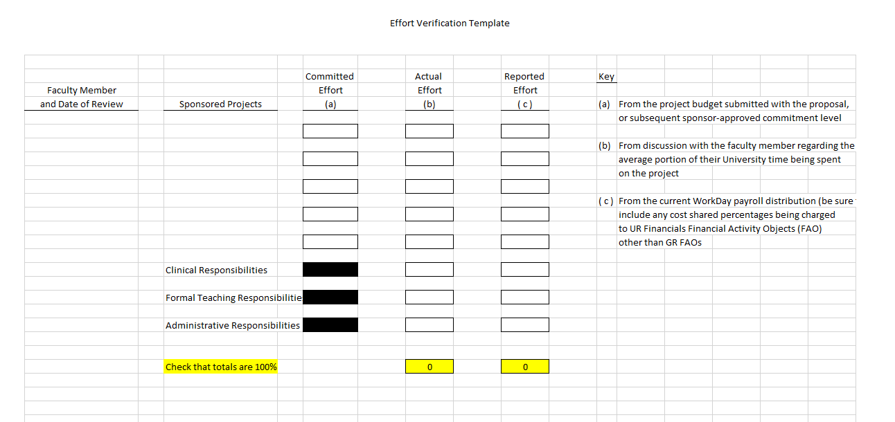
1a. Effort Reporting Policy Compliance - Management of Faculty Member/Investigator Effort
Commitment
Effort Verification Template https://www.rochester.edu/orpa/policies/#sra
9

Slide 10
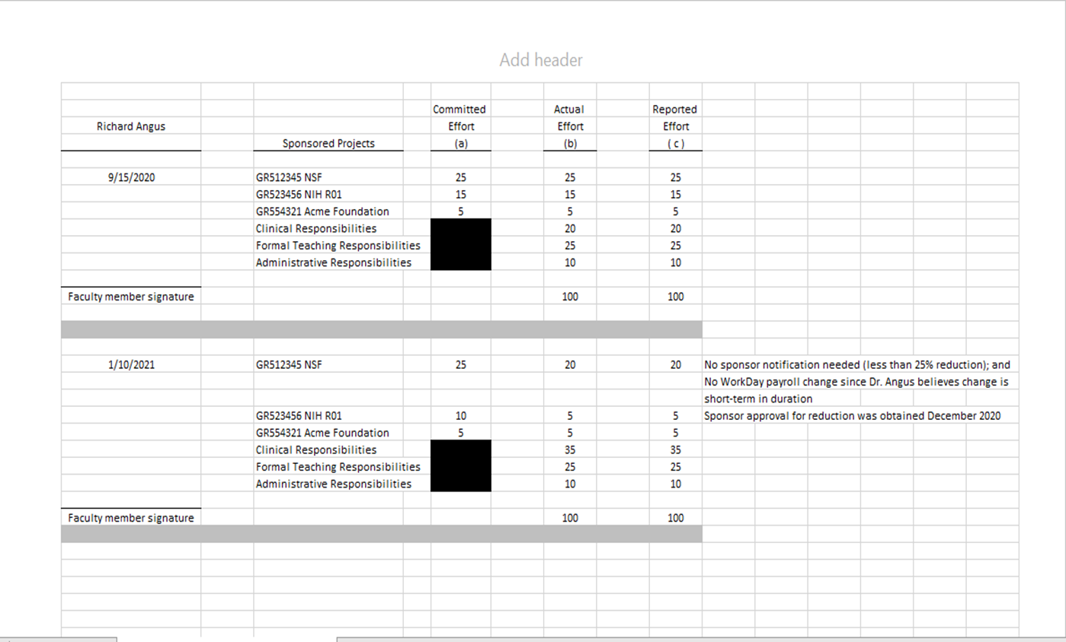
1a. Effort Reporting Policy Compliance - Management of Faculty Member/Investigator Effort
Commitment
Example of how to complete the Effort Verification Template
10

Slide 11
1a. Effort Reporting Policy Compliance - Investigator / Faculty Member Effort Evaluation (Floor Check)
Audit Procedure:
OUA will evaluate the accuracy and compliance of the effort reporting for selected faculty/investigators by conducting live interviews, similar to a Federal auditor's “floor check” interview.
Information is obtained directly from the faculty/investigators and focused on:
Ensuring the three components of effort (Committed, Reported, and Actual devoted effort) are a reasonable reflection of activities and are compliant with the overall effort reporting requirements.
Verifying that faculty participate in the decision-making and understand their salary allocations as they relate to effort reporting compliance.
Cost Sharing, if it exists, with the faculty members/investigators selected as indicated on the Effort Reports.
Faculty members/investigators' conflict of interest through the current conflict of interest disclosure forms and conflict management plans (if applicable).
Department's compliance with the University's Effort Reporting Policy for Extra Compensation to ensure that it is not a part of the Total University Effort. A justification is needed if there is an exception.
11

Slide 12
1b. Effort Reporting Policy Compliance - Changes to Previously Certified Effort - Payroll Accounting
Adjustments (PAAs) (Previously called “Reallocations”)
Payroll Accounting Adjustments:
Policy Objectives:
“Once effort certification has been completed, only in certain circumstances will retroactive subsequent effort/payroll allocation adjustments be permitted”.
If it is necessary to adjust the effort/payroll allocations for a previously certified effort period, submit a Payroll Accounting Adjustment (PAA) using myURHR and select the appropriate reason for the retroactive reallocation from the drop-down menu on the PAA process page.
Reallocations of previously certified effort will require re-certification. Refer to policy for further details.
At close out of a project, a PAA should not be used to retroactively change effort/payroll allocations from a sponsored account that is in deficit, if the underlying effort was truly expended on the project. Rather, the value of effort in excess of the project’s budget is to be a component of the journal entry that transfers the final deficit to an unrestricted account.”
Audit Procedure:
OUA will run URHCM0441 Pay Accounting Adjustments Reports for the most recent 3 months, filtering by days > 90 days.
The number of Days is calculated from the Pay Period Begin Date and the PAA Date (Date Entered).
Workday myURHR has a dropdown box for the following reasons: Administrative Delay, Clerical Error, Funding Updates and Changes, Other Adjustment.
OUA will request more detailed reasons from the Administrator for PAA’s > 90 days. OUA will review for reasonableness and appropriateness.
12

Slide 13
1c. Effort Reporting Policy Compliance - Effort Certification
Workday procedure – Electronic:
Process kicked off and reviewed by ORACS
Currently, not included in OUA reviews.
General Principles:
Effort must be certified for faculty members, staff members and other individuals who have payroll—in whole or in part— charged directly to sponsored projects or who expend committed effort on a sponsored project, even if the effort is cost shared (i.e., no part of the individual’s payroll is charged to the project).
Effort certification will occur at least twice per year based upon predefined time periods:
Persons with academic (9 month) appointments:
January – May Certify in June
June – August (if applicable) Certify in September
September – December Certify in January
Persons with non-academic (12 month) appointments:
January – June Certify in July
July – December Certify in January
By completing the effort certification statement, an individual certifies that the effort/payroll allocation for the respective effort certification period is a reasonable reflection of the actual effort/actual work performed for that time period.
13

Slide 14
Sponsored Research – Full-Scope Audits
Annually, OUA initiates a series of full-scope Sponsored Research Reviews
Purpose:
Provide an objective assessment regarding risk exposures as to adherence to University’s Policies, which is based on regulations set forth by the Uniform Guidance and other external regulations.
Key focus areas:
Effort Reporting Policy Compliance - Department’s Internal Control Procedures for Monitoring Effort & Payroll Allocations (prior slides)
Effort Reporting Policy Compliance - Faculty Member Effort Evaluation (Floor Check), includes Conflict of Interest and Extra Compensation (prior slides)
Effort Reporting Policy Compliance – Payroll Accounting Adjustments (PAA) (prior slides)
4. Fiscal Management (next slides)
Direct Costs and Cost Transfers – (includes T&C and Pcards – next slides) - (UR Policies, NIH 7.9 Allowability of costs, NSF PAPPG Guide, etc. )
6. Cost Sharing
7. Sub-Awards/Sub-Agreements (next slides)
8. Non-Grant (Limited) (includes T&C and Pcards – next slides)
9. Service Centers
10. Clinical Trials Participant Payments (Limited)
14

Slide 15
2. Fiscal Management (FAO controls)
University Audit’s guidance document: https://www.rochester.edu/adminfinance/audit/practices.html
Financial Analysis is an internal control activity or activities that include an overall assessment of the financial position related to a specific FAO. Effective Financial Management must balance the risk associated with each FAO and the resources available to complete the internal control procedures.
FAO Reconciliation is an internal control activity where the transactions within the monthly FAOs are agreed to the respective supporting documentation.
FAO Review is an internal control activity performed by an individual referred to as the “Reviewer”. The Reviewer is performed by a person:
Who is fiscally authorized / responsible for the FAO or their delegate.
For Sponsored Award FAOs, the PI should be performing the review and signing a PI sign-off form.
Should incorporate using the Appendix E Sign-Off Form (page 14) once the appropriate Reviewer is involved. The Sign-off on the ledger review financial package should be the same person as the FAO Reviewer.
The PI Sign-off form for Fiscal Management is a separate required control than discussed in slide 7, #3 for Faculty Member/Investigator Verification – Acknowledgment or approval from the faculty member/investigator that the Reported Effort (i.e., Workday Payroll Allocations), the Committed Effort, and the Actual Devoted Effort for the time period(s) indicated in the analysis have been reviewed.
However, the PI sign-off form for the FAO review could be obtained at the same time as Faculty Member/Investigator Verification if, for example, both are discussed in the same meeting.
15

Slide 16
Sponsored Research – Pcards – Reminders
Audit Procedure: OUA will review:
Charges to Sponsored Projects: All costs incurred on a sponsored project must be reasonable, necessary, allowable and appropriate to the specific account charged.
Monthly credit limits to determine if they are being followed (obtained from Nate Hodge).
A transaction that exceeds the UR’s single purchase limit ($5,000 per purchase) has to be approved by Nate Hodge, Pcard Program Administrator, Procurement.
Check expenditures to Pcard Policy Appendix – 5A Approved and Restricted Use – examples:
Cell Phones/Smartphones:
Any such device used for University business that has wireless capability and connects to the University network must be properly vetted and encrypted through University IT to prevent the possibility of cyberattacks/hacking.
Best Practice Purchase Method: Purchase through UR Tech Store.
Computers:
May include: desktops, laptops, and tablet devices. Any such device used for University business must be properly imaged & encrypted by University IT to prevent the possibility of cyberattacks/hacking.
Such devices must also follow the standard capital asset tag process with Plant Accounting, even when the item may not meet the capital purchase threshold.
Best Practice Purchase Method: Purchase through UR Tech Store.
16

Slide 17
Sponsored Research – Subawards – important requirements
Audit Procedure:
OUA will select a sample of awards for review - Run Workday Report URF0400 for Spend Category SC 57150
Subcontracts for FYXX for a cost center. For awards selected for review, OUA will ensure the following
controls are in place:
UR Subward Manual - Section F Fiscal Monitoring: https://www.rochester.edu/orpa/_assets/pdf/train_submanual.pdf
Page 30 - The UR PI must approve subawardee invoices prior to submitting them to ORACS for payment. The UR PI’s review indicates that the invoice corresponds with the technical performance of the subrecipient.
Given the importance of the UR PI’s oversight, the UR PI cannot delegate this responsibility in WorkDay/UR Financials, unless the PI has manually signed the corresponding invoice.
(note: some exceptions have been granted)
Invoices are reviewed for accuracy and for compliance with the terms of the subagreement
Page 31 - Ensure the request for payment includes the following certification from either the site’s Principal Investigator or financial representative: “I certify to the best of my knowledge and belief that the information provided herein is true, complete, and accurate. I am aware that the provision of false, fictitious, or fraudulent information, or the omission of any material fact, may subject me to criminal, civil, or administrative consequences including, but not limited to violations of U.S. Code Title 18, Sections 2, 1001, 1343 and Title 31, Sections 3729-3730 and 3801-3812.”
This exact statement is required by the Uniform Code 2 CRF §200.415(a) – no partial or other statement can be accepted
Note: the certified should provide clear documentation of their name and title.
17

Slide 18
Sponsored Research – Domestic & Foreign Travel
OUA reviews expense reports and other transactions from a Federal Auditor’s perspective to ensure compliance with the University’s Sponsored Research Policies and Federal Regulations.
Incorporates the increased scrutiny by Federal agencies of universities’ use of Federal Funds to help ensure expense transactions, including those from employee expense reports, are appropriate and thoroughly documented to substantiate the charges made to Federally Sponsored Research
18

Slide 19
Sponsored Research – Domestic & Foreign Travel
One Conference/One Trip per Expense Report: limited to a single conference to maintain clarity and transparency. (Frequent violations here!)
Upfront Supporting Documentation as an attachment in Workday: This should be required as part of the approval process for travel expense reports, and should include:
Agendas/itineraries: UR’s Business Expense and Travel Reimbursement Policy: When attending a conference or meeting, a full copy of the agenda must be included, indicating which meals were provided.
Substantiate the allowability of direct cost charges to awards when charging days that are outside of the conference/event dates. Note: It is an acceptable University practice to allow travel-related charges on a grant for 1 day before the conference and 1 day after.
Substantiate the allocation of direct costs to multiple grants, including the benefit to each grant and the basis for allocation.
When personal travel is involved, include:
Further explanation as to the dates and documentation to clearly separate the personal travel from the business travel, and a statement to confirm that no personal expenses were charged to UR grants or other UR accounts.
Documentation to support the Personal Travel Component at the Beginning or End of the Trip”:
”Lodging, meals, and incidentals incurred during the personal component cannot be reimbursed (from grant or department funds)
Document the comparison of the airfare cost that was incurred to what the airfare cost would have been otherwise (i.e., if the traveler did not add on the personal travel component).
The excess of the actual airfare against the “would be” airfare cannot be allocated to the sponsored project.”
19

Slide 20
Sponsored Research – Domestic & Foreign Travel
3. Direct Cost Principles:
Ensure all charges to Sponsored Research Accounts, including travel expense reports, adhere to the cost principles. For costs to be allowable, they must be necessary, reasonable -- prudent person test, allocable (can’t be assigned based on funds availability, award expiration date), and treated consistently with like costs/like circumstances.
4. Personal/Social Events:
Exclude personal/social events from grant charges that are included in registration, as they are not allowable as direct costs. If a personal/social networking event is listed separately in the registration with a specified or itemized cost, do not charge it to a grant. At the Department’s discretion, the cost can be charged to an operating account (OP).
In the event family members are also traveling with the UR Employee, fees for rental cars beyond mid-size, and incidentals such as child/infant car seats or additional drivers insurance are considered personal expenses, and are not reimbursable by the Sponsor or UR.
5. Per Diem Guidelines:
Ensure all faculty and staff are aware of Per Diem guidelines, including adjustments for meals provided by conferences and travel days. (Refer to “Workday Expenses, Reference Guides, How to Enter per Diem Meals”)
20

Slide 21
Sponsored Research – Domestic & Foreign Travel
Pre-Award Spending Federal Costing Rules:
Expenses incurred more than 90 calendar days pre-award require prior approval of the Federal Awarding Agency.
All costs incurred before the Federal awarding agency makes the Federal award are at the recipient's risk (i.e., the Federal awarding agency is not required to reimburse such costs if, for any reason, the recipient does not receive a Federal award or if the Federal award is less than anticipated and inadequate to cover such costs.
7. Foreign Travel:
UR’s Business Expense and Travel Reimbursement Policy:
“Receipts in foreign languages should be translated if the type of expense is not clear, indicating the type of purchase (e.g., meal, transportation, etc.) and the US dollar equivalency”.
To help ensure support documents are easily reviewable by internal (and potentially external) parties, we recommend the department require travelers to foreign countries to provide some additional translation for key details and elements of foreign language receipts, such as, for example, the name of the airlines, airport, other travelers on the trip, etc.
UR’s Malign Foreign Talent Recruitment Programs & Foreign Talent Recruitment Programs Policy.
8. Meals and Conf (while NOT on travel status)
In general, meals and working session ancillary foods and beverages are NOT allowed by Federal Sponsors UNLESS the employee working on research is on Travel Status. Local dinners with Lab personnel, ordering meals in for “lab meetings and discussions,” and ANYTIME spouses, or other family members, are present, those meals are NOT reimbursable by Sponsors, and only possibly allowed on Non-Federal sponsored projects if they are specifically budgeted and approved.
Local conferences MUST be included in the Proposal budget to be reimbursable by the Sponsor.
21

Slide 22
Sponsored Research University Audit Contacts
Christopher W. Butler, CPA
Chief Audit Executive, Office of University Audit
University of Rochester, Box 278931, Rochester, NY 14627
Phone: (585) 275-1099; Fax (585) 256-3444
E-Mail: chris.w.butler@rochester.edu
Kimberly A. Davis, MBA
Senior Internal Auditor
University of Rochester, Box 278931, Rochester, NY 14627
Phone: (585) 275-0671; Fax: (585) 256-3444
E-mail: kdavis56@ur.rochester.edu
Shirley F. Brown, CIA, CISA, MBA, MMM
Audit Manager
University of Rochester, Box 278931, Rochester, NY 14627
Phone: (585) 313-3866; Fax: (585) 256-3444
E-Mail: Shirley.brown@Rochester.edu
22

