Slide 1
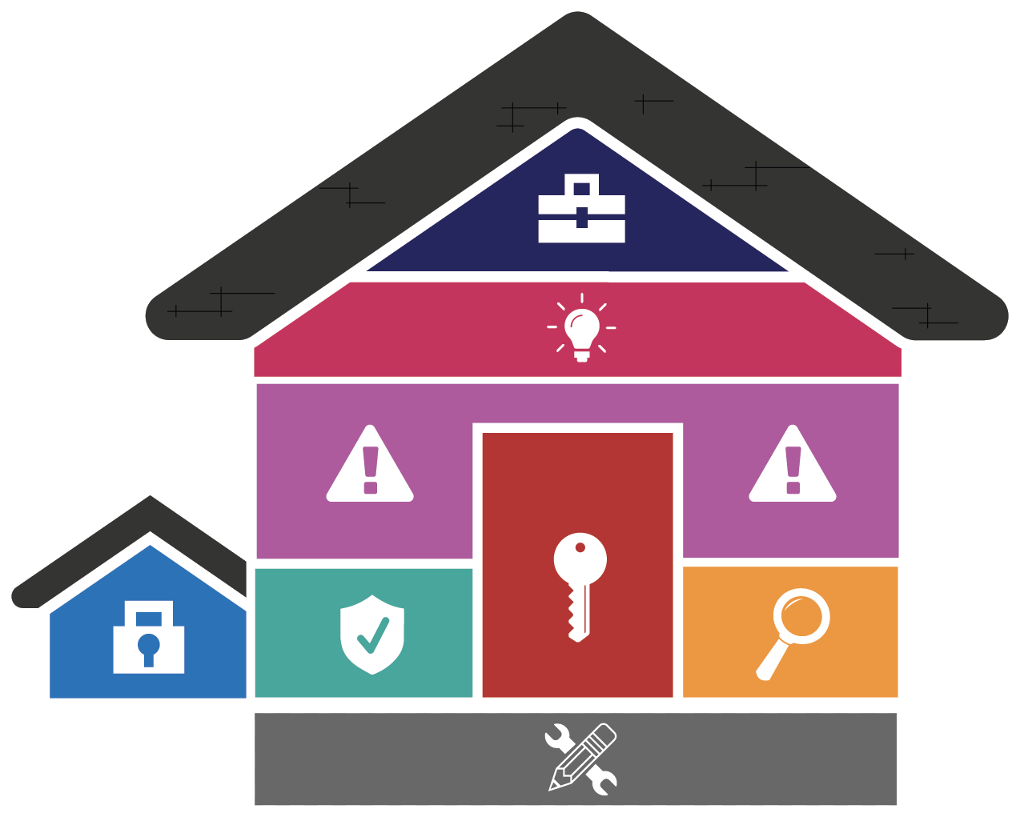
Reducing the Use of USB Storage Devices in URMC
Leaders Meetings
Feb-Mar 2023

Slide 2
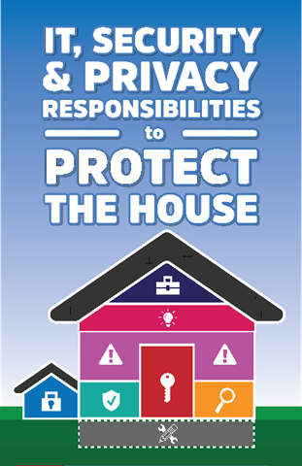
Reducing the Use of USB Storage Devices in URMC Why the Need
Goal: Block use of unencrypted and unapproved storage drives
Problem: USB storage devices are not secure and easily lost
More and more organizations are restricting use of external storage devices and drives
Two instances of lost USB storage devices at URMC that contained PHI factored into the $3 million settlement our organization paid in Nov. 2019
That settlement included a corrective action plan which is requiring better safeguards for PHI – reducing the use of USB storage devices, specifically

Slide 3
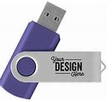
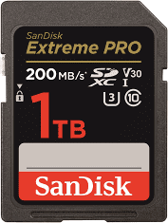
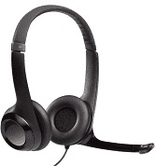
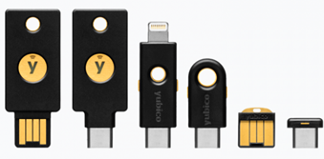
Reducing the Use of USB Storage Devices in URMC What, When, What
What will be blocked
Flash/thumb drives
SD cards
External hard drives
Smartphone storage
USB storage devices used in clinical patient care will NOT be blocked.
What Will Happen Starting in June, IT will begin activating a technology that will block the use of USB storage devices on computers that have NOT used these devices for the past 90 days
Gradual rollout across the organization throughout 2023
Change will happen silently – no indications on the computer at the time the change is being made; will see change when a USB storage device is inserted
If USB storage device use has been detected on a computer within the past 90 days, it will NOT be blocked at this time – there will be later follow up to assess needs and evaluate opportunity for alternative storage/transfer solutions IT recommends using encrypted USB storage devices to protect information
Eventually, new URMC computers requested through the Tech Store and managed by ISD will come pre-enabled for USB storage device blocking.
USB peripherals/activities are not considered storage and won’t be blocked
Keyboard & mouse
Web camera
Headset
YubiKey
Printer
Charging via USB ports – e.g. charging smartphones

Slide 4
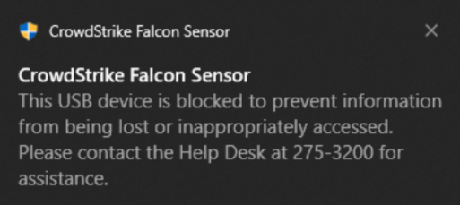
Reducing the Use of USB Storage Devices in URMC New Rules Ahead for External Storage Devices
If someone inserts a USB storage device in a blocked computer, a pop-up message will be displayed:
Pop-up message will display each time on computers where USB storage devices were deactivated (Above: message on Windows, Below: message on macOS)
Can a drive be un-blocked?
Yes – if a USB storage device needs to be used on a blocked machine, a request can be called in/submitted to the ISD Help Desk ((585) 275-3200) and the computer or specific device can be un-blocked.
Please expect up to 1 business day for un-blocking to be completed.
That exception will be transferred to our list for follow up with the goal of returning it to the blocked list if an alternative can be recommended.

Slide 5
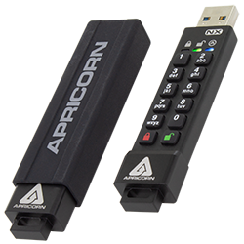
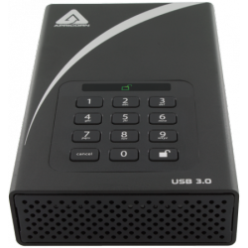
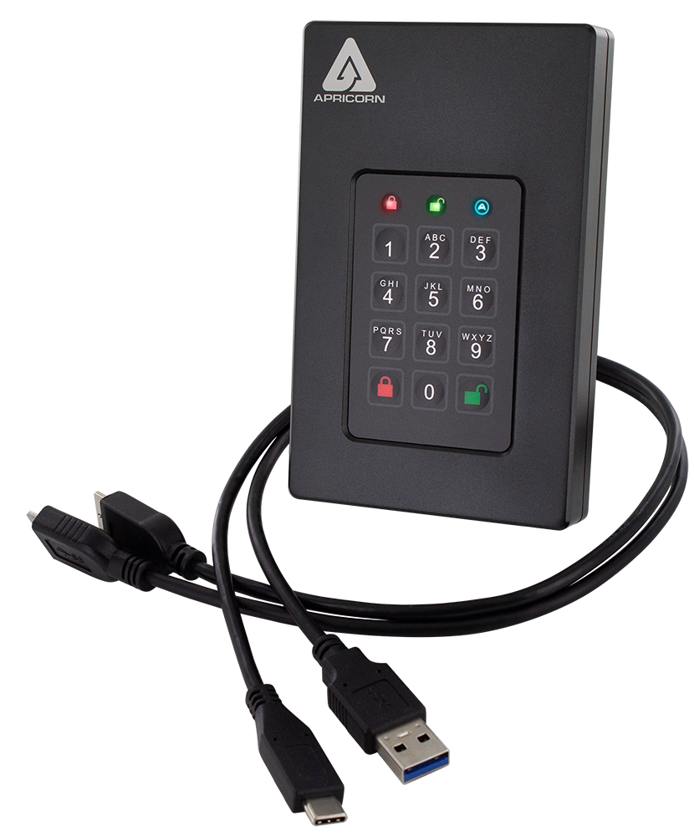
Reducing the Use of USB Storage Devices in URMC Alternative Solutions
URMC supported option for encrypted storage dives
Apricorn manufactured drives where encryption is already in place and cannot be turned off
You can order the Apricorn drives from the UR Tech Store.
There is a lead time of up to two (2) weeks for these orders
Online storage option – Box
Project team is evaluating additional solutions and will provide updates when we have more information.
Project Team is also working with individuals/teams/departments to evaluate specific needs to work out a solution.

Slide 6
Reducing the Use of USB Storage Devices in URMC Timeline in Summary
Date | Activity
Mid March-End April | ISD Pilot Test
Feb-April | Advance awareness for Leaders (meetings)
End April | Follow up email to managers with manager’s toolkit & FAQs
Mid-May | Begin broad awareness to URMC, Affiliates
June - rest of 2023 | Begin USB blocking phased roll out

