Slide 1

NIH Common Forms – Frequently Asked Questions
Office of Research and Project Administration

Slide 2






Helpful External Links
NOT-OD-26-018 – NIH announces Common Forms Implementation
Frequently Asked Questions
Biographical Sketch Common Form in NIH Forms Directory
NIH Biographical Sketch Supplement in NIH Forms Directory
Current and Pending (Other) Support (CPOS) Common Form in NIH Forms Directory
SciENcv Helpdesk (technical questions): nlmsciencv@mail.nih.gov OPERA Common Forms Email (policy questions): nihosbiosketch@nih.gov

Slide 3
UR Resources Available
Library Support:
UR Libraries Data Services
Medical Center Support Request
Or
Linda Hasman: linda_hasman@urmc.rochester.edu
Research Security at the University of Rochester
UR Guide – links to QRCs

Slide 4
FAQ Outline
Appointment disclosure guidelines
Subaward support on CPOS
Clinical trial cost estimate on CPOS
Faculty requests to ORPA to review forms
Credential/Account trouble – SciENcv/MyNcbi/eRA Commons/ORCID
Contributions to Science references
“Current” flag in biosketch positions
Disclaimer: this is an evolving topic - all answers reflect our current understanding as of 4/27/26 and are subject to change, some questions may need further research

Slide 5
Appointment disclosure guidelines – NIH FAQ
Professional appointments: formal appointments outside of one's primary place of employment that are due to one's professional expertise and generally temporary in nature, including but not limited to:
  Editorial service for journals
  Serving on municipal, state, or federal advisory boards (including study section service)
  Holding offices in professional societies
Report on all professional appointments that have been active in the last three years
  Older professional appointments are not required, but may be included if relevant to the specific application
Other types of appointments that are typically with one's primary place of employment (i.e., academic and institutional appointments), must be listed for a period that covers the duration of one's professional career
  All professional appointments at a primary place of employment, not just at UR

Slide 6
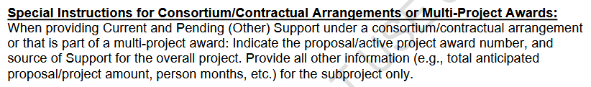
Subaward/Multi-Project Support on CPOS
Overall project:
  Proposal/active project award number
  Source of Support
All other information for the faculty member’s piece only

Slide 7
Clinical trial cost estimate on CPOS
Use enrollment target and budget to estimate total support

Slide 8
Faculty requests to ORPA to review forms
ORPA is available to receive and field specific questions that come up during form preparation, but not to review completed forms prior to application routing
ORPA will review included attachments for formatting during application review
Reminder - faculty are ultimately responsible for all attachments’ compliance with instructions within applications

Slide 9
Credential/Account Linking Issues
ORCID ID needs to be linked with both eRA Commons and SciENcv, by the faculty member (cannot be delegated)
Pick ONE login method and stick with it forever
  Documents in SciENcv are linked to the login method
Possibility that the faculty member has a previous MyNCBI account already linked to ORCID ID
  SciENcv Helpdesk: nlmsciencv@mail.nih.gov

Slide 10
Biosketch Supplement references
No references to closely related products anywhere in the supplement – NIH FAQ
The five other significant products can be discussed in the contributions to science question.
No discussion of products in the personal statement.

Slide 11
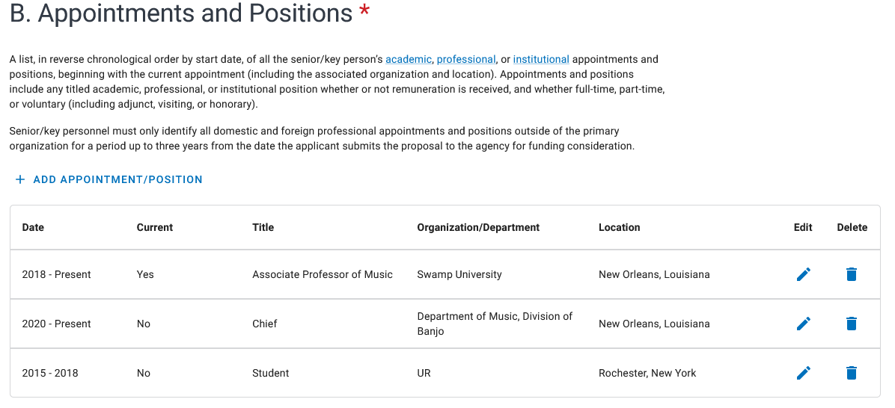
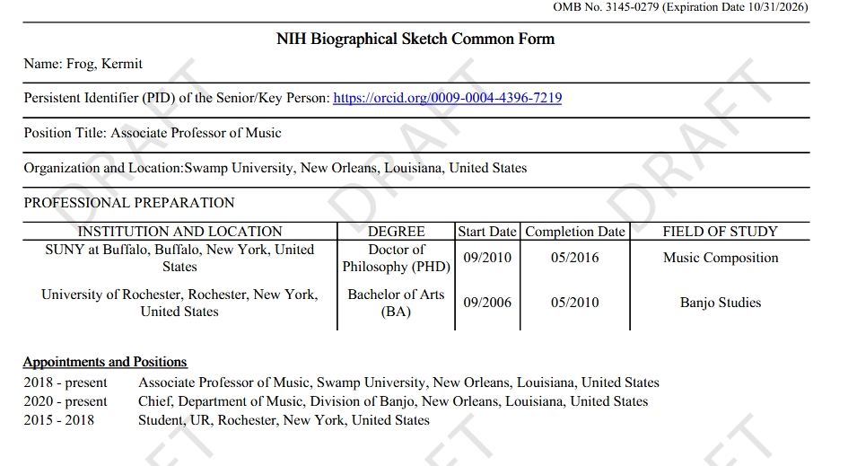

Current flag in Biosketch positions
Form says “current,” but you can only select one position. Form entry vs. downloaded form discrepancy.

Slide 12
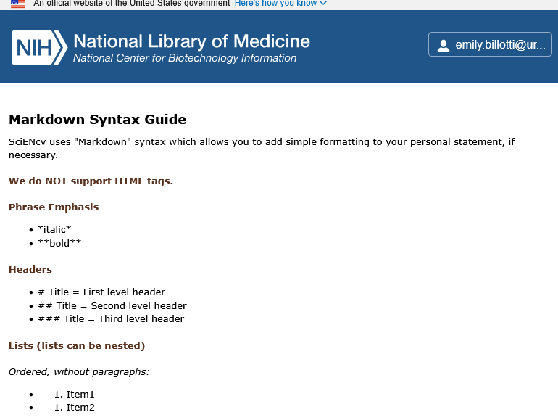
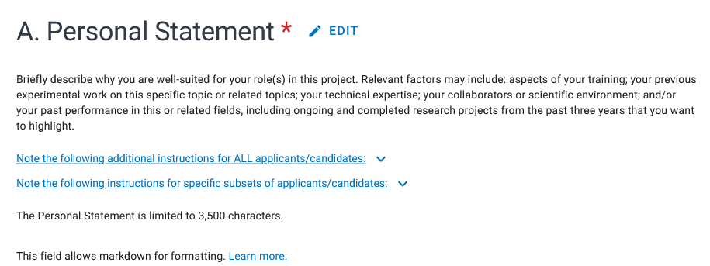
Personal Statement Formatting
Markdown formatting is supported per SciENcv help text (learn more link):

Slide 13
Products Not in PubMed
ORCID can also store a record of products, which can then be loaded into the Common Form Biosketch
  Common for trainees - abstracts, poster presentations, etc
PubMed --> Edit Products --> Manage My Bibliography --> Add citations --> Manually

Slide 14
REMINDER
Senior/key persons must certify that the information is current, accurate and complete.
Notes:
A final reminder from ORPA and the Research Security Officer. The certifications required as part of the Common Forms are personal assurances by the individual named on the form that the information included is current, accurate, and complete. All three of these elements are crucial to get correct.
If information is found to not be current, accurate, or complete, the senior/key person who certified can be subject to prosecution under several federal statutes, including the False Claims Act.
Individuals should understand federal agencies have the ability to verify whether the information in the required disclosures is current, accurate, and complete by utilizing publicly available information and other information available to the agencies, including publicly posted CVs, affiliations listed in publications, etc.

