Slide 1

Office of Research Integrity, Stewardship & Ethics
(ORISE)
Sonya Maria Hadrigan, APRN, MLS, CIP
AVP Research Integrity

Slide 2
Research Integrity: Building Trust
My role is to co-create a University-wide framework for research integrity, building a unified structure across policies, processes, and cultural norms.
This includes working across schools and departments at all stages of researchers’ careers to ensure the ethical conduct of research is embedded in everyday practices, not just during crises.
ORISE works collaboratively with the Office of General Counsel and partner offices under the Office of the Vice President for Research to support several mission-critical functions.

Slide 3
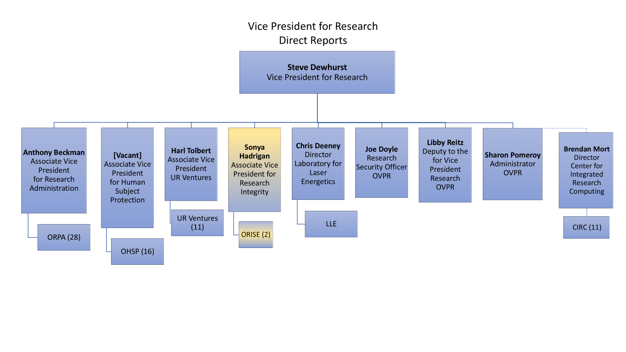

Slide 4
Areas of Support & Oversight
Serve as University’s Research Integrity Officer (RIO)
Management of research misconduct allegations and proceedings
Oversight of research conflicts of interest/commitment (COI/C) and related committees
Responsible and Ethical Conduct of Research (RECR) education programs
Support for data stewardship and governance
QA, monitoring, and compliance reviews related to these areas

Slide 5
A Unified Approach to Research Integrity
Integrated Strategy
  Align training, disclosures, and management of research misconduct proceedings across the University
Cross-Department Collaboration
  Partner with RSRB, ORPA, Research Security, Research Deans, MarCom, Faculty Affairs, Department Chairs, etc.
Culture of Shared Responsibility
  Integrity as an enabler- not a barrier- to innovation
Shaping the Narrative Together: Purpose and empower-driven integrity!
Shifting the narrative by building trust, aligning systems, and centering the researcher experience. Integrity can feel empowering and serve as an essential part of how we support discovery!

Slide 6
In Progress
Policies & Guidance
  Research Misconduct – Revised compliant policy now available and posted at https://www.rochester.edu/policies/policy/policy-on-research-misconduct/
  Faculty Conflict of Interest
  Authorship & Dispute Resolution Guidance
Responsible and Ethical Conduct of Research
  IND 501
  RECR Seminar Series
  Integrity Workshops
Communication Strategy for Data Stewardship & Research Integrity Tools
  LabArchives
  iThenticate
  Proofig

Slide 7
Contact Information:
Sonya Hadrigan: AVP Research Integrity & Research Integrity Officer
https://www.urmc.rochester.edu/smd/research-integrity
Office Email: ORISE@rochester.edu
Sonyah@rochester.edu | Office: (585) 273-5707 | Mobile: (585) 683-1418
Hylan Hall
140 Trustee Road, Suite 509

Slide 8
Questions?

