Slide 1
Leveraging 1:1 devices to transform K-12 Schools

Slide 2
Current Landscape
Not clear how many K-12 schools have 1:1 initiatives (would make for an interesting study)
Not clear how many K-12 students use 1:1 devices in their learning (BYOD or school-supplied)
Norris & Soloway (2015) predict by 2020 that all students in K-12 schools will have a device
http://www.imlc.io/files/ETMobileTechnologyIn2020.pdf
Devices by themselves are not a solution
Integration of technology and practice is essential

Slide 3
Large-scale 1:1 implementations
Maine, Texas, North Carolina, California
It’s all about the planning and it doesn’t always go smoothly
http://blogs.edweek.org/edweek (click for the full link)l
Thoughtful planning and an entrepreneurial approach are key
http://digitalconversion.mgsd.k12.nc.us/
http://dc.eastiron.org/
Partnerships, digital resources, and capacity building are also essential
http://www.eastiron.org/news/newsshow.asp?newsID=2034
https://corporate.discovery.com/(click for the full link)

Slide 4
Pre-thinking questions
What do we already know about student use of computers in K-12?
What digital technologies do K-12 students already use in their everyday lives? How can these technologies and related experiences be leveraged to support their learning?
What are the key challenges / barriers to capitalizing on 1:1 devices in K-12 schools? How could these challenges / barriers be addressed?
How can we support novice 1:1 teachers so they can develop specific 1:1 / digital teaching practices?
What professional development experiences are needed?
How does the K-12 organizational structure need to change to support 1:1?
What else do we still want to know?

Slide 5
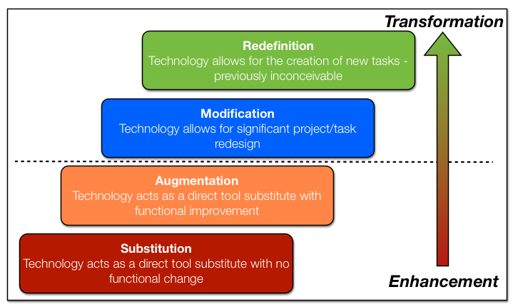
Theory → Practice
SAMR model provides an interesting perspective

Slide 6
SAMR Examples

Slide 7
SAMR Example cont’d
Science class at East Irondequoit
Living Environment
Operating in the Transformation area of SAMR
Possible through 1:1, LMS, and a substantive shift in teaching practice by the teacher and learning practice by the students
Flipped learning and other lesson design shifts
Collaborative approach to student learning
Students own their individual learning
Completion learning and Mastery learning as drivers

Slide 8
Framing Question
So what made this possible at East Irondequoit?

Slide 9
Mission & Vision at EICSD
Guiding the decision
Driving student achievement within a 21st century teaching and learning paradigm
Examination of the research
Project RED Technology Factor (PDF)
Planning & logistics
Successes and challenges

Slide 10
Guiding the decision
Administrative leadership
School board
Teacher leadership
Research
Data collection
Site visits
Hours and hours of planning

Slide 11
The research
Project Red report
997 schools, 49 states & District of Columbia
11 diverse education success measures
22 categories of independent variables
Comparison of findings by student-computer ratios (1:1, 2:1, 3:1, etc.)
Comprehensive demographic data correlated to survey results
District-specific research
Class visits and teacher interviews
Coding of the data and examining themes
Develop key findings and recommendations

Slide 12
Planning
Which device to choose?
Which teachers to pilot the implementation?
Proposal-based approach
Professional development?
Types and how much?
Implementation timeline?

Slide 13
Which mobile device for EICSD?

Slide 14
Proposal based approach

Slide 15
Proposal based approach (cont’d)

Slide 20
Implementation timeline

Slide 21
Logistics
App selection process
No in-app purchases
No advertising
No student accounts on external vendor websites
Development of policies & procedures to ensure consistency (while maintaining flexibility)
Budget support and sustainability of the initiative
Phased-in approach
Replacement cycle
Planning for the unanticipated – insurance, breakage
Additional capacity required – internal and external
Parent communication
Day-to-day, beginning-of-year, end-of-year management

Slide 22
Impact in the Classroom
Teacher adoption and teaching practice shifts (and resistance)
Student adoption and learning practice shifts (and challenges)
Classroom management
Human factors
Device factors

Slide 23
How do we know it’s working?
1st and 2nd order changes, per Project Red (research-based evidence collected)
1st order = efficiencies
2nd order = transformation (change in focus from teacher to student)
Examination of our 3-year data collection
Partnership with Warner – class visits, teacher and student group interviews, data examination, findings & recommendations

Slide 28
Questions?

