Slide 1
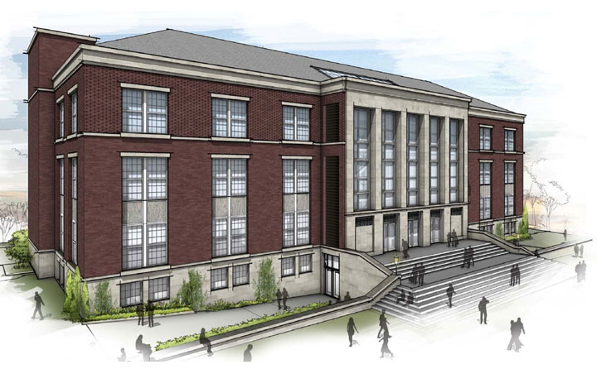
Warner’s Certificate in Online Teaching
October 10, 2016

Slide 2
Agenda
The larger context: LiDA
Review of OTL Courses and Programs
Thoughts and comments from OTL students
Questions/discussion
Notes:
Raffaella

Slide 3
Warner’s LiDA Initiative
Offering new online learning opportunities to Warner students
*Preparing quality online instructors
→ Preparing K-12 teachers for digitally-rich teaching
Supporting colleges in launching online initiatives
→ Supporting K-12 schools’ digital conversion
Conducting research on online teaching & learning
→ Conducting research on Learning in the Digital Age
→ Be a catalyst for research on LiDA (Study Group)
Notes:
Raffaella

Slide 4
Preparing Online Instructors
How can rich teaching and learning experiences be facilitated in an online environment?
How can we best prepare instructors for online teaching?
Notes:
Raffaella

Slide 5
OTL Certificate Goals
Appreciate affordances and limitation of F2F vs. online learning
Know about different learning theories and their pedagogical implications
Be able to design high quality online learning modules and courses (with minimal online tools)
Be able to use a select number of “high-leverage” online teaching practices
Target student population:
UR doctoral students (& faculty)
Future “online instructional support staff”
[K-12 teachers & other instructional staff]
Notes:
Raffaella

Slide 6
OTL Certificate Requirements
Core courses:
EDE484: Online Teaching & Learning
EDE486: Designing Online Courses
EDF488: Practicum in Online Teaching
2 pedagogical electives
Notes:
Raffaella

Slide 7
EDE484: Goals
Empower students to design and implement effective “online learning modules” using Blackboard
More specifically students will:
Learn key principles about motivation, learning, teaching, assessment, instructional design
Learn to use basic OTL tools
Learn about key “OTL practices”
Design and implement online modules
Notes:
Dave

Slide 8
EDE484: Organization & Structure
Getting started
OTL foundations – modules on
Motivation, learning & teaching
Assessment
Instructional design
OTL practices (parallel)
Group project: design and implement an online module on special topics within OTL for the rest of the class
Individual project: design an online module on topic of choice
Final synthesis
Notes:
Dave

Slide 9
EDE486: Organization & Structure
Online Teaching Strategies & Special Issues
Final Project - Building an Online Course
Faculty & Institutional Perspectives
Conceptual Frameworks for Online Learning
Instructional Design Concepts
Instructional Resources & Technology Tools
Notes:
Eric
486 builds on 484 …

Slide 10
EDE 486 - Learning Activities
To read and think about all assigned readings prior to class discussions.
To actively and respectfully engage in class discussions (online – synchronous and asynchronous)
Construct a paper that connects what you learned in EDE 484 with research on online teaching
Take an online quiz in each module to help you assess your comprehension of the readings
Two organization and instructional planning assignments
Practicum activities with Web 2.0 tools and technologies
To complete a Final Project – Applying concepts and principles of good instruction to building an online course (we will build on multiple assignments)
To reflect on the readings, class discussion and learning activities in each module and capture personal meaning in an online journal
Notes:
Eric
A four week module (Module 5)
Students will use Blackboard and our Online course template to create their complete online course
Personal tutoring / mentoring via 1:1 synchronous sessions with Professor and each student
This activity will be build throughout the semester
Research Paper in Module 1
Learning Objectives Table in Module 3
Instructional Resources & Tools in Module 4
Reflection Journal in Module 5
Initially submitted in Module 5 and shared with classmates
Revised final version in Module 6
Courses will be shared with classmates for peer review and feedback (students will be provided a rubric to guide their thoughts)

Slide 11
EDF488: Practicum in Online Teaching
Provides students in the certificate program in online teaching with a mentored experience that allows them to put into practice what they've learned in previous coursework about online teaching. Students will produce a number of artifacts related to this experience that will serve as evidence of their proficiency with specific aspects of online teaching.
Teach a complete course or modules within a course
Mentored experience with structure and support
Four cohort meetings
Capture meaningful artifacts
Reflection Journal
Presentation
Notes:
Eric
Artifacts include:
Syllabus of the course
Revised online materials
Samples of student exchanges
Samples of student Assessments
Course revision plans

Slide 12
OTL Certificate Graduates
25+
Graduates of the Certificate Program are welcome to share their experiences…
Notes:
Dave/Eric: Use this slide only if you can report on the total number of graduates, and hopefully their distribution across programs
Best if you could also comment on what some of these graduates are currently doing related to online

Slide 13
Questions/Discussion

